Slide 1
What does a successful ministry look like?

Slide 2
The CHURCH LIFE CYCLE
Every church – no matter the size, denomination, or location – moves through these stages.

Slide 3
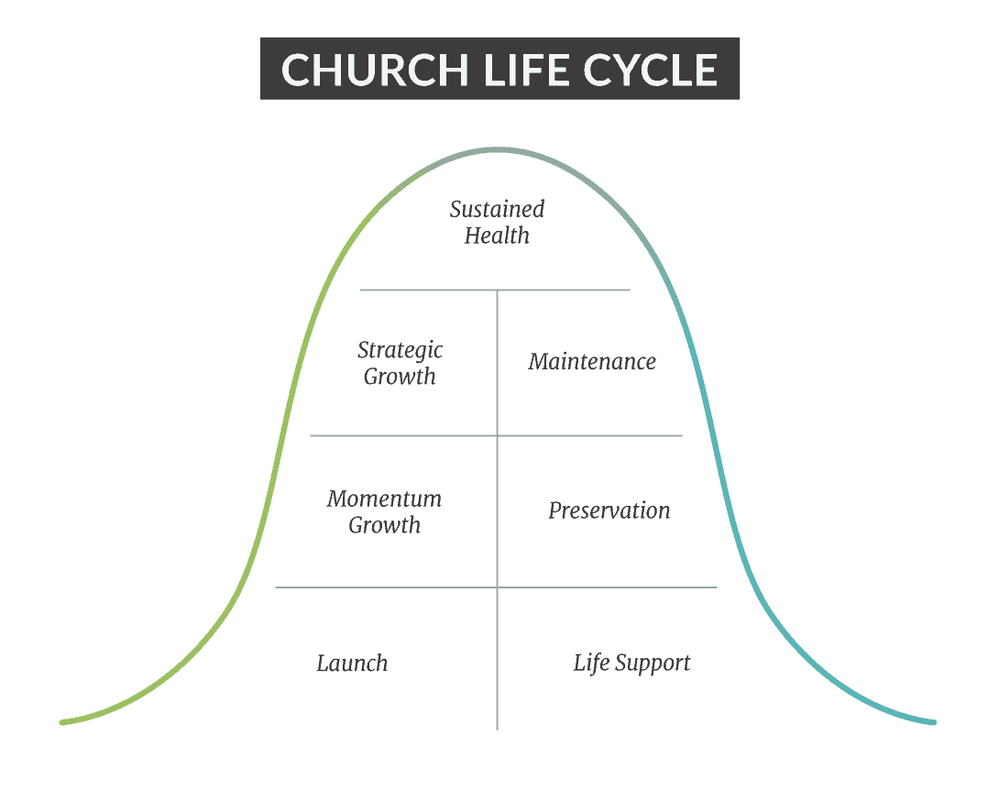
Which stage is your church in?

Slide 4
A church’s life cycle has eight stages.
The first four lead to growth and vitality.
The last four lead to stagnation and decline.

Slide 5
The Launch Stage (Birth or beginning stage)

Slide 6
The Momentum Stage

Slide 7
The Growth Stage (increase and Expansion)

Slide 8
The Sustained growth Stage (congregation is Mature and growing spiritually and in number)

Slide 9
THE TURNING POINT
Every church eventually hits a crossroads:
Generally, about every generation (every 20-25 years)
They face an important question – Will we renew the mission and vision…or protect what we’ve built?
This decision determines whether the church enters renewal or decline.

Slide 10
THE DECLINE SIDE OF THE LIFE CYCLE

Slide 11
The Maintenance Stage

Slide 12
The Preservation Stage

Slide 13
The Life-Support Stage

Slide 14
The Closure Stage

Slide 15
THE GOOD NEWS:
RENEWAL IS ALWAYS POSSIBLE

Slide 16
Churches don’t die because God stops moving.
They die because they stop obeying their mission.

Slide 17
WHAT DOES A SUCCESSFUL CHURCH LOOK LIKE!

Slide 18
10 Marks or Characteristics of a successful church…

Slide 19
2 things that DO NOT define a successful church
1st – A CHURCH IS NOT DEFINED BY NUMBERS alone or by how many show up on a Sunday.
#2 – A church is not defined by “how much or how little money it has.”
Nor is it defined by its building or property.

Slide 20
1– Do you have a Clear Vision (direction) and Mission (purpose) from God?
Without mission and purpose, you lose clarity.
Without vision, you lose direction.
Without both, you drift.

Slide 21
The mission explains what you do. Why you exist. What is our purpose?
The vision explains where you’re going.

Slide 22
Mission shapes identity.
Vision shapes church culture.

Slide 23
Purpose of a Mission Statement (Why are we here?)
A mission defines your present purpose and what you do every week.

Slide 24
The Purpose of a Vision Statement (Where you’re going)
A vision describes your future direction and destination.

Slide 25
Without a mission, you drift.
Without a vision, you stagnate.

Slide 26
The key to having a successful church is this –
Do “the pastor and the People” have a clear understanding of why the church exists?
Successful churches don’t drift – they are guided.

Slide 27
Another mark of a successful church is –
Does God’s anointing rest upon the church?

Slide 28
#3 – Is the church producing Long-lasting fruit?

Slide 29
#4 – Are Souls being Saved?

Slide 30
Pastors are weak in 3 areas:
Receiving the offering
Giving an Invitation for salvation
In Leading the church

Slide 31
The Biblical principle is this –
The Shepherds lead – the sheep follow!

Slide 32
Is true Discipleship taking place in the church?

Slide 33
Is the church producing healthy, Strong Families?

Slide 34
Is the church having an Impact on the Community?

Slide 35
Successful churches raise up future leaders.

Slide 36
A successful church goes “outside its 4 walls.”

Slide 37
Successful churches either have or participate in an ongoing MISSIONS outreach.
Acts 1:8 4 Pulpits of the local church

Slide 38
The more of these characteristics a church has, the more successful it is in accomplishing God’s purpose.

