Slide 1
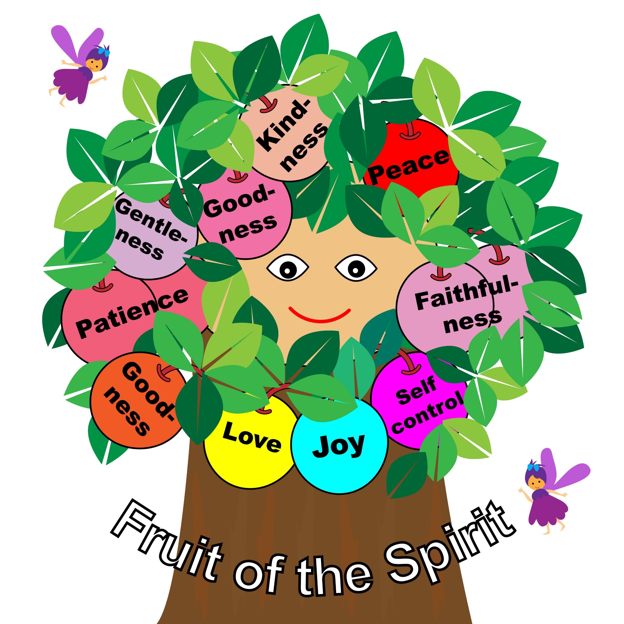


Galatians 5: 22-23

Slide 2

God’s word teaches us to love one another. God’s Word tells us that we are to live and walk in the Spirit. We can know we are “walking in the Spirit” by the Fruit we produce.
God’s Word lists nine items (fruit) in Galatians 5: 22-23 that we can practice that shows we live and walk in the Spirit of love according to the Holy Spirit.

Slide 3
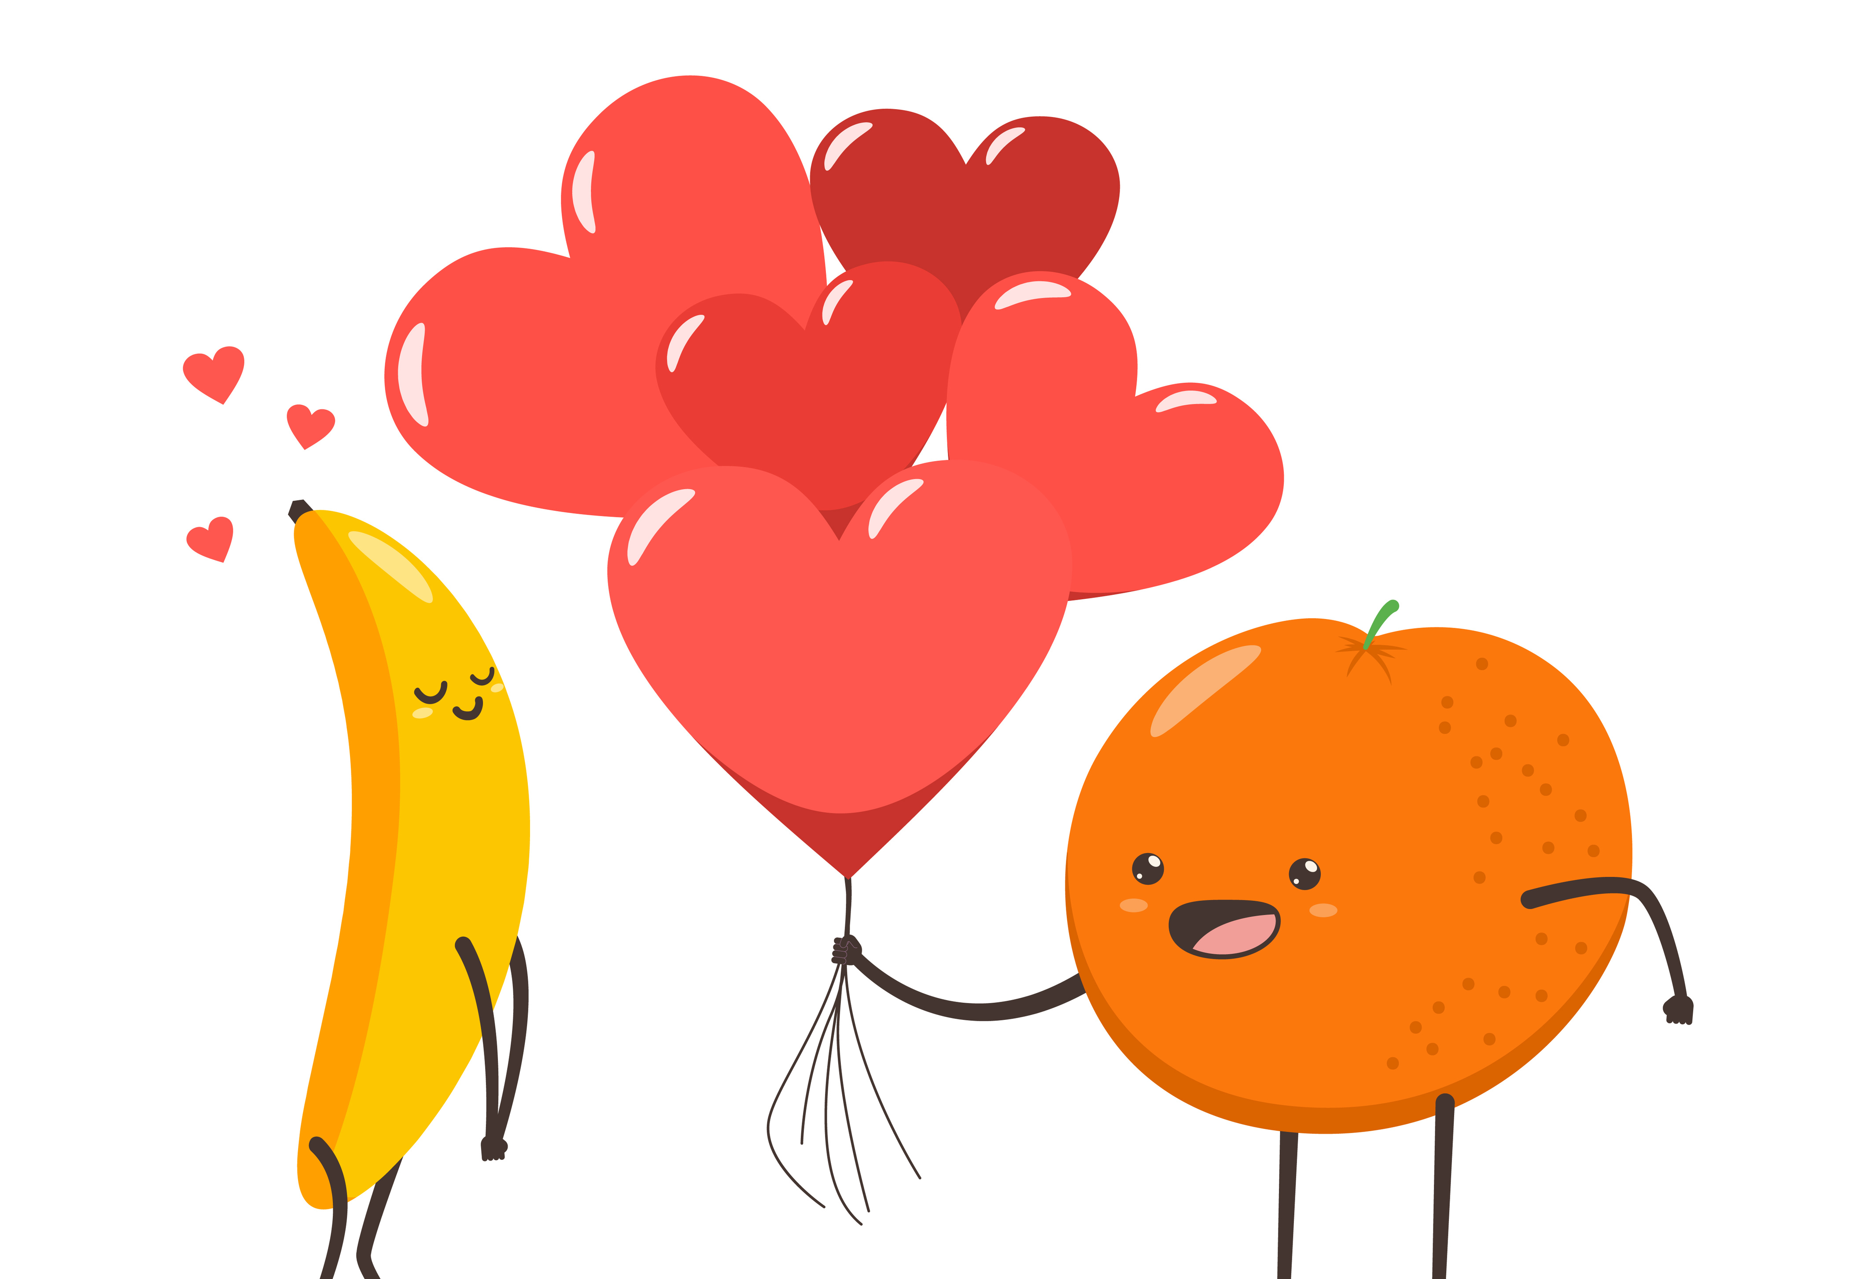
One way to love God is for us to practice the Fruit of the Spirit. This lesson will present the nine Fruit and their meanings.
We can ask the Holy Spirit to help us to produce the Fruit of the Spirit and live life God’s way.

Slide 4
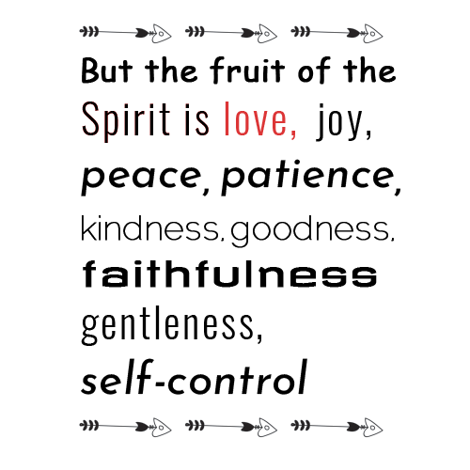

The 1st Fruit of the Spirit is LOVE.
If we produce the Fruit of LOVE, we put other’s needs before our own, we take action to notice others and extend grace and forgiveness.
Jesus said in John 13:34 “A new command I give you: Love one another. As I have loved you, so you must love one another.” NIV
1 Corinthians 13:4-7 explains what Love Is.
What are some ways you can
show love to others?
LOVE

Slide 5
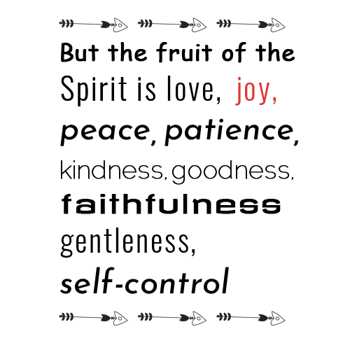



The 2nd Fruit of the Spirit is JOY
If we produce the Fruit of JOY, we should experience overall gladness. That does not mean we will be happy all the time, but the Holy Spirit can give us gladness inside.
We can have JOY that God is with us and wants what is best for us regardless of what happens in our lives.
JOY
LOVE

Slide 6
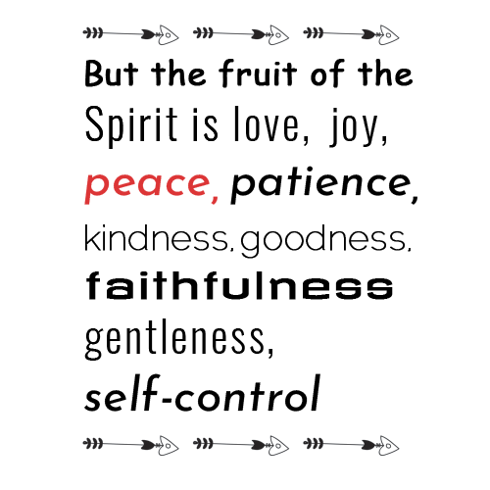
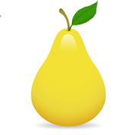


The 3rd Fruit of the Spirit is PEACE
If we produce the Fruit of PEACE, we seek unity between people. The Fruit of peace is also a comfort and rest inside of us.
Jesus said He gives us His peace and if we practice the Fruit of Peace, we also practice God’s peace that no one can really understand.
Philippians 4:7
John 14:27
PEACE
LOVE

Slide 7
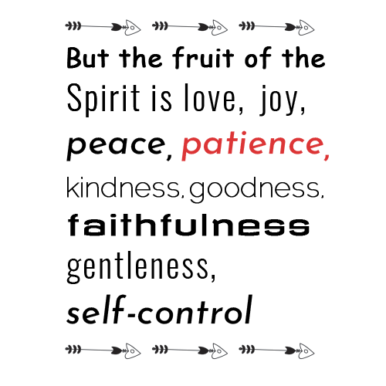
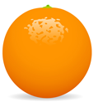
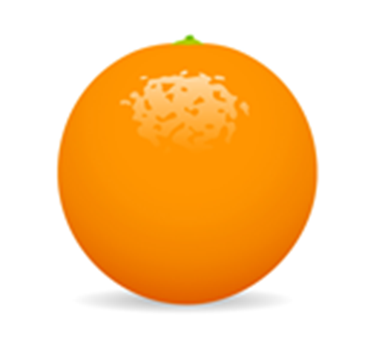
The 4th Fruit of the Spirit is PATIENCE
If we produce the Fruit of PATIENCE, we can stay calm and content. We can wait for something we want and not be upset. Also, we can be patient with people when they are not nice.
Be patient, bearing with one another in love.
Ephesians 4:2b NIV
How do you feel when others are
patient with you or forgive you
for your mistakes?
PATIENCE
LOVE

Slide 8
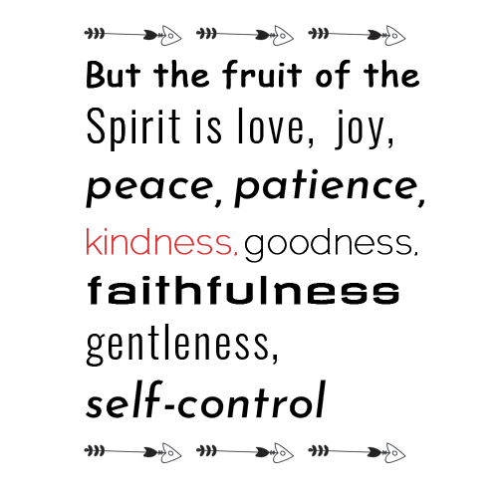
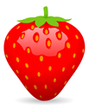

The 5th Fruit of the Spirit is KINDNESS
If we produce the Fruit of KINDNESS, we are doing something and not expecting anything in return (giving and not receiving). We are performing acts of kindness, even in a small way, that can make someone’s day happier.
Here are just a few examples of acts of kindness:
A warm smile
Saying “please” or “thank you”
Volunteering to help someone
with a chore
Sharing with others
What are some acts of kindness
you can do for others this
week?
KINDNESS
LOVE

Slide 9
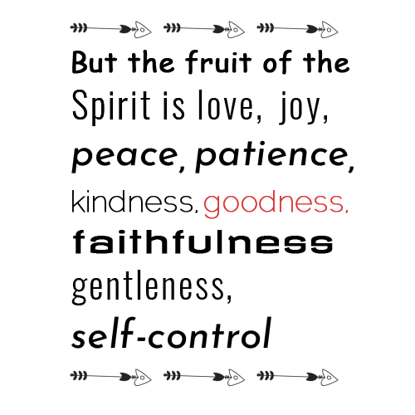



The 6th Fruit of the Spirit is GOODNESS
If we produce the Fruit of GOODNESS, we are being honest and truthful.
Gods Word says, “ Therefore, whenever we have the opportunity, we should do good to everyone, especially to those in the family of faith.” Galatians 6:10 NLT
The family of faith means born again believers of Christ.
What good thing can you do
for someone today that will
be pleasing to Jesus?
GOODNESS
LOVE

Slide 10
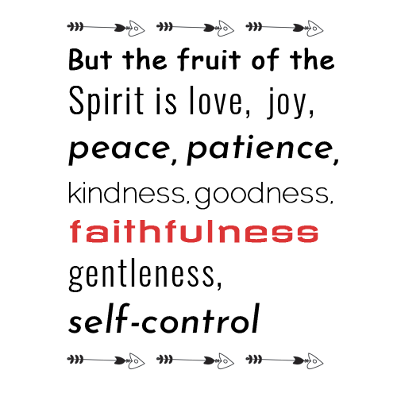


The 7th Fruit of the Spirit is FAITHFULNESS
If we produce the Fruit of FAITHFULNESS, which is received from God, not by man, we will not quit or give up on ourselves or others. We will trust God always believing He will never let us down. We will be devoted, reliable and loyal in our lives and in our work for the Lord. We are to be faithful as God is faithful.
1 John 1:9 says, “If we confess our sins,
He is faithful and just to forgive us
our sins and to cleanse us from all
unrighteousness.”
In your own words, what does it
mean to be faithful?
FAITHFULNESS
LOVE

Slide 11
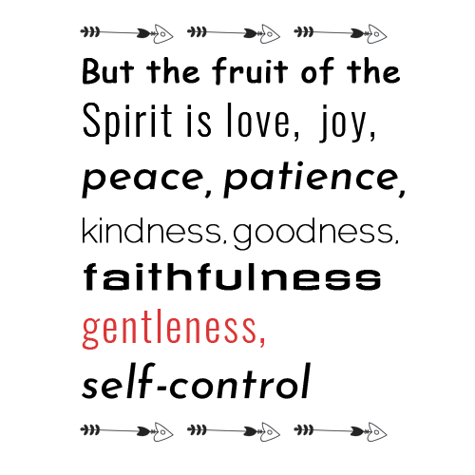


The 8th Fruit of the Spirit is GENTLENESS
If we produce the Fruit of GENTLENESS, we are tender, calm, and humble in the things we say and do. We are not harsh or mean to others.
Proverbs 15:1 says: “A gentle answer turns away wrath,
but a harsh word stirs up anger.”
How can you be gentle to others?
GENTLENESS
LOVE

Slide 12
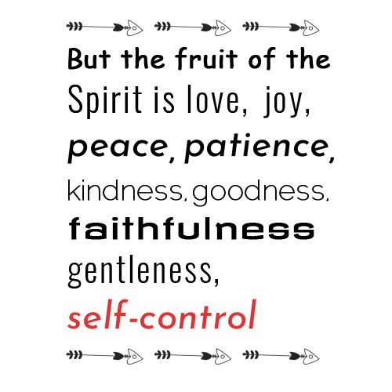


The 9th Fruit of the Spirit is SELF-CONTROL
If we produce the Fruit of SELF-CONTROL, we can say no when we know something is not good for us. We can think before we do something wrong. We won't sneak a piece of candy before dinner even though we want it.
We must be careful how we talk and treat
others. It means fighting against temptation, sin
and keeping our emotions, thoughts and
actions under control. Self control is not
always easy, but we can pray for God’s help
because we cannot produce self-control or
any of the other Fruit of the Spirit
by ourselves.
SELF-
CONTROL
LOVE

Slide 13

Memory Verse:
Beloved, let us love one another, for love is of God; and everyone who loves is born of God and knows God.
1 John 4:7 NKJ
Closing Prayer:
God, You have provided us with an abundance of evidence of Your love for us. Please remind us to share Your love and Fruit of the Spirit with others so they may have a relationship with You. We want our obedience to reflect Your Spirit and love. In Jesus’ Name, Amen.

Slide 14








This Sunday School Lesson was created by the NABCOR Sunday School Ministry

