Slide 1

ReKINDLE THE FIRE
CH MASON DISTRICT
CHURCH DEVELOPMENT SESSION
FEBRUARY 23, 2019
RESILIENCE IN MINISTRY BURNOUT
Supt. James Lee
District Missionary, Shannon Felder

Slide 2

Burnout
Fatigue — Frustration or Apathy resulting from prolonged stress, overwork, or intense activity
https://www.dictionary.com

Slide 3
Some Common Causes of Lay Members Burnout
The church does not have a clear purposes or vision
The church has certain activities because “we’ve always done it that way before
Too few members doing most of the ministry
The church does not celebrate enough
The church has no clear expectations of membership
There is NO mutual support among other members
https://thomrainer.com/2016/02/five-common-reasons-church-members-burnout//

Slide 4
Top 7 REASONS LEADERS BURN OUT

Slide 5
#1 24/7 Mentality
Always on
Always ready for the call
Igniting the gift/deborah white/2018

Slide 6
#2 CONFLICT
Change-Conflict-Criticism. Perpetual state that constantly drains you;
Igniting the gift/deborah white/2018

Slide 7
#3 EXPECTATIONS
There are all kinds of expectations.
Igniting the gift/deborah white/2018

Slide 8
#4 OMNI SYNDROME
Omnicompetent
Omnipresence
Omniscient
Omnipotent
Igniting the gift/deborah white/2018

Slide 9
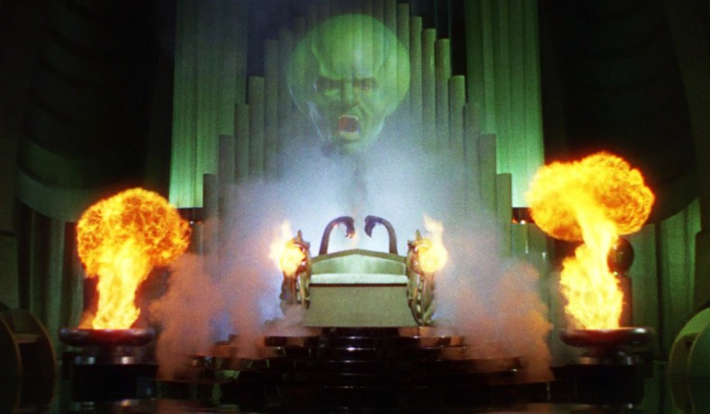
ALL POWERFUL OZ
Igniting the gift/deborah white/2018

Slide 10
OMNI SYNDROME
If You Are Not Any Of Things Then You Will Probably Not Going To Meet All The Expectations Of The Church.
You Have To Recognize Your Limitations.
Igniting the gift/deborah white/2018

Slide 11
#5 LET GO
Unwillingness to let go or delegate
WE don’t let go
WE don’t equip the saints
it’s just easier if I do it myself
Igniting the gift/deborah white/2018

Slide 12
#6 Lack of Fellowship
No friends!
Igniting the gift/deborah white/2018

Slide 13
#6 Out of Place
Not suited for every task
Too much time doing things that you are not equipped or energized to do
Igniting the gift/deborah white/2018

Slide 14
#7 NO BALANCE!
No life outside the church
“If you give all of your time to the church-the church will eventually have none of your time” (Thom Rainer).
Igniting the gift/deborah white/2018

Slide 15
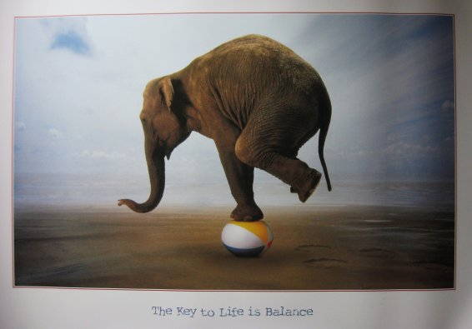
THE KEY TO LIFE IS BALANCE

Slide 16
Burnout Among Leaders
1500 Ministers
Leave Their Ministries Each Month Due To Burnout
https://www.barna.com/burnout-breakdown-barnas-risk-metric-pastors/

Slide 17
Statistics: The Difficult Path
94% Of ministers feel under pressure to have a perfect family.
90% Of ministers work more than 50 hours a week.
80% Of ministers believe that pastoral ministry affects their families negatively.
https://www.barna.com/burnout-breakdown-barnas-risk-metric-pastors/

Slide 18
Statistics: The Difficult Path
75% Of ministers report severe stress causing anguish, worry, bewilderment, anger, depression, fear, and alienation.
70% Of ministers don’t have any close friends.
56% Of pastors’ wives say that they have no close friends.
https://www.barna.com/burnout-breakdown-barnas-risk-metric-pastors/

Slide 19
Statistics: The Difficult Path
45% Of pastors say that they’ve experienced depression or burnout to the extent they need to take a leave of absence from ministry.
40% Of pastors are suffering from burnout, frantic schedules, and/or unrealistic expectations.
47% Of pastors’ spouses are suffering from burnout, frantic schedules, and/or unrealistic expectations.
https://www.barna.com/burnout-breakdown-barnas-risk-metric-pastors/

Slide 20
In addition to doctors and lawyers, Clergy have the most problems with drug abuse, alcoholism, and suicide.
https://www.barna.com/burnout-breakdown-barnas-risk-metric-pastors/

Slide 21
REKINDLE
To cause to begin burning again;
ignite again:
www.dictionary.com

Slide 22
REKINDLE THE FIRE
Just how do we rekindle our spiritual fire?
How can we renew our spiritual vigor?
How can we avoid those spiritual killers, and keep our fire red hot?
Igniting the gift/deborah white/2018

Slide 23
REKINDLE THE FIRE
Whether we’re talking about literal, burning fire or fire in its spiritually symbolic sense, there are some fundamental principles that are common to both.
Igniting the gift/deborah white/2018

Slide 24
REKINDLE THE FIRE
1) Both need fuel to continue burning.
2) Remove the fuel and before long you kill the fire.
3) If left to itself, the natural tendency of any fire is to go out.
4) Feed the Flame – by the Word of God and Prayer.
Igniting the gift/deborah white/2018

Slide 25
Prayer Is Essential
We are too busy to pray, and so we are too busy to have power.
– R. A. Torrey

Slide 26
RESILENCE
The power or ability to return to the original form, position, etc., after being bent, compressed, or stretched; elasticity.
https://www.dictionary.com

Slide 27
RESILENCE TO COME BACK STRONGER
Simon, Simon, behold, Satan demanded to have you, and that he might sift you like wheat, but I have prayed for you that your faith may not fail. And when you have turned again, strengthen your brothers.”
Luke 22:31-32

