Slide 1
Church Protocol and Etiquette
Elder Demetrius C. Moye’
C.H Mason District

Slide 2
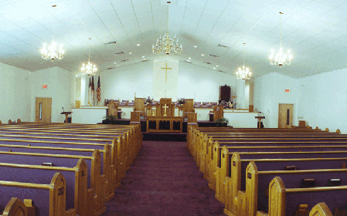
TOPICS
CHURCH PROTOCOL
CHURCH ETIQUETTE
CHURCH ETHICS
CHURCH DISCIPLINE
“Let all things be done decently and in order”
(1 Cor. 14:40)

Slide 3
Local churches exist in order to fulfill a threefold purpose:
Worship God in spirit and truth,
Edification and encouragement of the body of believers,
And to fulfill the Great Commission – “Make disciples of all nations.”

Slide 4
Church is more than a building, corporation, or organization.
It’s a living organism!
Diverse community
We’re all related because of the blood of Jesus Christ
Christ paid a debt He didn’t owe … one we could not pay.
Jesus has a right to lay down rules for his church.
The Holy Scriptures are our rules to guide the church.

Slide 5
How should we maintain the church?
The church is the most important place where dignity, protocol, respect and reverence should be maintained. Why? Because when we come to the church and its services, we are entering into the Kingdom of God on earth, His habitation, and we choose to honor this sacred place by our attentiveness to what is proper and ordered. At that very moment, we have the opportunity to reflect the image of Christ within us by our actions.
Protocol
Respect
Reverence
Dignity

Slide 6

Let’s reflect the image of Christ within us by our actions.
But ye are a chosen generation, a royal priesthood, an holy nation, a peculiar people; that ye should shew forth the praises of Him who hath called you out of darkness into His marvellous light.
1 Peter 2:9

Slide 7
Key terms
Behavior
We are to live for Christ, not for ourselves (2 Cor. 5:15). Jesus told his disciples to teach people "to obey everything I have commanded you" (Matthew 28:20).
Respect
To view or consider with some degree of reverence; to esteem as possessed of real worth.

Slide 8
Key Terms
Integrity
First, integrity is “the condition or quality of being complete; undivided or unbroken; wholeness.” Second, integrity is “an unimpaired condition.” The third definition is, “moral soundness or uprightness.”
Practices
Forms of doing; to continually do something to get better at it.
Manners
Require you to discipline yourself

Slide 9
Key terms
Equality
The belief that all people are the same before God and in Christ.
Reverence
The quality that guides one’s behavior – quietness, attentiveness, and dignity are key ingredients.
Dignity
Nobleness or elevation of mind
Values
Those things that are important to you.

Slide 10
What is the purpose of the church?
Fellowship
To learn and instruct about Jesus
Gain and give strength for the next week
To give and get guidance for issues of life
Tell of God’s goodness

Slide 11
CHURCH PROTOCOL
A code of courtesies, proper practices, set of rules regarding church worship service. “Let all things be done decently and in order.” (1 Cor. 14:40)
ORDER
Obedience +
Rules +
Direction +
Excellence =
Results

Slide 12
Worship
Worship is a sacred opportunity to draw closer to God through Jesus Christ. “Enter his gates with thanksgiving, and his courts with praise! Give thanks to him; bless his name!” — Psalms 100:4
For us to worship God in spirit and in truth we must make sure we obey all of His commandments as given by Him in the Bible on how He is to be worshipped. Worship is the central act of the people of God, as well as at C. H. District churches
Worship is the adoration of God through lifestyles, through reading and hearing the Word of God, singing in praise of God, and talking and listening to God through prayer.

Slide 13
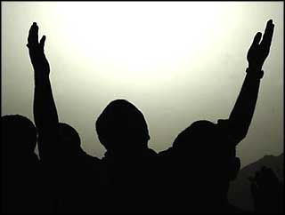
Worship
Before service we speak to God.
During service God speaks to us.
After service we speak to each other!

Slide 14
CHURCH PROTOCOL
Call to Worship - the opening of the worship experience;
Invocation – a prayer asking God’s help as part of the service.
Hymn
Opening hymn - song of praise to God
Doxology - beginning or the end of worship service
Types of hymns: worship; adoration; guidance; renewal; aspiration
Responsive reading
A scriptural reading designed to allow the congregation to read and be with the word of God.

Slide 15
CHURCH PROTOCOL
Prayer – spiritual communion with God
Types of prayers: supplication (plea); thanksgiving; adoration; and confession
Addressing the house - respect and honor our leaders, such as our Presiding Bishop.
Welcome/Announcements - An “intermission” in worship to make worshippers aware of activities, events, and concerns.
Offertory - participate in giving.

Slide 16
CHURCH PROTOCOL
Sermon - divine activity in which the Word of God is proclaimed or announced.
Invitation to Christian Discipleship – individuals are invited to be a part of the household of faith.
Altar Call - An invitation to the congregation to express personal concerns by means of the people assembling at the altar and kneeling to pray.
Benediction - a prayer that God may bestow certain blessings on His people. It is important to receive the benedictional prayer.

Slide 17

When to Stand and Why
Doxology - Always stand in reverence to God when the Doxology is played.
Call to Worship – Standing allows us to participate in the purpose of our coming together.
Responsive Reading - We stand in respect of the reading of God’s word.
Offertory – Stand to participate in giving. You only sit if a tray is passed to collect the offering.
The Invitation to Christian Discipleship – Standing demonstrates our agreement with the spirit of God and the invitation to be a part of God’s family.
Accepting Jesus Christ as your personal Savior –Love

Slide 18


If you must walk during service …
Never walk
Walk during
In front or across the front of the altar or the pulpit area during worship
During scripture readings or prayer.
During communion
***If you are walking and someone begins to read the scripture or begins to pray, STOP AND STAND UNTIL THEY ARE FINISHED!
Singing by the choir
Offering
Announcements
**Reminder! When you move :
Do not pass in front of the pulpit
Use the side aisles and the side doors
Do not run, but walk
No Talking

Slide 19
CHURCH ETIQUETTE
Church etiquette - is a set of rules that govern behavior in the house of God. Etiquette deals with the outward behavior. The second most important commandment next to loving God is found in Matthew 22:39, “Thou shalt love thy neighbor as thyself.” Proper etiquette helps worshippers engage in reverent and respectful behavior.

Slide 20
Teaching church etiquette to children
Don’t assume teens know what behavior you expect in church, teach them.
The best way to teach them is by modeling appropriate behavior.
Step 1
The basic tenet of etiquette is to act respectfully and interact politely with others.
Step 2
Instruct your teenager about the holiness of the church building, specifically the sanctuary.

Slide 21
Teaching church etiquette to children
Step 3
Encourage punctual behavior from a teenager when attending church.
Step 4
Talk about appropriate dress and appearance in church.
Step 5
Teach your teen to leave gum, beverages and food at home or in the car.
Step 6
Model self-control and self-restraint for your teen.

Slide 22
CHURCH ETIQUETTE
Turn off all digital devices, especially cell phones.
Govern yourself accordingly during worship service. No eating, talking loud, foolish conversations, or excessive walking.
Exhibit respect in your wardrobe choices.
Avoid cliques.
Observe worship service schedules. Don’t be the “arrive late and leave early” member. If an emergency arises, exit the sanctuary with discretion.
Be considerate of others if you have small children.

Slide 23
CHURCH ETIQUETTE
Sit close to the door to facilitate quick and easy access to the bathroom.
Speak words of encouragement. Remember, the tongue is dangerous.
Think of others first.
Be hospitable and friendly.
Do not be boastful, arrogant or loud. Let your deeds speak for themselves.
Listen before speaking.
When you give your word or promise something, please fulfil it.
Do not criticize or complain.

Slide 24
CHURCH ETHICS
Ethics
Ministerial Ethics
Right or wrong
To behave ethically is to do what’s right
Reflect who the person is – conduct, innermost thoughts, speaking, lifestyle
Religious code of behavior grounded in biblical truth
Persons called to preach the gospel should exhibit godliness and integrity
Virtuous vs sinful behavior

Slide 25
The Christian Church
In Relationship to the Pastor and Other leaders of the Church
We will love, honor and submit to our pastor and other spiritual leaders as they, by example and word, watch over our souls.
We will support the pastor financially so that s/he may be able to meet his/her obligations.
We will not allow anything among us that would undermine the pastor.
We will endeavor to respond to all criticism dealing with the pastor, other spiritual leaders, or their families in an honorable manner.

Slide 26
Congregational Ethics
"...lead a life worthy of the calling to which you have been called, with all humility and gentleness, with patience, bearing with one another in love, making every effort to maintain the unity of the Spirit in the bond of peace." Ephesians 4:1-2

Slide 27

Conclusion
Think about it!
Lead by example
Showing respect is never wrong
Doing right never goes out of style
You are showing respect to God
You are responsible for your actions

Slide 28
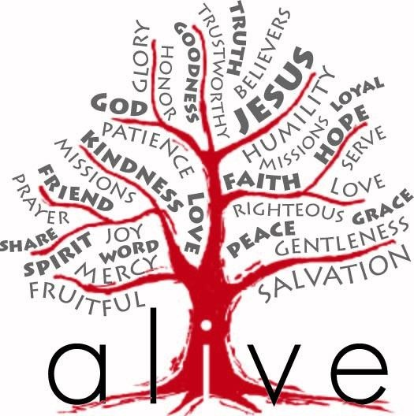
Zion, let’s be ALIVE in the power of God
Adore God
Love everybody, all people
Invest in God’s work
Value God’s word
Expand God’s kingdom

Slide 29






Question & Answer

