Slide 1

FISHERS Of Men:
Principles for Effective Evangelism
Pastor G. Lydell Mungin

Slide 2
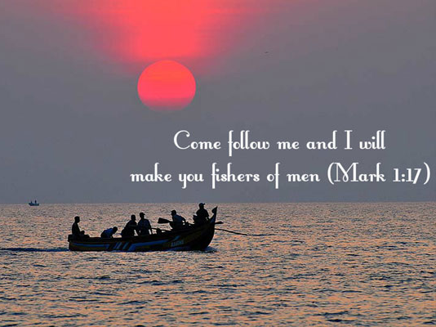

Slide 3

"Unfortunately, many churches don't take the time to understand the people they want to reach. Therefore, they don't have a STRATEGY"

Slide 4
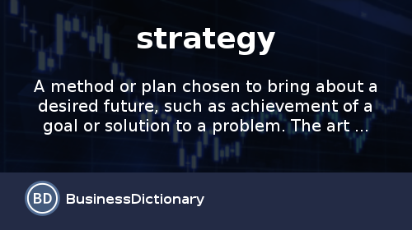

Slide 5

5 Strategies For Effective Evangelism

Slide 6

1. Understand The Fish And Catch Them On Their Terms…

Slide 7
2. Know What You Are Fishing For…

Slide 8
3. Go Where The Fish Are Biting….

Slide 9
4. Learn To Think Like A Fish…
.

Slide 10
5. Use More Than One Hook…..

Slide 11

II.
EVANGELISM

Slide 12


When the Membership is committed to the mission and/or goals of the church, and also find the day-to-day work personally resonant.
Buy-in promotes engagement and a willingness to go the extra mile in the work of ministry!

Slide 13



Slide 14


Slide 15
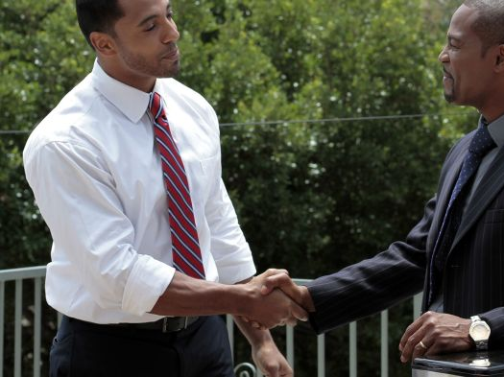

Model Evangelism

Slide 16



Slide 17
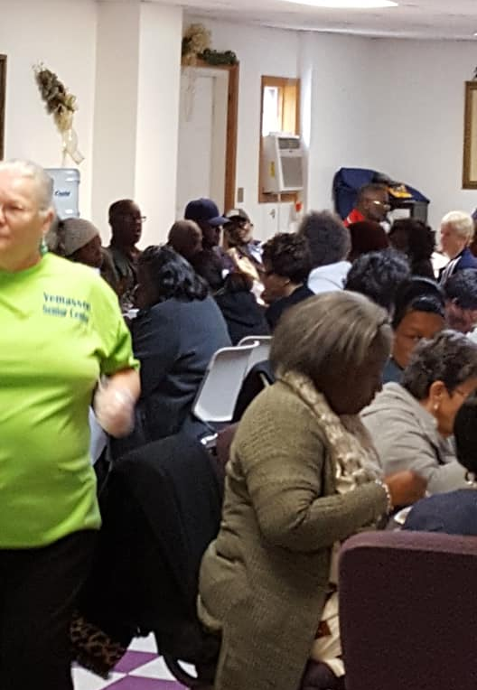
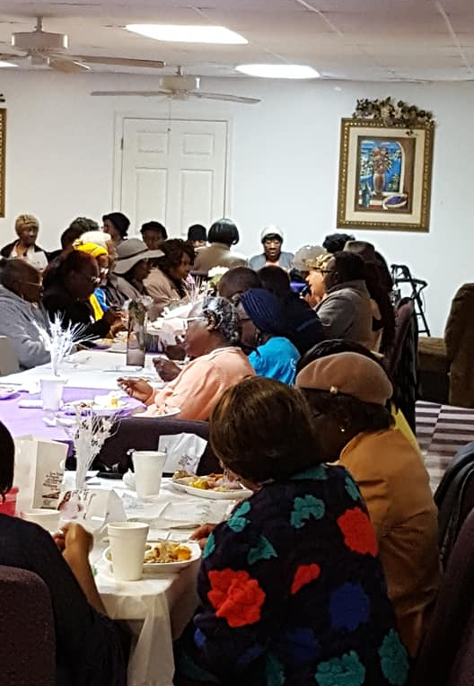

Slide 18
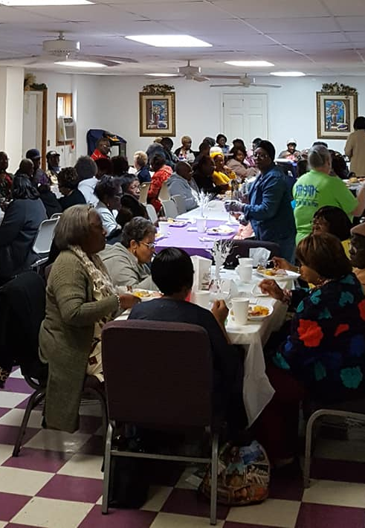
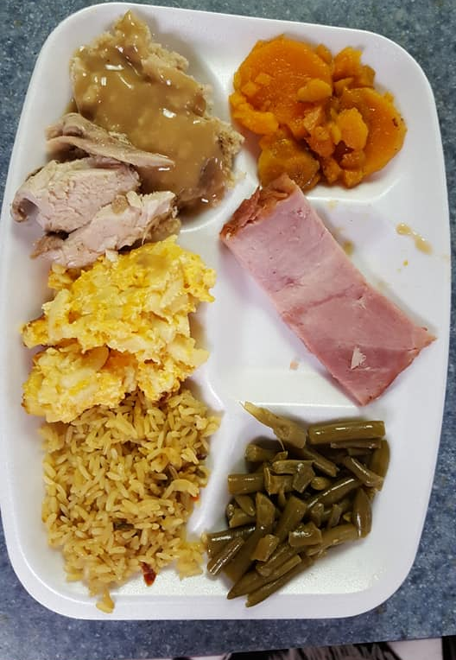

Slide 19
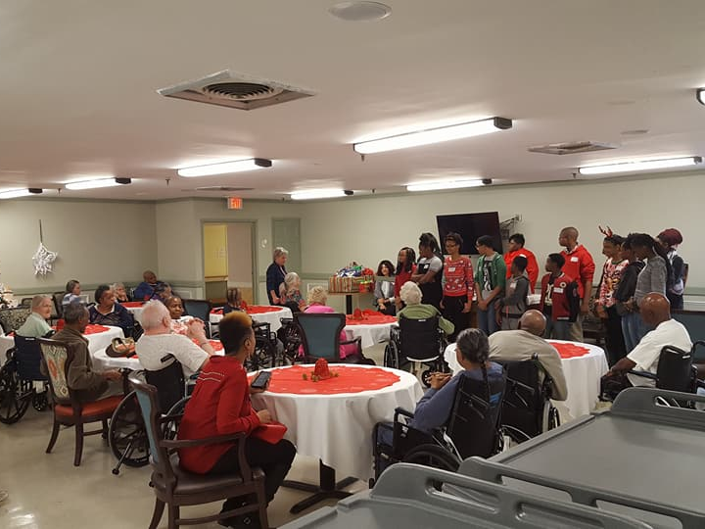

Slide 20
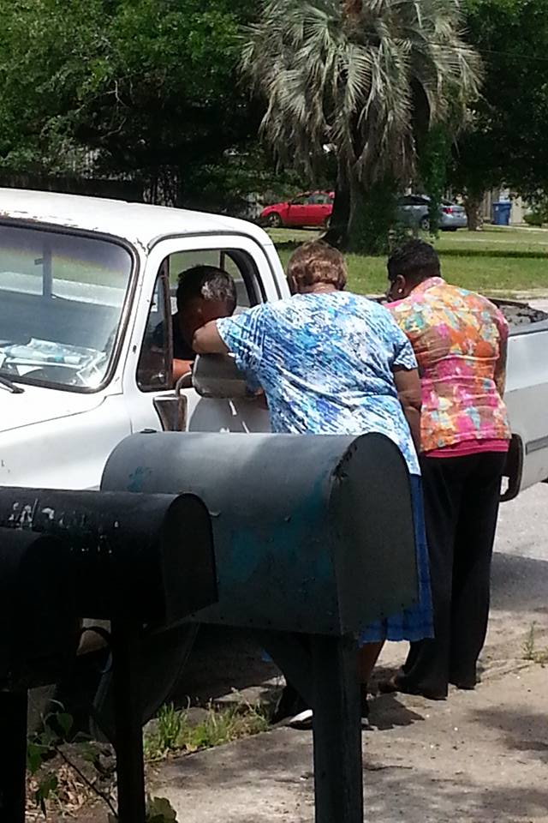
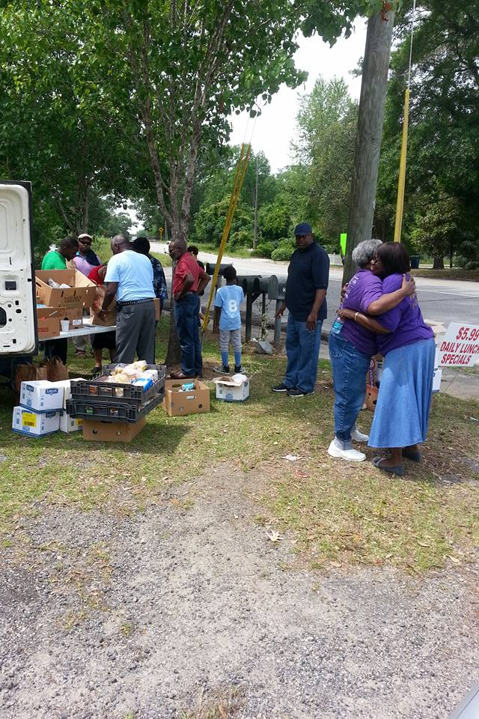

Slide 21
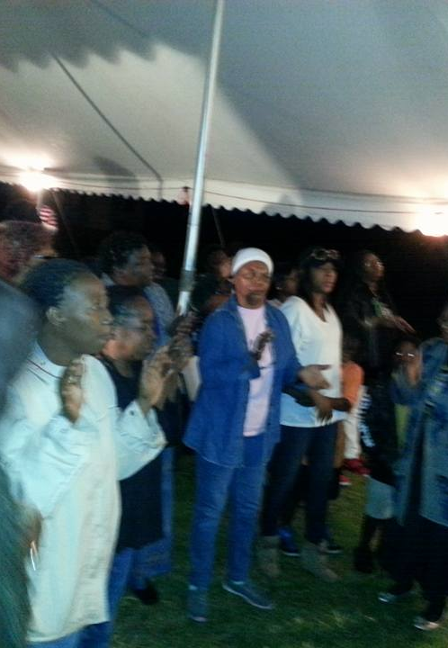
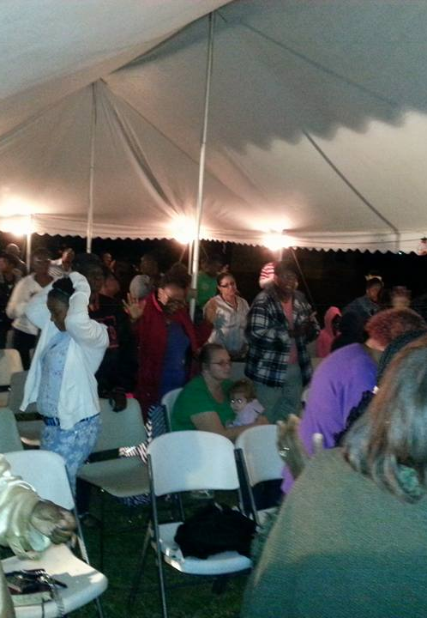

Slide 22


Slide 23
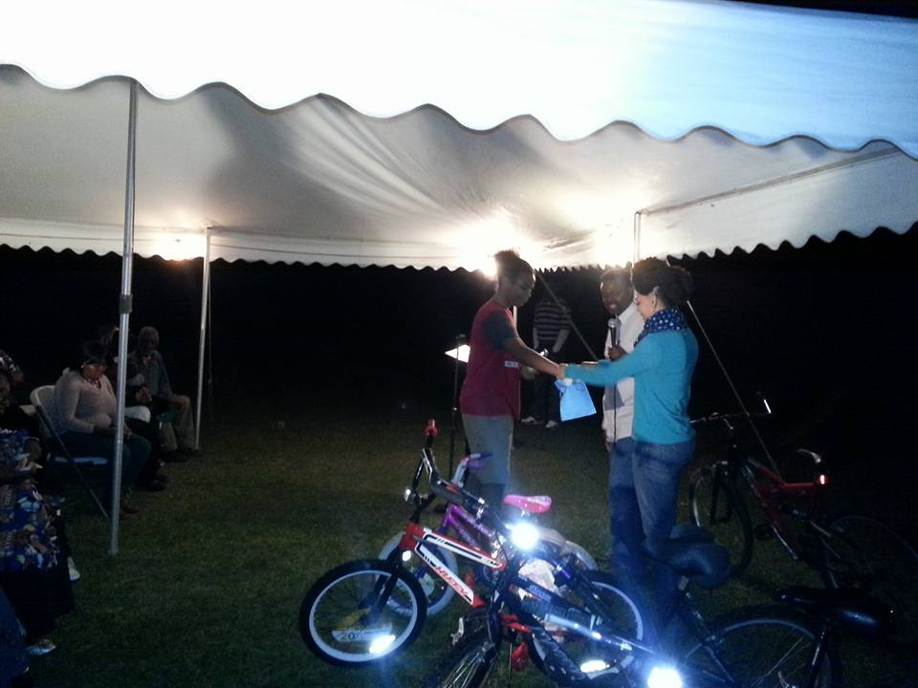

Slide 24


Slide 25


Slide 26
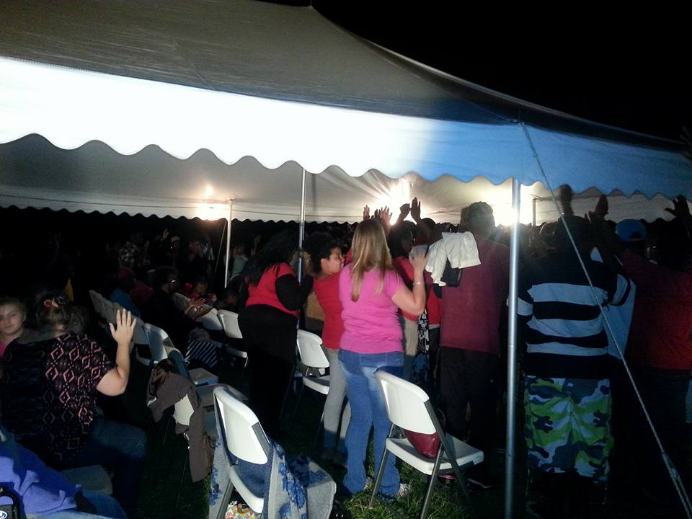

Slide 27


Slide 28


Slide 29


