Slide 1
Walk With the Word
Acts 10

Slide 2
10:1-48 – The Holy Spirit falls upon the Gentiles.

Slide 3
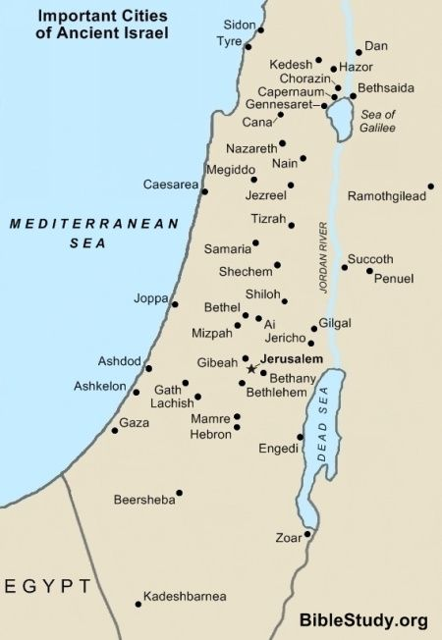

Slide 4
10:1-8 – The centurion Cornelius is described as “a devout man
and one who feared God” and “gave many alms” and
“prayed continually.”

Slide 5
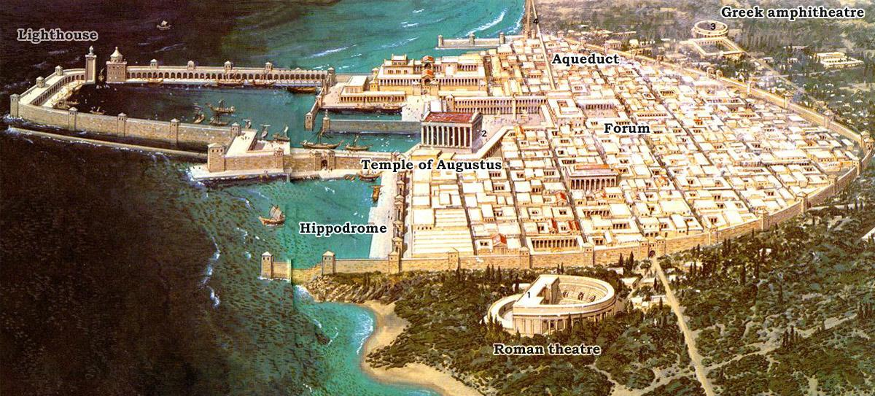

Slide 6
Cornelius is visited by an angel and is terrified.
The angel instructs him to send to Joppa for Peter.

Slide 7
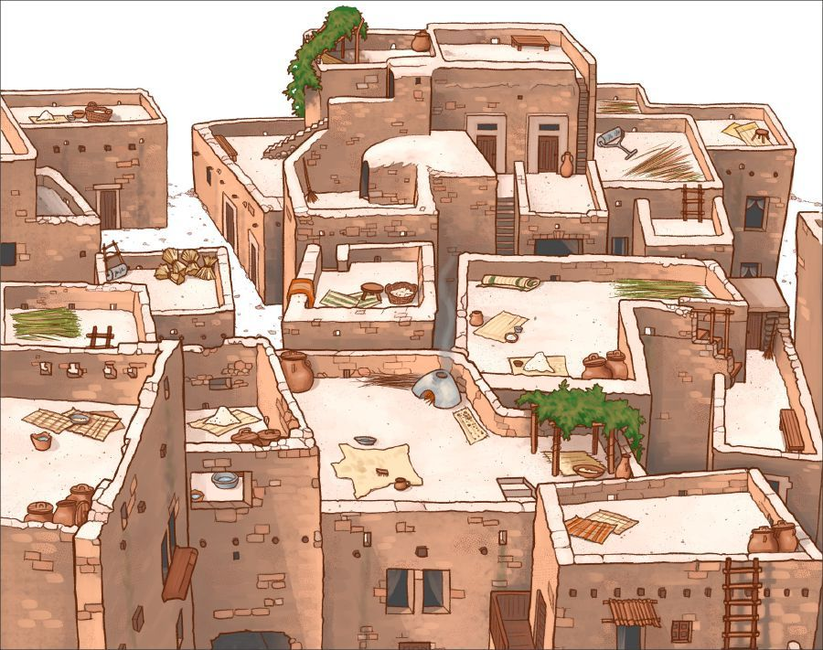

Slide 8
10:9-29 – While praying, Peter has a vision to “kill and eat!” all
kinds of unclean animals.
Peter objects: the voice tells Peter “What God has cleansed
no longer consider “unholy or unclean.”
Peter will discover that God will “cleanse” the Gentiles.
This new teaching will be realized by Peter: “…I should not
call any person unclean.”

Slide 9
10:30-43 – Peter presents to Cornelius and his household the gospel.
10:44-48 – After Peter states “…everyone who believes in Him
receives forgiveness of sins,” the “gift of the Holy Spirit” is
“poured out on the Gentiles also.”
Here, speaking in tongues is a sign.

