Slide 1
Walk With the Word
Acts 11

Slide 2
11:1-18 – Returning to Jerusalem, Peter confirms to the apostles
and “brethren” that Gentiles have received the Holy Spirit.
Some “circumcised” men take issue.
Most acknowledge that “God has granted to the Gentiles
also the repentance that leads to life.”
11:19-21 – In Antioch, the Lord Jesus is preached to Gentiles.
A “large number” turn to the Lord.

Slide 3
11:22-26 – Barnabas is sent to Antioch by the apostles to
witness “the grace of God.”

Slide 4
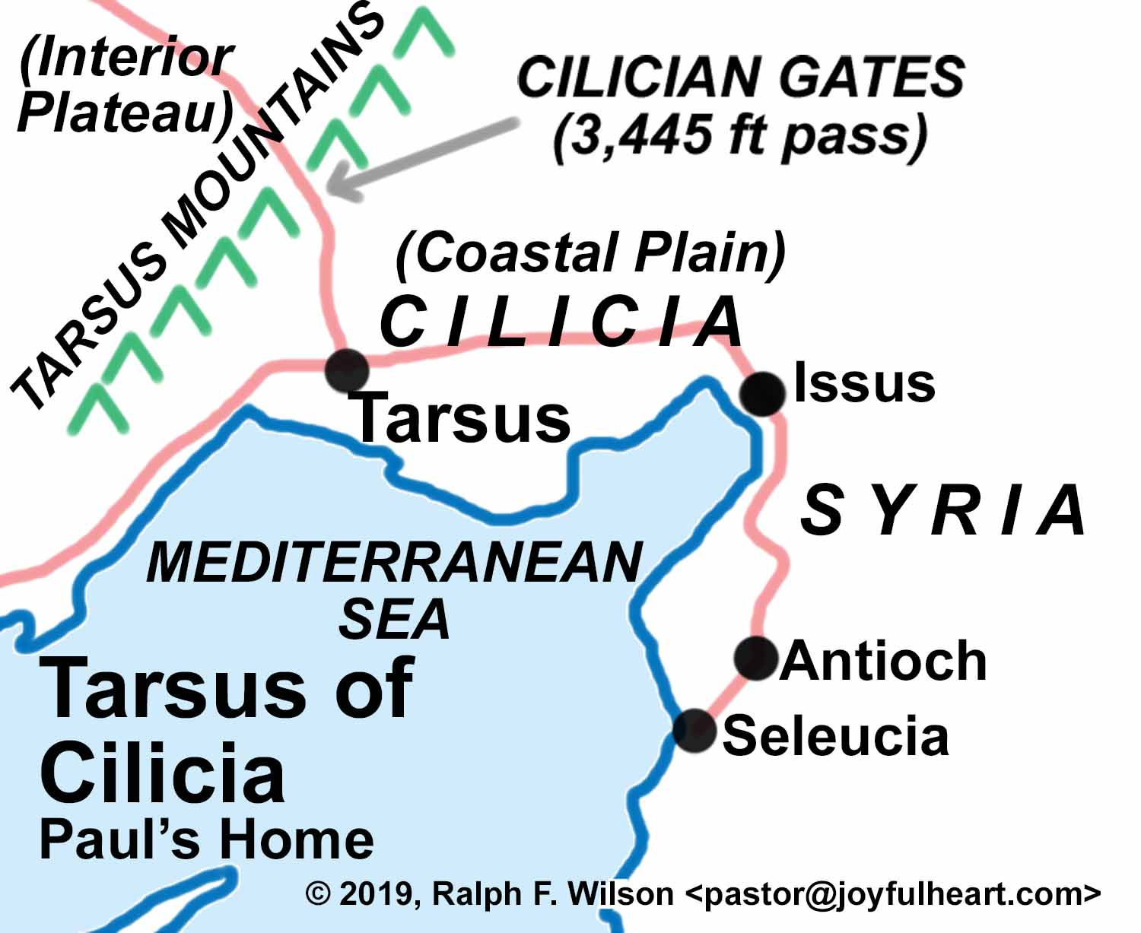
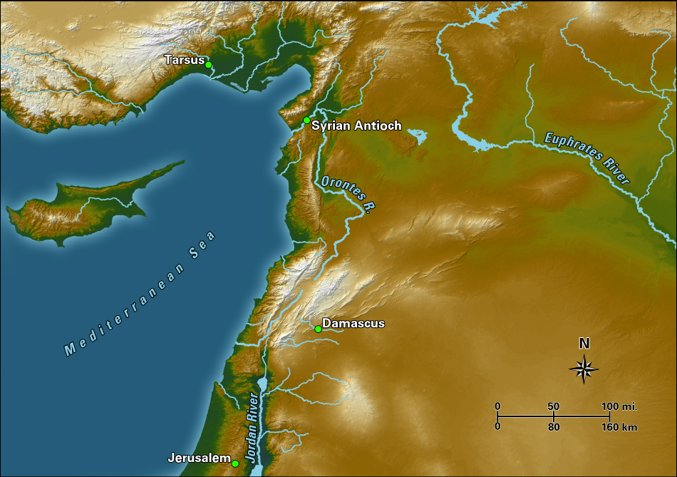
Barnabas travels to Tarsus to “look for Saul.”

Slide 5
Barnabas and Saul teach at the church in Antioch for a year.
In Antioch the disciples are first called “Christians.”
11:27-30 – Due to a famine, financial help is sent to Jerusalem.
This help is sent to the elders by Saul and Barnabas.

