Slide 1
Walk With the Word
Acts 12

Slide 2
12:1-5 – The beginning of government sanctioned persecution.
This is Herod Agrippa I, grandson of Herod the Great.

Slide 3
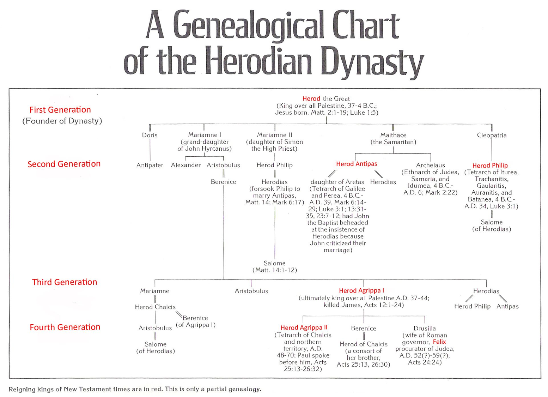

Slide 4
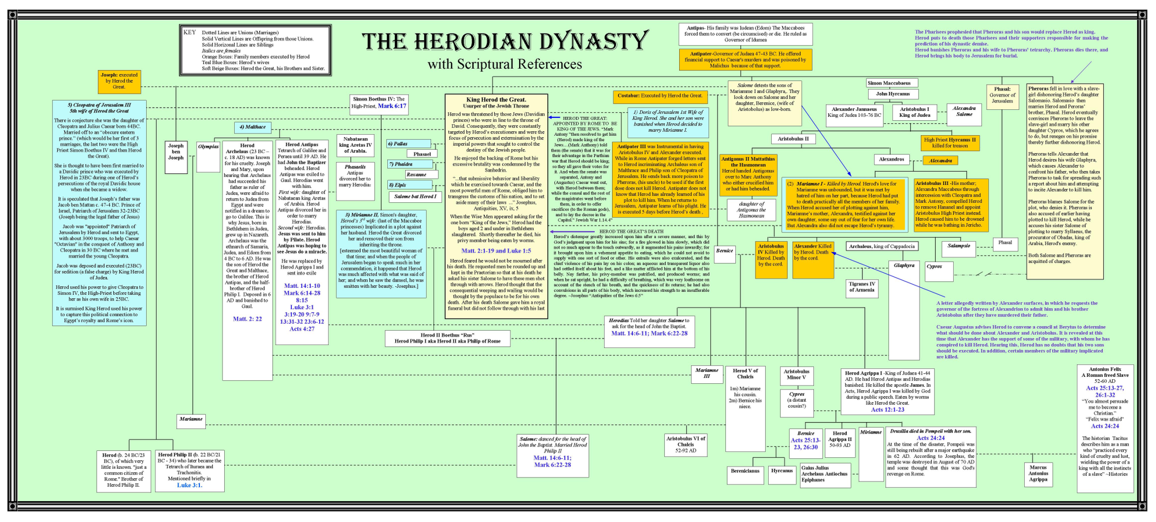

Slide 5
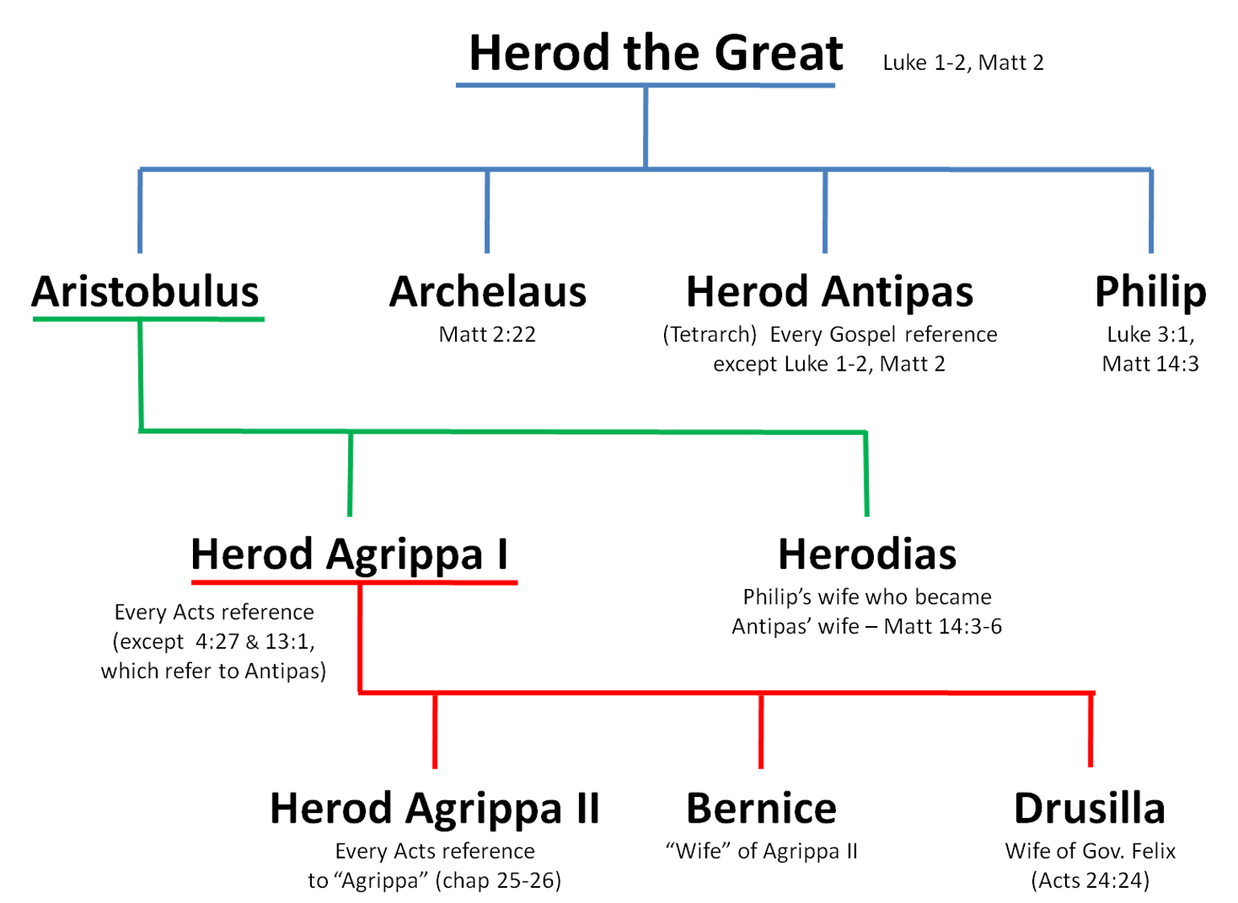
Jesus’ birth
Jesus’ death
Executes James

Slide 6
12:1-5 – The beginning of government sanctioned persecution.
This is Herod Agrippa I, grandson of Herod the Great.
He imprisons and executes James, the brother of John.
He also imprisons Peter.

Slide 7
12:6-17 – Peter’s miraculous escape from prison by an angel.
For Peter’s protection and release, the church was praying.
Peter instructs the disciples to inform James, Jesus’ brother.

Slide 8
12:18-25 – Herod is struck down by an angel for allowing
himself to be called a “god” and not giving God the glory.
The word “immediately” indicates a grisly death.
The “word of the Lord” continues to grow and multiply.
Note: Verse 24 summarizes the advancement of “the word of God”
and begins a new section that focuses entirely on the apostle Paul.
Barnabas and Saul return to Antioch from Jerusalem bringing
with them John Mark.

