Slide 1
Walk With the Word
Acts 13

Slide 2
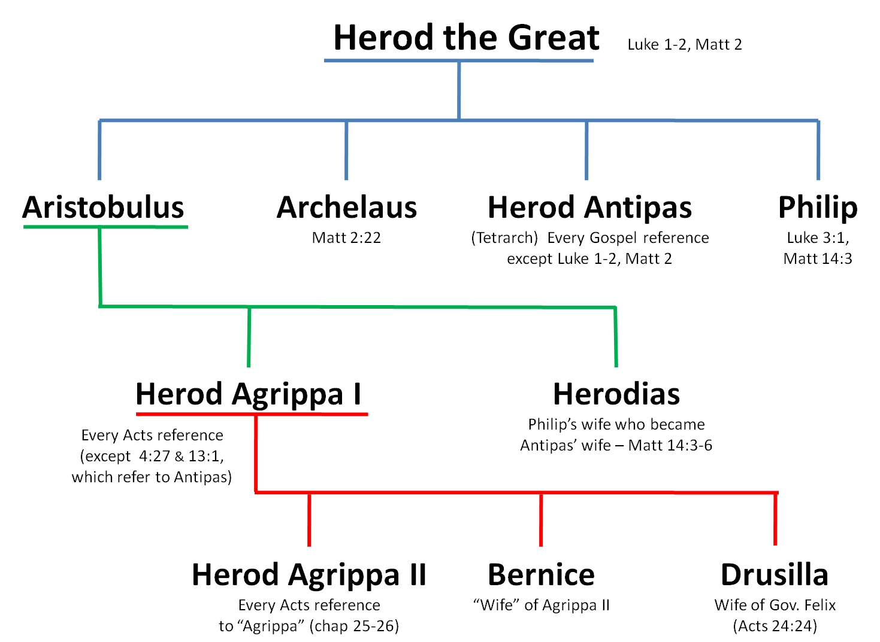
Manaen friend
with Herod Antipas

Slide 3
13:1-12 – The first missionary journey.
Barnabas and Saul were “set apart for Me” by the Holy Spirit.
This happened during consistent prayer and fasting.
They began evangelizing first in Cyprus.
In Paphos, they are opposed by a “magician” named Elymas.
Elymas is blinded by Paul and the proconsul believes.
Saul adopts his Greek name Paul.

Slide 4
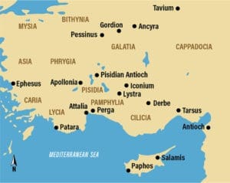

Slide 5
13:13-41 – Paul preaches in the synagogue at Pisidian Antioch.
Paul reviews Jewish history from Moses to David.
Paul declares that God “has brought…a Savior, Jesus…” who
was announced by John the Baptist.
Paul states that the promised Savior is Jesus who was
crucified, but then rose from the dead.
Paul announces the “good news”; this fulfills a promise.

Slide 6
Paul declares that because Jesus was raised from the dead,
“through Him” there is forgiveness of sins.
Believing in Jesus frees people “from all things,” including
“the Law of Moses.”
Paul gives a warning from Habakkuk: “…take heed….”

Slide 7
13:42-47 – Resistance to Paul’s message results in Paul’s
declaration, “…we are turning to the Gentiles.”
13:48-52 – Many Gentiles believe, and the gospel begins
spreading to “the whole region.”

