Slide 1
Walk With the Word
Acts 14

Slide 2
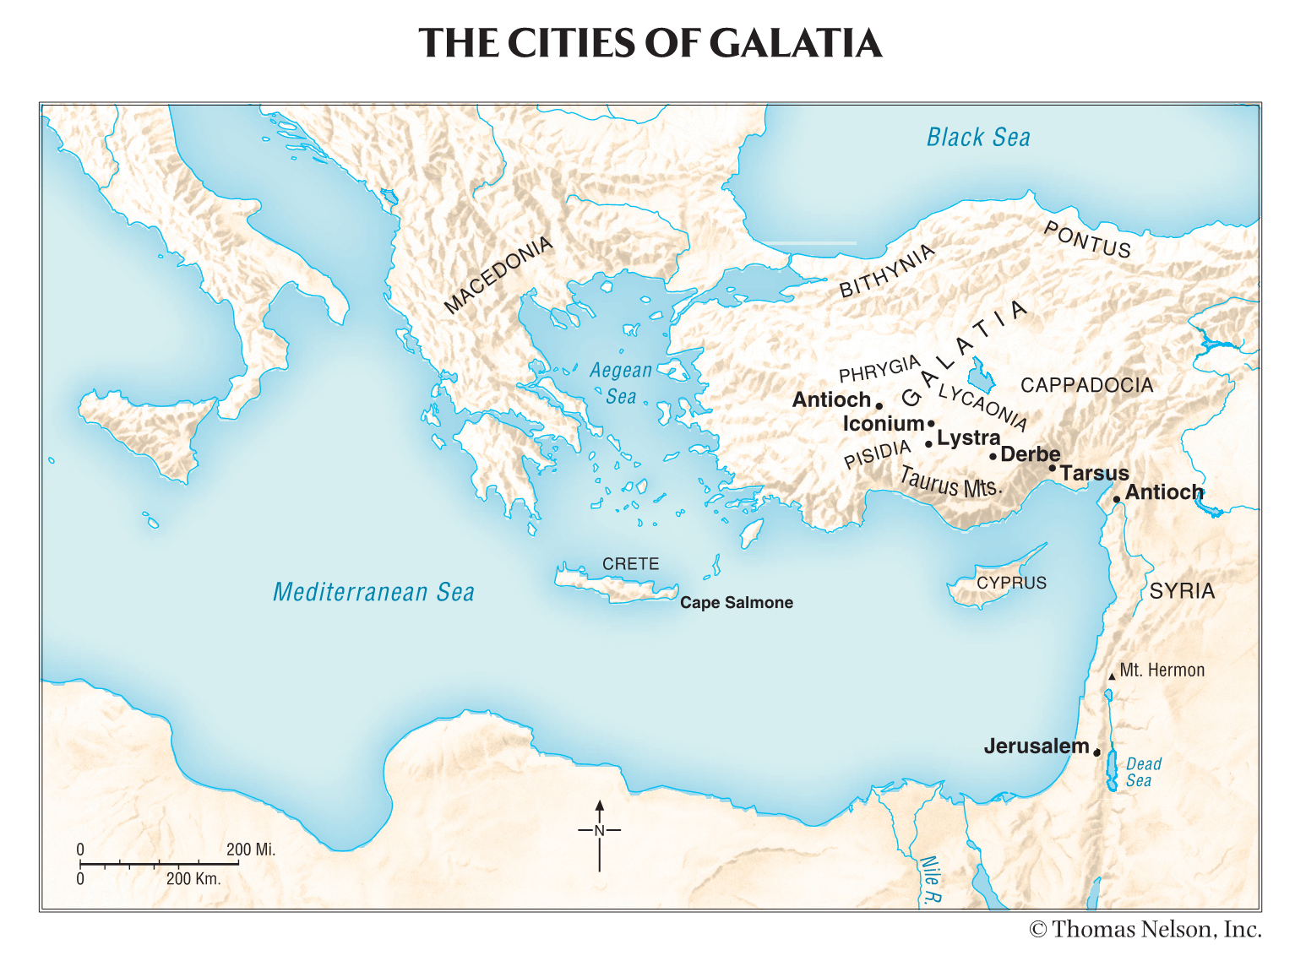

Slide 3
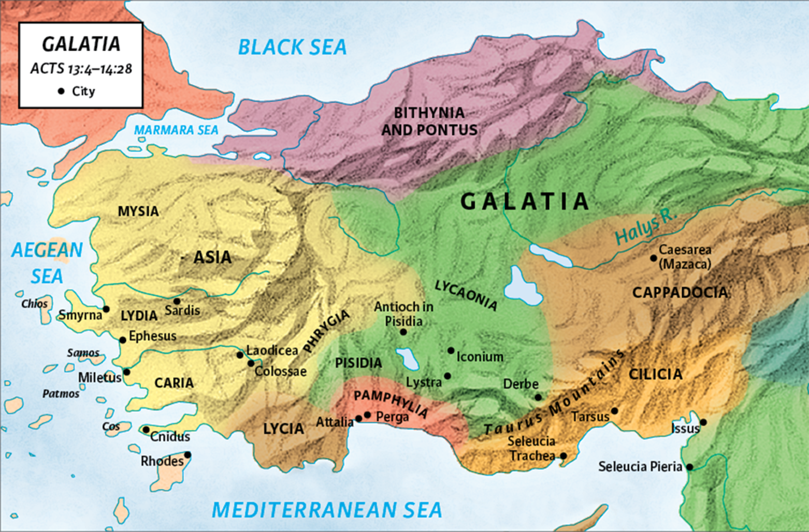
14:1-7 – The evangelistic ministry continues in Galatia.

Slide 4
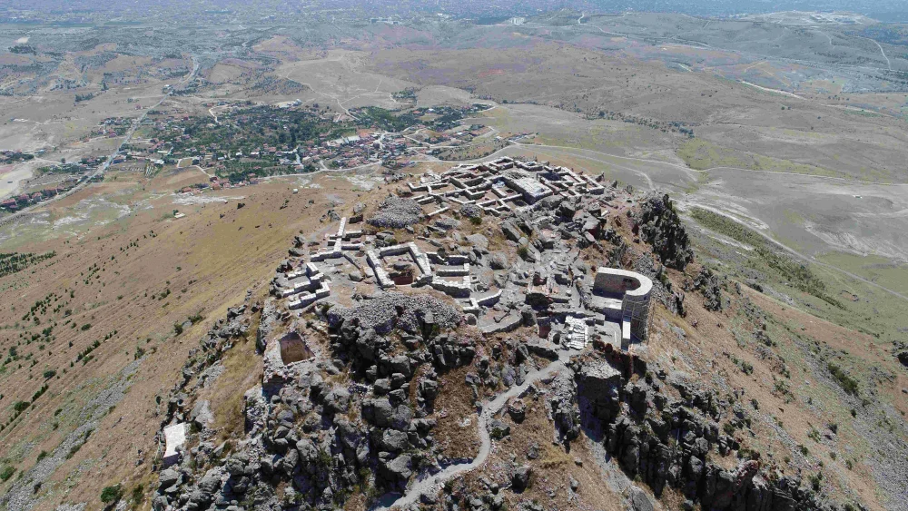
Iconium

Slide 5
14:1-7 – The evangelistic ministry continues is Galatia.
Their ministry in Iconium has great results.
This, despite manifesting “signs and wonders.”

Slide 6
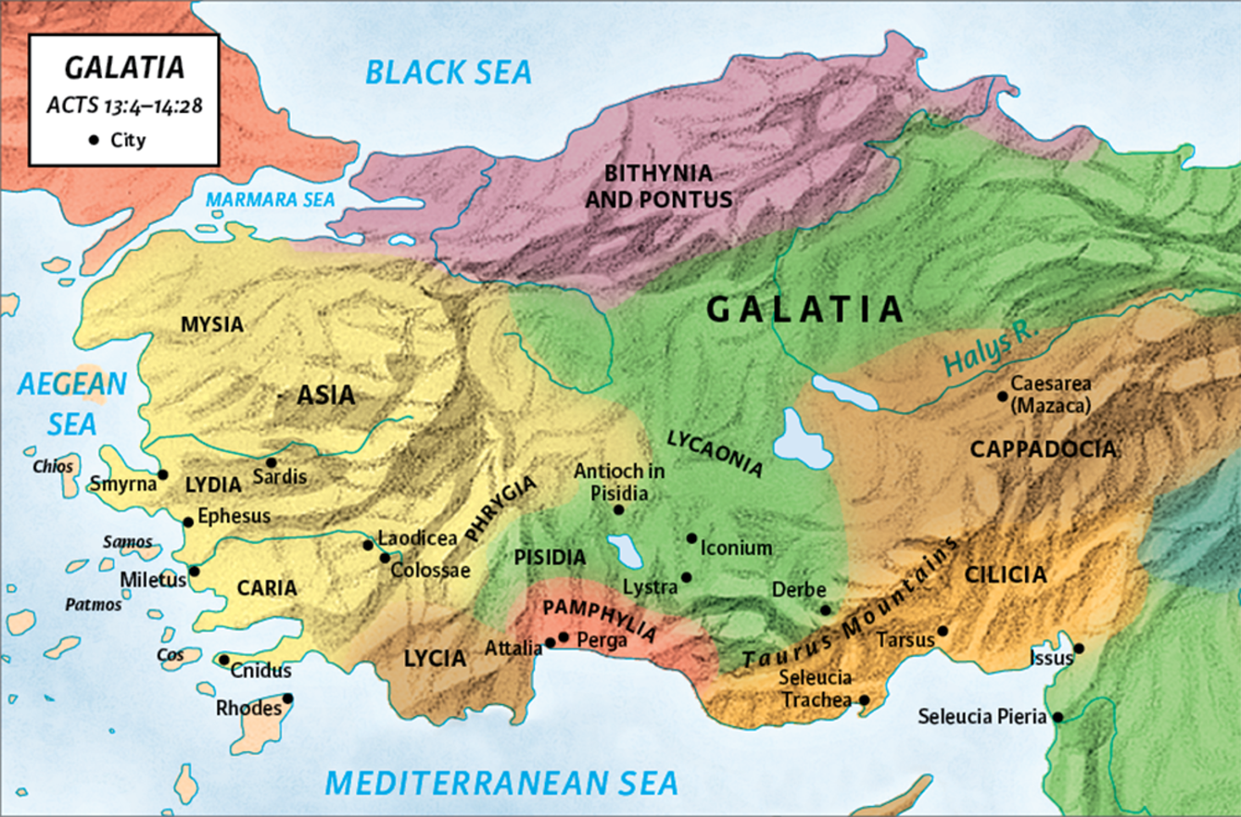

Slide 7
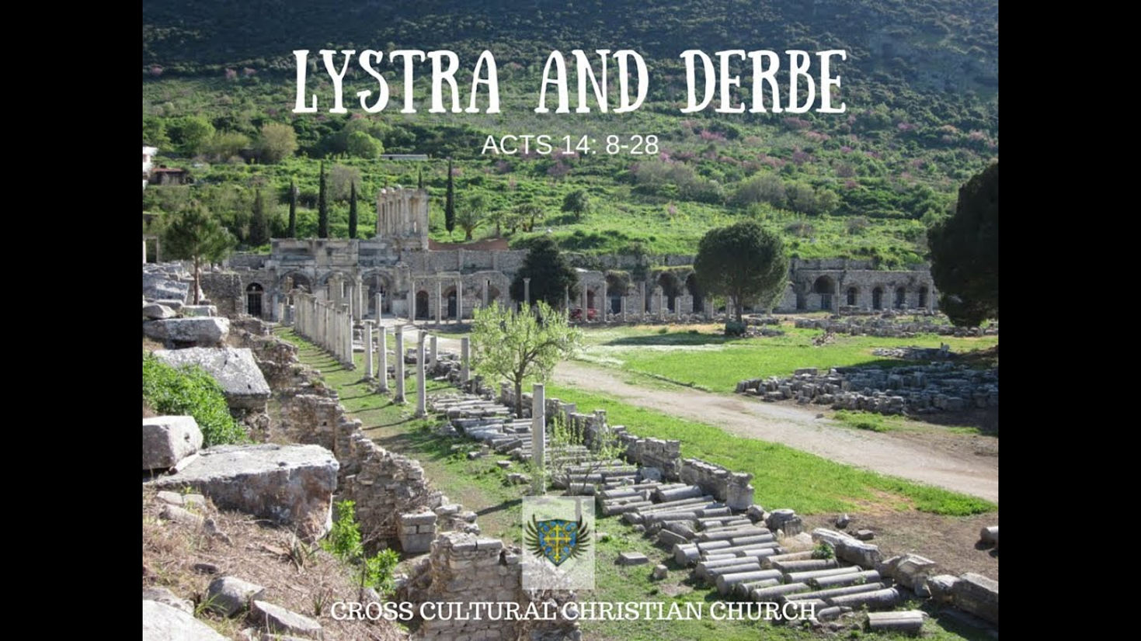
14:8-18 – In Lystra, Paul heals a man who had “never walked.”

Slide 8
Seeing the miraculous healing, the people assume Paul and
Barnabas are Zeus and Hermes, Greek gods.
Despite Paul’s objection, stopping the crowds from
worshipping them was very difficult.

Slide 9
14:19-23 – The gospel is preached throughout Galatia despite
opposition.
In Lystra, Paul is stoned by the Jews and presumed dead.
(For a full list of Paul’s persecutions, see 2 Cor. 11:21-29)
In the Galatian cities where disciples are made, churches are
established and elders appointed.
14:24-28 – Upon returning to (Syrian) Antioch, Barnabas & Paul
report that God “had opened a door of faith to the Gentiles.”

