Slide 1
Walk With the Word
Acts 16

Slide 2
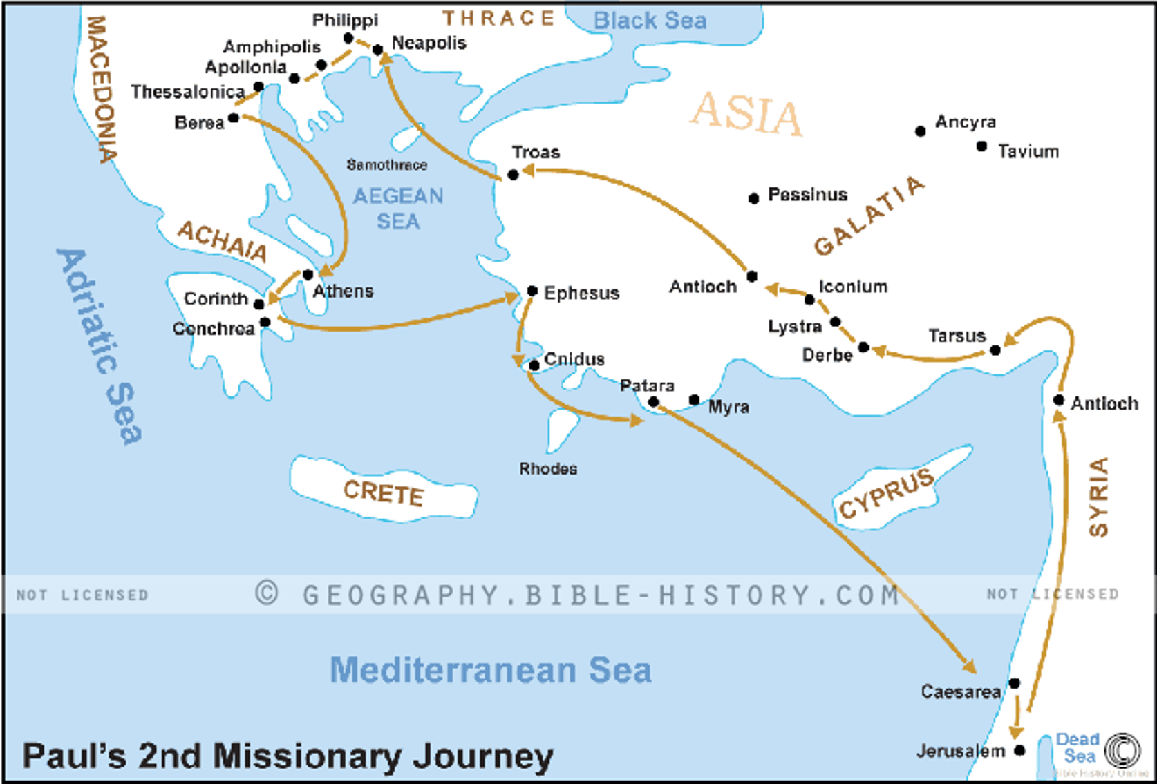
15:41 - 16:5 – Paul and Silas start the 2nd missionary journey.

Slide 3
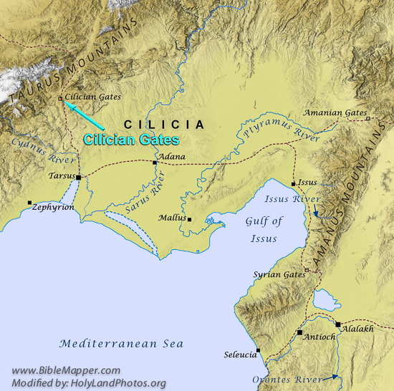

Slide 4
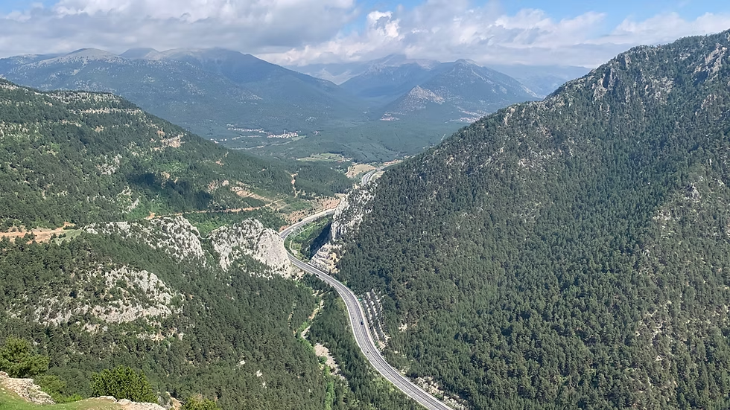

Slide 5
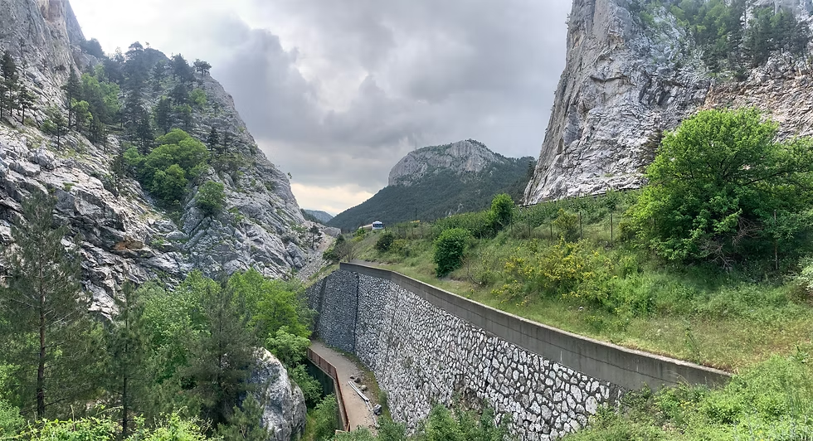

Slide 6
16:1-5 – Paul and Silas start the 2nd missionary journey.
They recruit Timothy and have him circumcised.

Slide 7

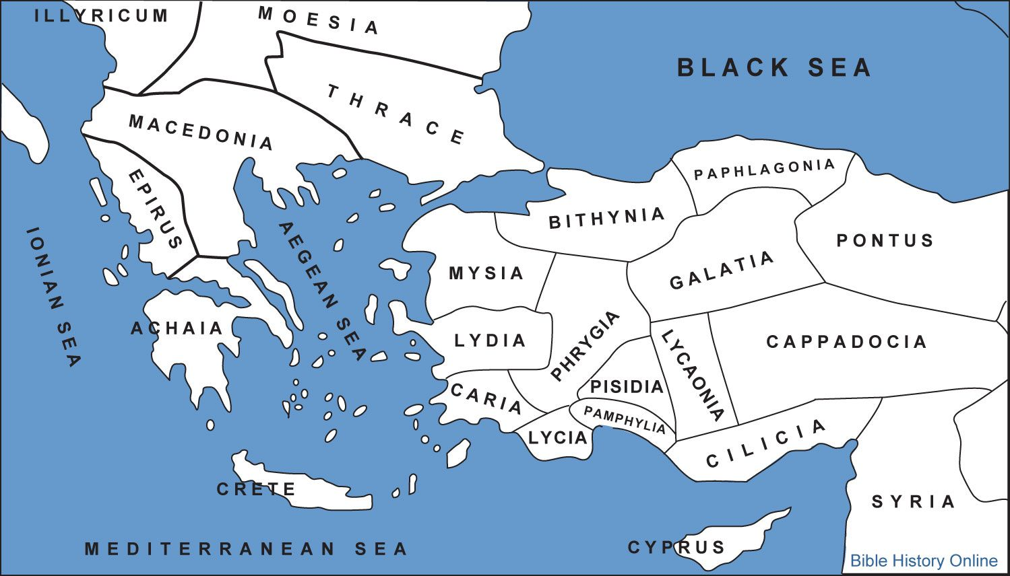
X

Slide 8
16:6-10 – Paul and Silas are “forbidden by the Holy Spirit” to
“speak the word” anymore in Galatia.
Paul has a vision to “preach the gospel” in Macedonia.
(Macedonia is a region in Greece.)
Many believe the “man of Macedonia” was Luke.

Slide 9


Slide 10


Slide 11
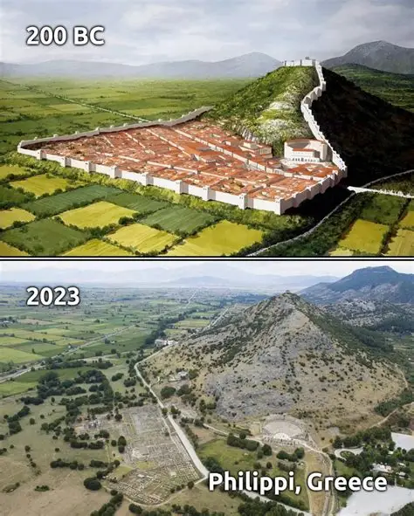
City
Amphitheater

Slide 12
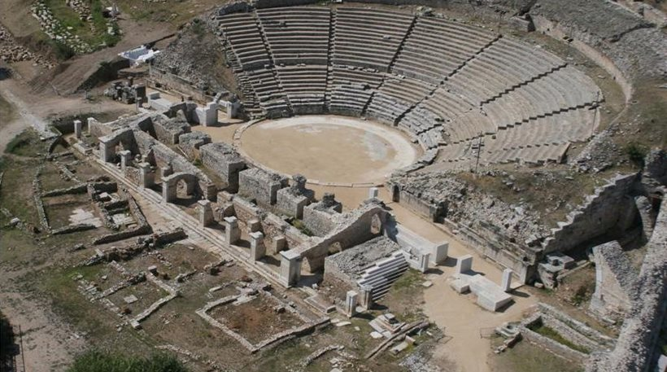

Slide 13
16:11-15 – In Philippi, Lydia and her family accept the gospel
and begin a house church.
16:16-34 – Paul exorcises a “slave girl” w/ a spirit of divination.
Her “masters” turn the crowd against Paul and Silas because
now the master has lost his profit.
Paul and Silas are imprisoned but an earthquake allows them
to be set free; their terrified jailer is later converted.

Slide 14
16:35-40 – Paul confronts the “chief magistrate” for imprisoning
them without a trial, for they are Roman citizens.
After release, they stay in the city with Lydia.

