Slide 1
Walk With the Word
Acts 17

Slide 2
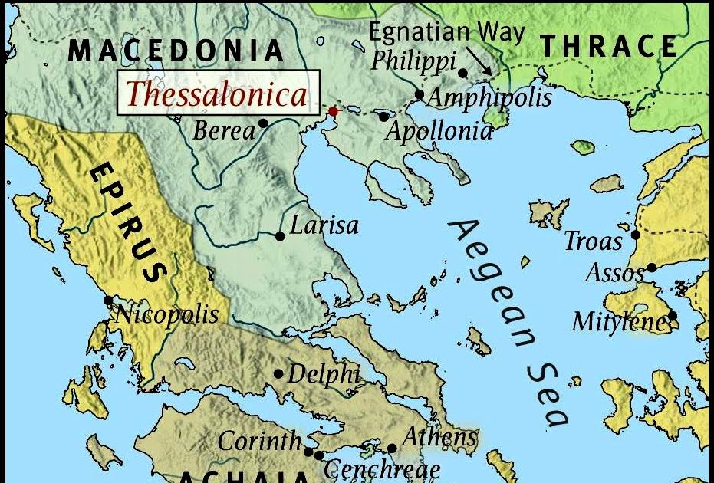
17:1-9 – The apostle Paul preaches the gospel in Thessalonica.

Slide 3
In the synagogue, he gives a message understood by Jews.
Some Jews believe, as well as God-fearing Greeks.
Some jealous Jews begin opposition and attack Jason.

Slide 4
17:10-15 – Paul presents the gospel in Berea.

Slide 5
The Bereans refer to the Scriptures, and many believe.
As in Thessalonica, many new believers are Gentiles.
Jewish agitators travel to Berea to oppose Paul.

Slide 6
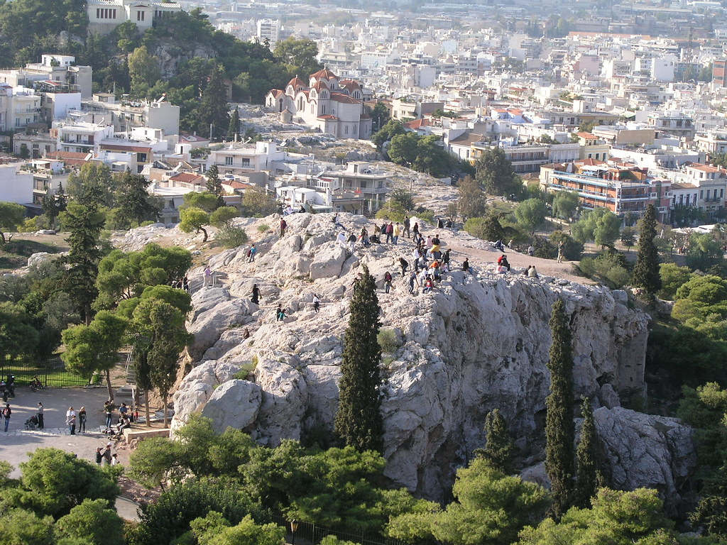
17:16-34 – Paul travels to Athens and preaches on Mars Hill.

Slide 7
His primary audience are Gentile philosophers and skeptics;
therefore, Paul adapts his message.
Paul introduces the concept of resurrection from the dead,
and that there is “a Man” in whose name they must repent.
Most listeners scoff at Paul, but some believe.

