Slide 1
Walk With the Word
Acts 18

Slide 2
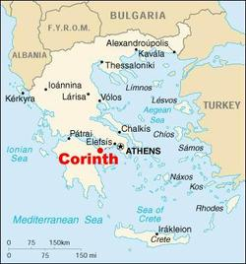
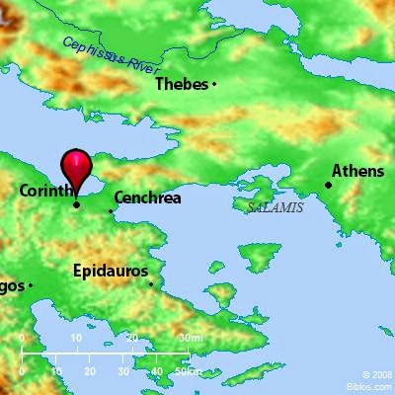
18:1-4 – The apostle Paul travels to and remains in Corinth.
Achaia

Slide 3
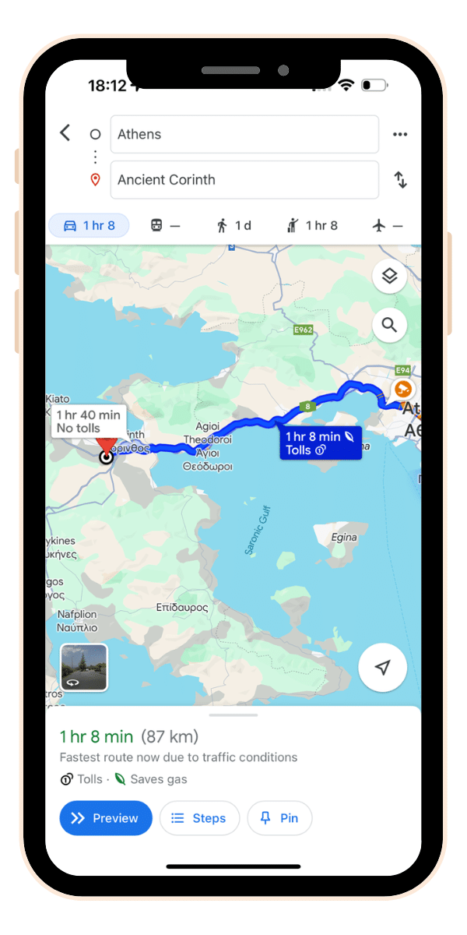

Slide 4

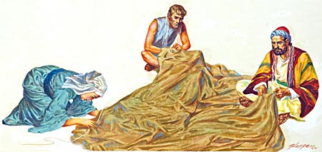

Slide 5
18:5-11 – In Corinth, Paul devotes himself completely to the Word.
Being rejected by the Jews, Paul turns his attention to Gentiles.
However, the synagogue leader Crispus becomes a Christian.
Jesus speaks to Paul in a vision: “In this city I have many people.”
Paul remains in Corinth for one-and-a-half years.

Slide 6
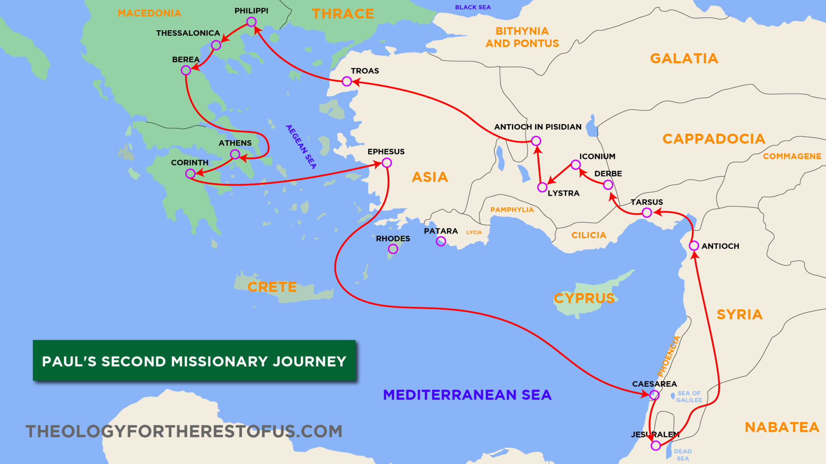
18:12-17 – In Corinth, Paul faces opposition.
18:18-22 – Paul takes Priscilla and Aquila w/ him to Ephesus.

Slide 7
18:23 – Paul begins his 3rd missionary journey.
18:24-28 – Enter Apollos, preaching John the Baptist: Priscilla and
Aquila explain to him more accurately “the way of God.”
Apollos becomes a dynamic evangelist in western Greece.

