Slide 1
Walk With the Word
Acts 19

Slide 2
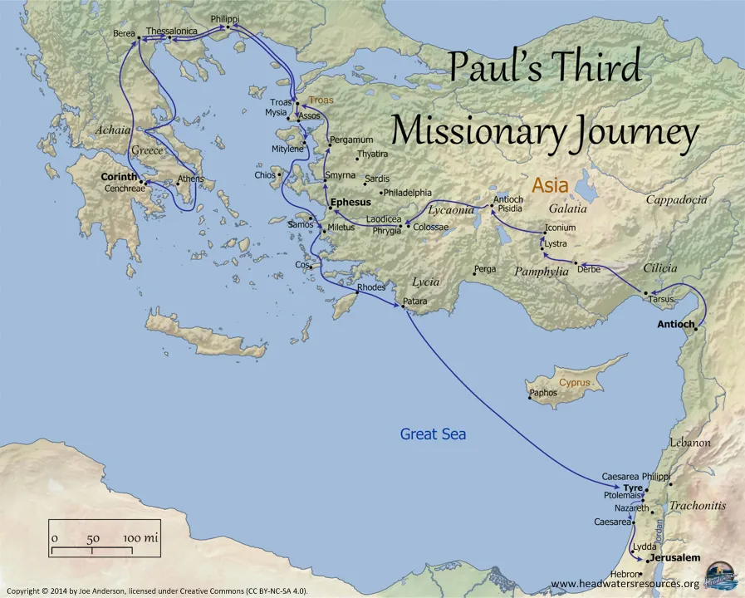

Slide 3
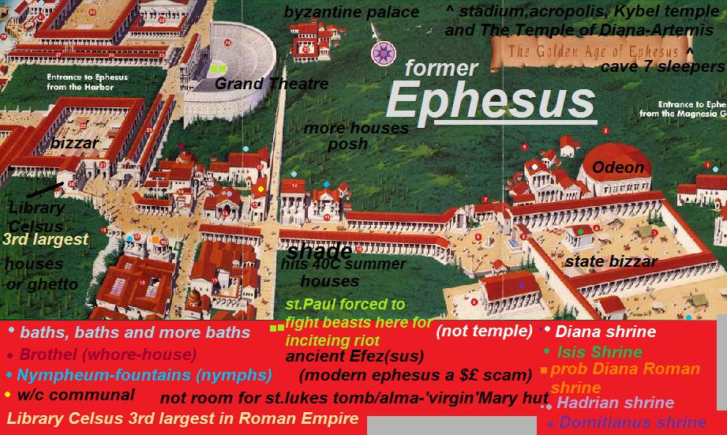

Slide 4
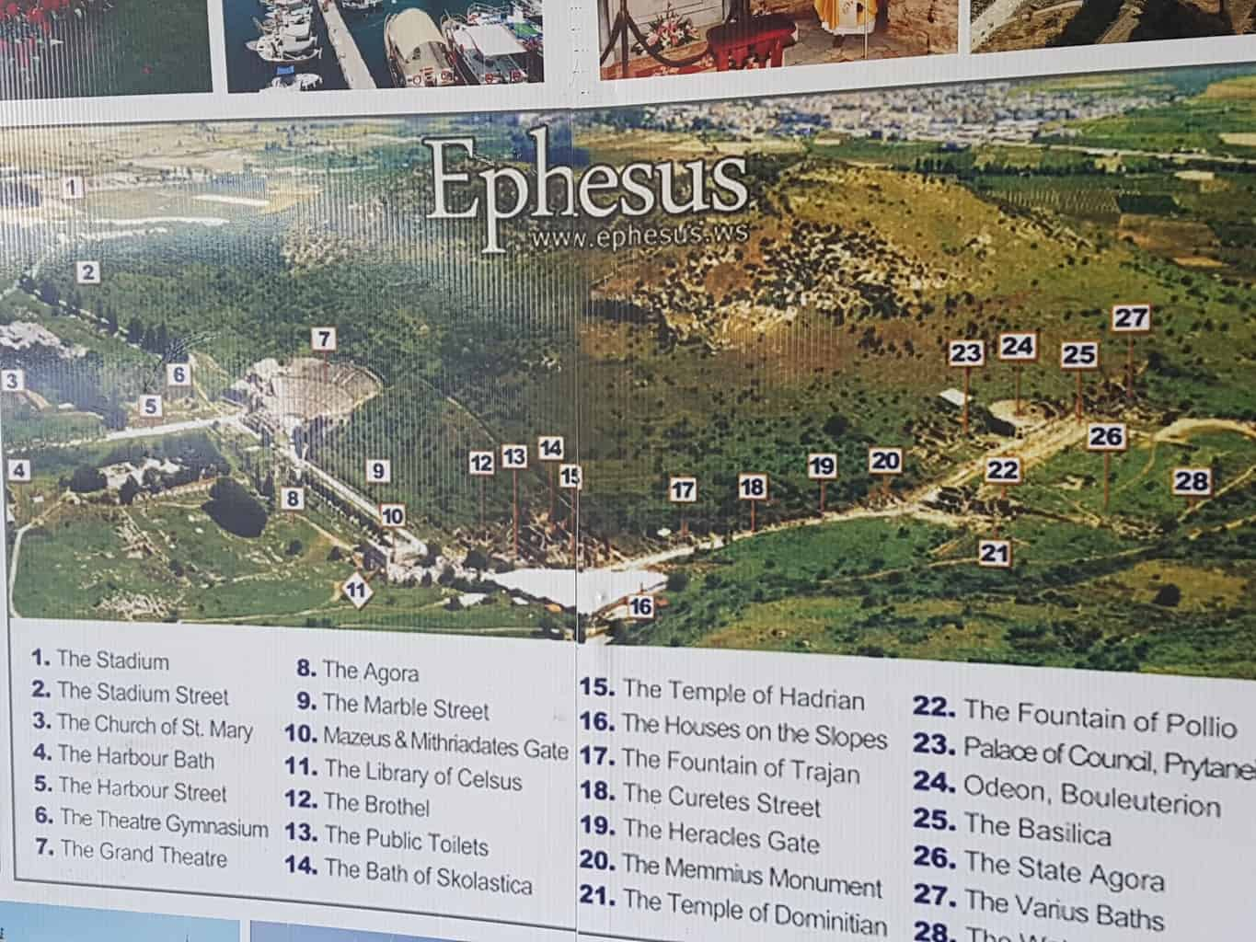

Slide 5
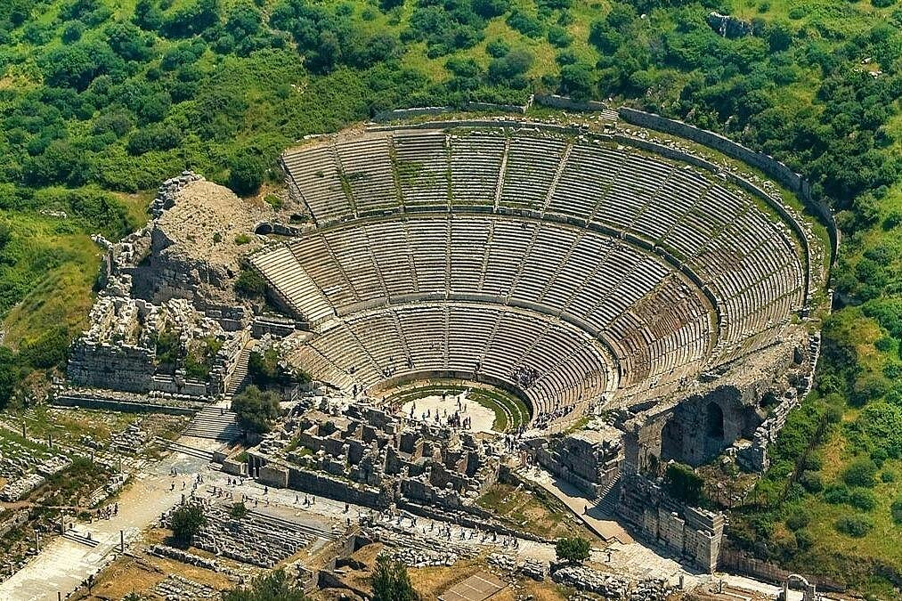

Slide 6
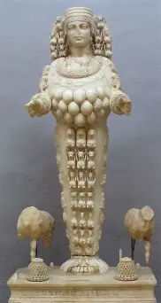
Some background on the city of Ephesus: occult!
Goddess
Artemis
(aka Diana)

Slide 7
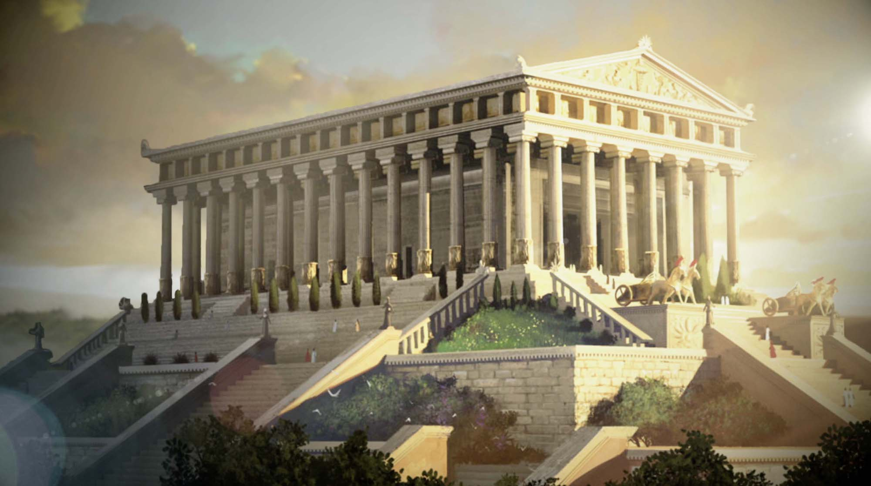
Known for the temple of Artemis.

Slide 8
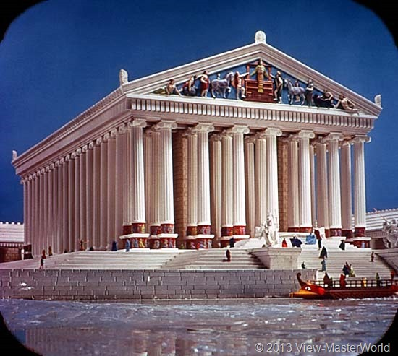

Slide 9
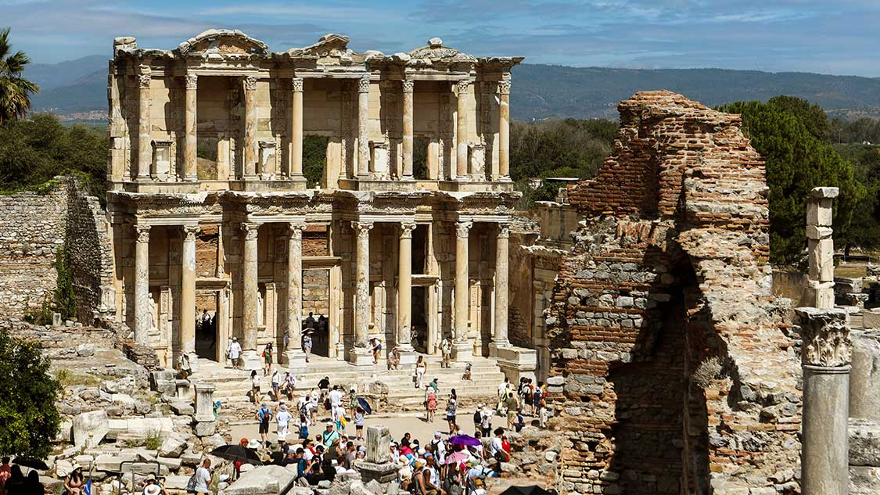

Slide 10
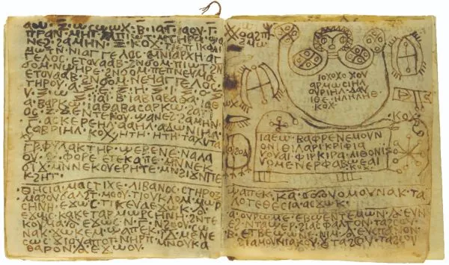
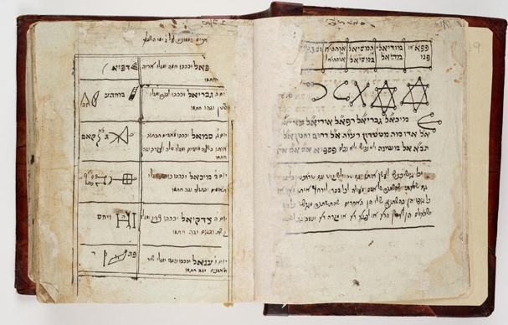


Slide 11
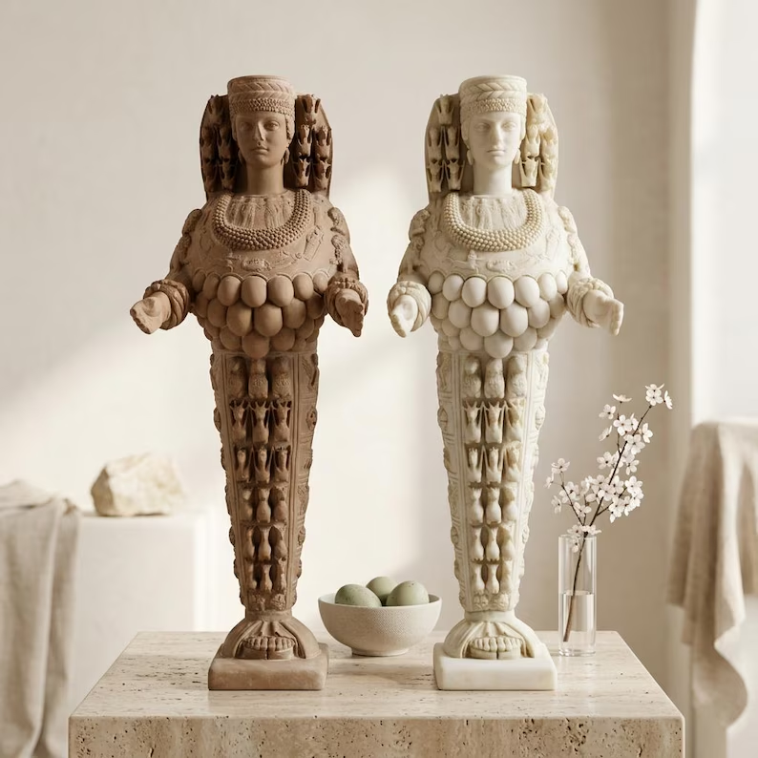

Slide 12
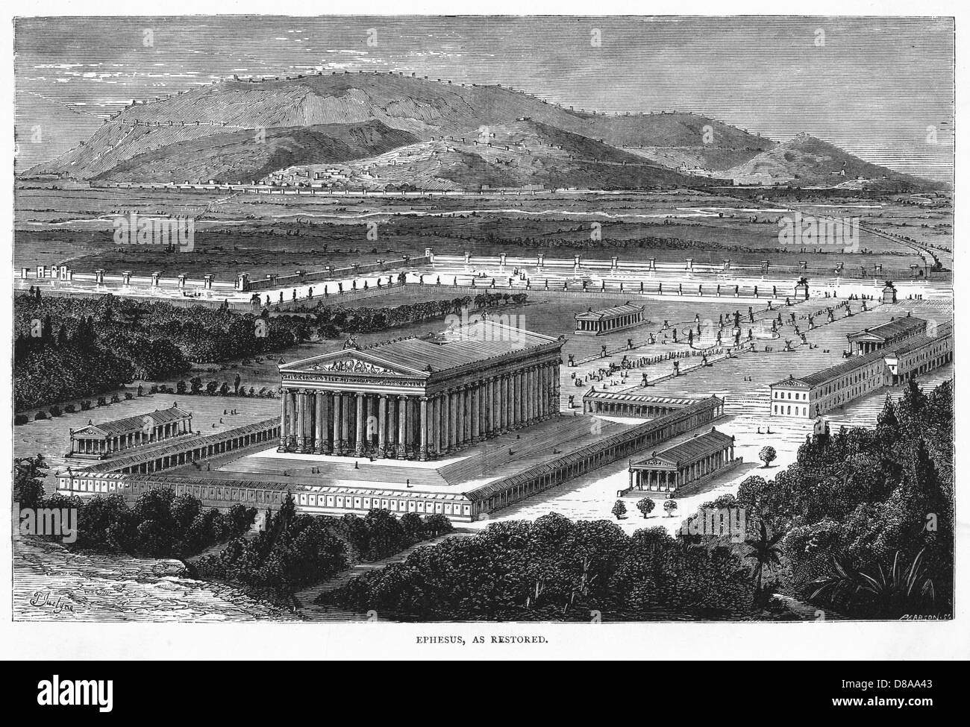

Slide 13
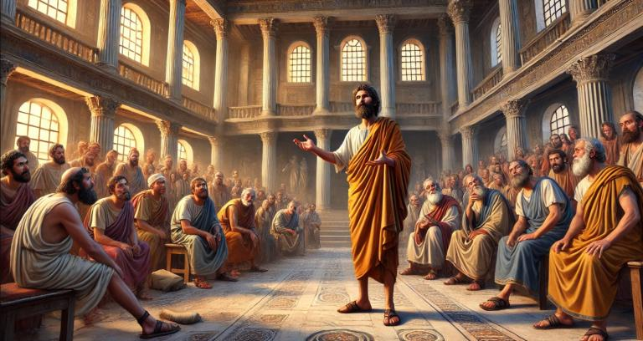
In Ephesus, Paul spends over 2 years.

Slide 14
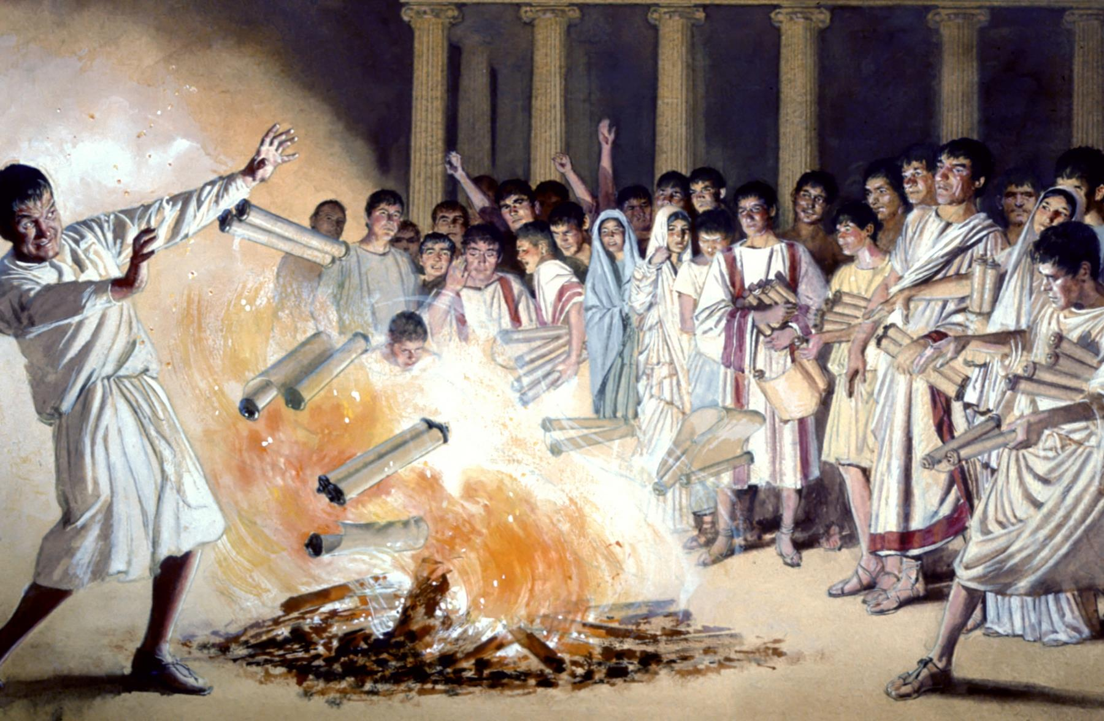
19:11-20 – In Ephesus, Paul performed extraordinary miracles.
Due to the miracles and teaching of Paul, huge growth!
Many are throwing away idols and burning books of magic.

Slide 15
19:20 – Key verse: The word of the Lord was growing.
(This highlights the 3rd section of the outline of Acts.)

Slide 16
19:21-41 – The riot in Ephesus concerning the Way.
A riot is started by Demetrius, a silversmith.
It all has to do with economic impact.
Paul is restrained from helping Gaius and Aristarchus.
After the riot, it is assumed Paul was asked to leave Ephesus.

