Slide 1
Walk With the Word
Acts 3

Slide 2
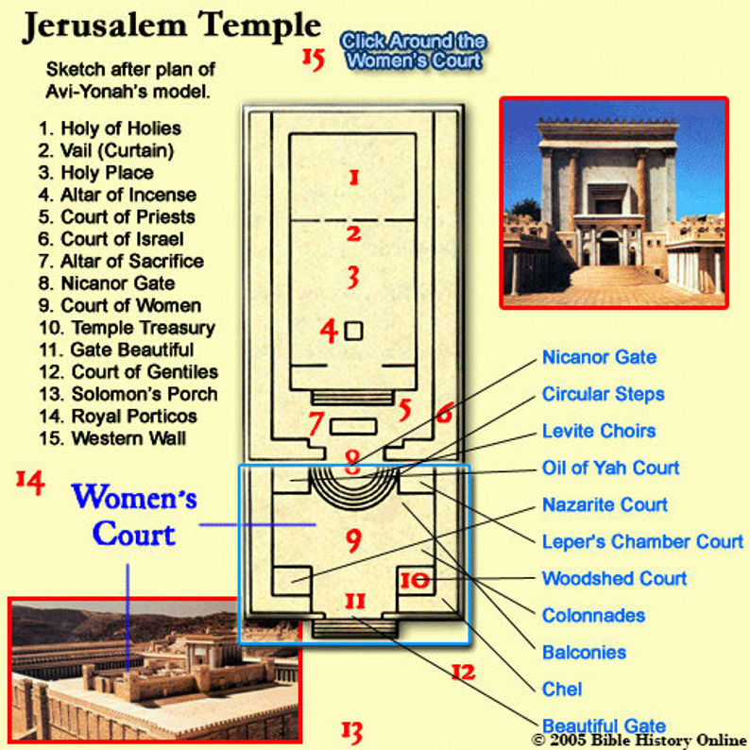

3:1-10 – Peter heals the lame beggar who had never walked.

Slide 3
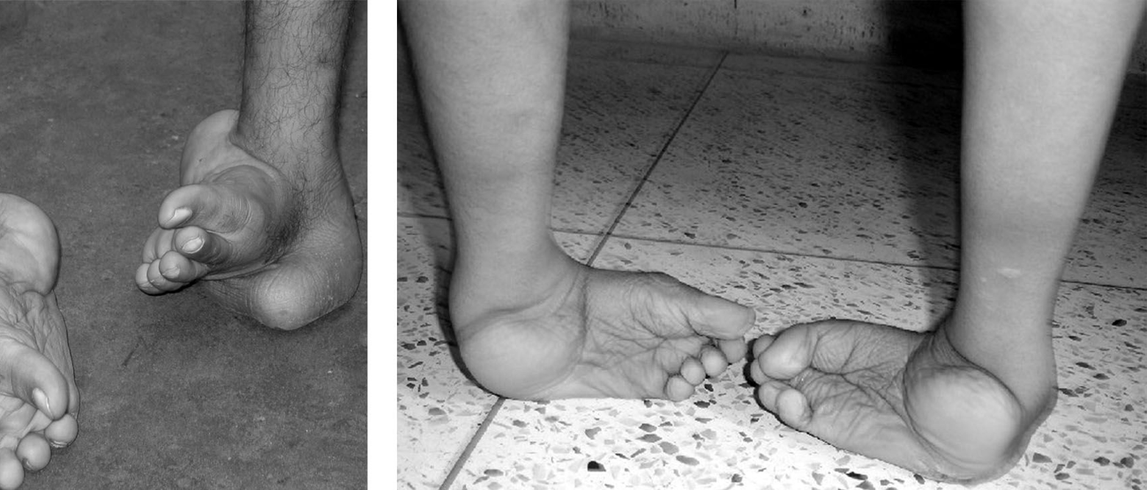

Slide 4
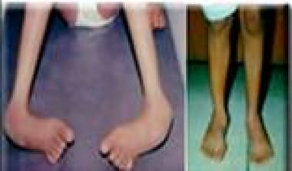
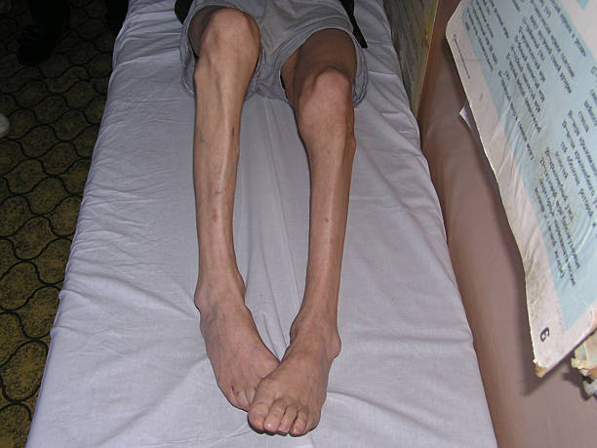
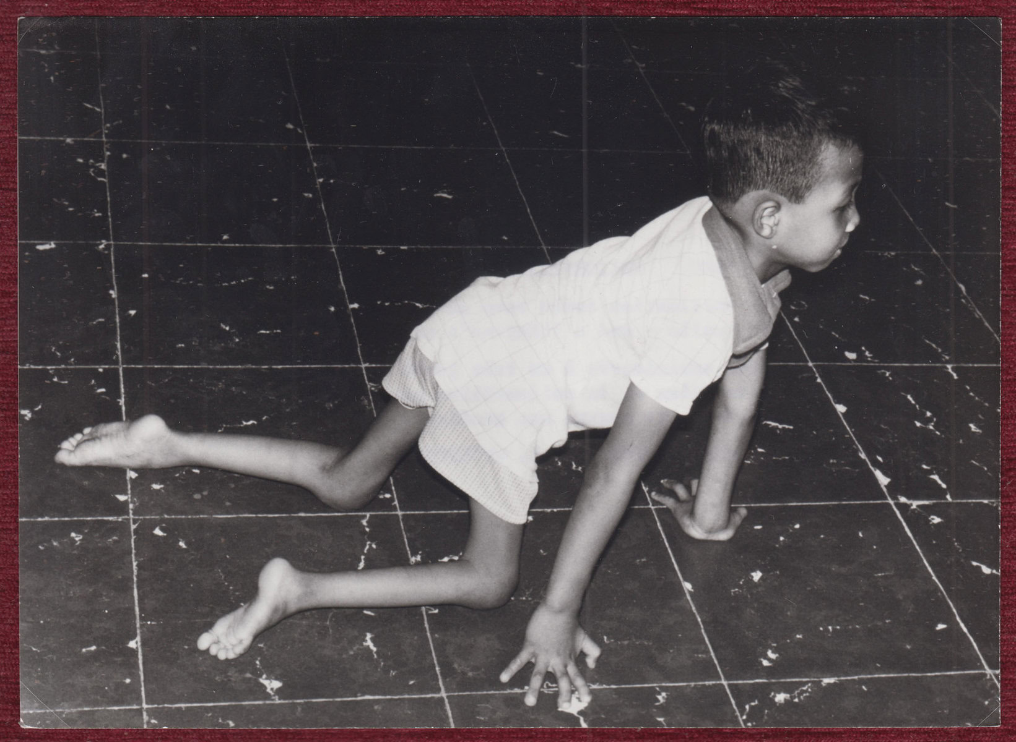

Slide 5
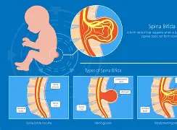

Slide 6
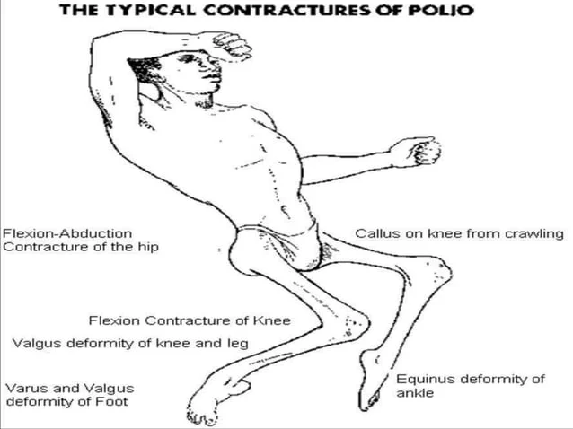


Slide 7
Jewish teaching was that a child being born paralyzed (or
any deformity) was the results of sin by the parents.
The man didn’t ask for healing: he asked for alms.
Peter offers healing “…in the name of Jesus Christ.”
The healed man was walking, leaping, and praising God.

Slide 8
3:11-26 – Peter’s second sermon: at the Temple.
Peter doesn’t mince words and places blame on the people.
Peter states that what healed the man was faith in Jesus.
After giving the basics, Peter tells his audience to repent.
Repentance causes sins to be wiped away forever!
Repentance results in times of refreshing.
There are serious consequences for all those who do not repent.
They can be blessed by turning from their “wicked ways.”

