Slide 1
Walk With the Word
Acts 4

Slide 2
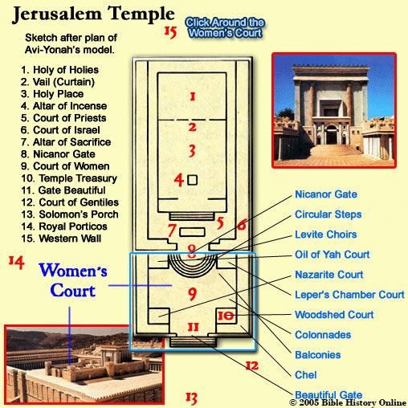
4:1-12 – For proclaiming the resurrection, Peter and John are
imprisoned, but not before 2,000 more believed.

Slide 3
Peter and John are brought before all the “big wigs.”
Note: No one denies that the paralytic man was healed(!)
In responding, Peter was “filled with the Holy Spirit.”
Peter doesn’t mince words: “…whom you crucified….”
Peter declares that only in the name of Jesus can you be saved.

Slide 4
4:13-22 – Ignoring the healing, the leaders command Peter and
John to “speak no longer.”
Peter states, “…we cannot stop speaking….”
4:23-31 – Gathered together, they do not pray for protection,
but that they may “speak Your word with confidence.”
“…They were all filled with the Holy Spirit and began to speak
the word of God with boldness.”
4:32-37 – The “church” considered “all things in common.”

