Slide 1
Walk With the Word
Acts 5

Slide 2
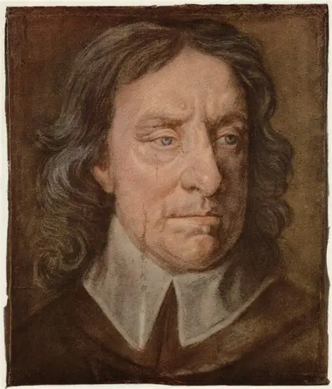

Slide 3
5:1-11 – The terrible fate of Ananias and Sapphira.
Ananias is accused of lying to God and the Holy Spirit.
Sapphira is condemned for agreeing to the deception.
The result of their fate created fear.
5:12-16 – The apostles carry on Jesus’ ministry of healing.
5:17-26 – Imprisonment and miraculous escape of the apostles.

Slide 4
5:27-32 – Peter and the apostles appear before the Council.
Peter responds: “We must obey God rather than men.”
Peter states Jesus offers repentance and the forgiveness of sin.
(Remember, Jews believe only God can forgive sin.)
5:33-42 – Gamaliel’s counsel, and the apostles are beaten.
In their beating, they rejoice at being considered worthy
“suffering shame for His name.”
They keep right on teaching and preaching.

