Slide 1
Walk With the Word
Acts 6

Slide 2
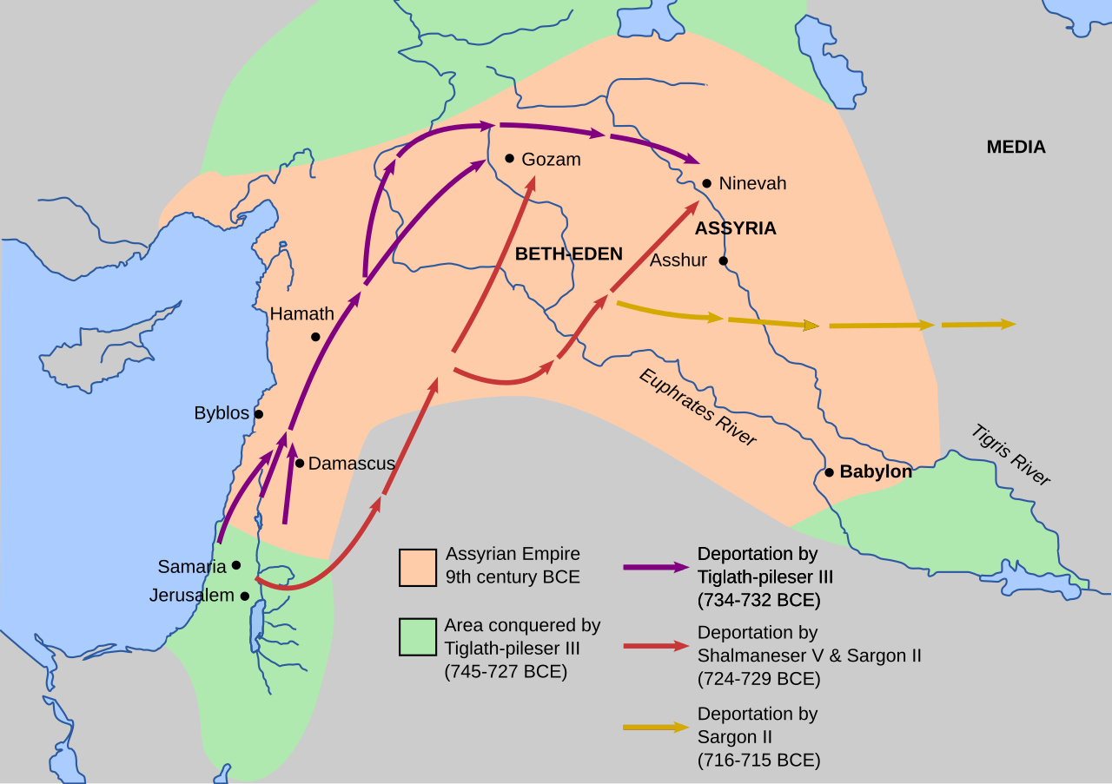

Slide 3
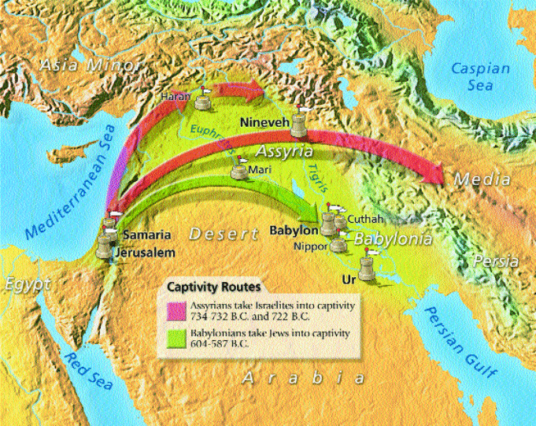

Slide 4
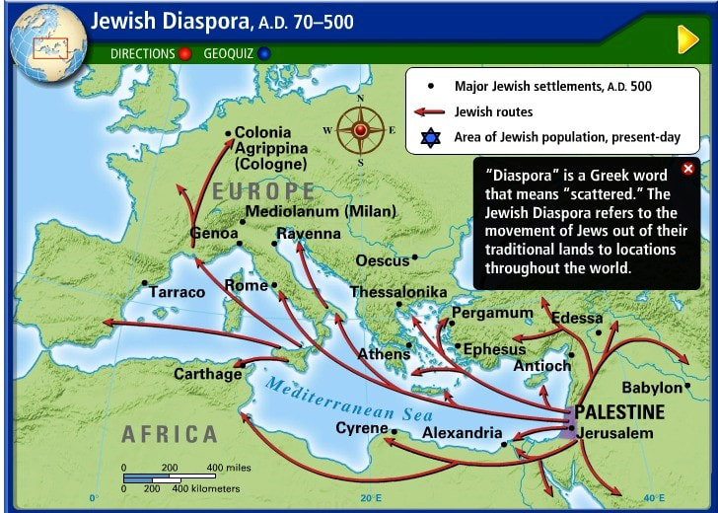

Slide 5
6:1-6 – Choosing the supervising seven.
This organizing of leadership came as a result of a complaint.
This is not the same as a church conflict.
Though not titled, these men do the work of deacons.
The apostles define their (the apostles’) clear mission.
Of the 7 named, more will be said about Stephen & Philip.

Slide 6
6:7 – Verse 7 completes the 1st section of the Book of Acts.
(refer back to 1:8)
Note: “…a great many of the priests believed.”
6:8-15 – The bold preaching (and eventual death) of Stephen,
the first Christian martyr.
Stephen was a “Hellenist,” a Greek cultured Jew.
Stephen was “full of grace and power, and performing great
wonders and signs.”
Stephen is seized and brought before the Council.

