Slide 1
Walk With the Word
Acts 8

Slide 2
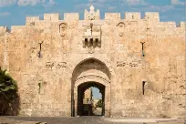

Slide 3
8:1-3 – The church comes under persecution by Saul.
v. 1: The beginning of the 2nd section of Acts:
The gospel spreads throughout Judea and Samaria.
8:4-8 – The apostle Philip takes the gospel to Samaria and
performs “healings” and “signs.”
8:9-13 – Simon the magician becomes a believer.

Slide 4
8:14-17 – Though the Samaritans received “the word of God,”
Philip could not bestow upon them the Holy Spirit.
Point: Only the apostles could bestow the Holy Spirit which
was probably manifested by speaking in tongues.
8:18-24 – Simon offers money to receive the Holy Spirit and
speak in tongues: thus, the term “simony.”

Slide 5
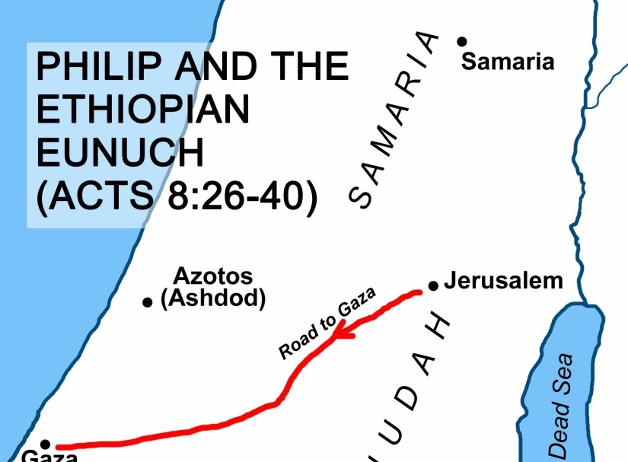
8:25-40 – The Holy Spirit directs Philip to share the gospel with
the Ethiopian eunuch.

Slide 6
8:25-40 – The Holy Spirit directs Philip to share the gospel with
the Ethiopian eunuch.
The eunuch is baptized with water (no mention of tongues).
Philip is “snatched away” (same word as “rapture”) and
eventually settles down in Caesarea. He reappears in Acts
21 as Paul is on his way to Jerusalem. Philip had four
daughters who were prophetesses.

