Slide 1
Walk With the Word
Acts 9

Slide 2
9:1-9 – On the road to Damascus: the conversion of Saul.
Jesus states that persecuting the church is persecuting Him.
9:10-19 – Saul’s blindness is healed through Ananias.
Jesus speaks to Ananias through a vision.
Jesus informs Ananias that Saul is a “chosen instrument,”
and that Saul will “suffer for My name’s sake.”
Through Ananias, Saul is “filled with the Holy Spirit.”

Slide 3
9:20-25 – Saul immediately (?) proclaims Jesus is “Son of God.”
Saul is immediately threatened by “the Jews.”
Saul escapes by being let down “in a basket.”
9:26-31 – In Jerusalem, Saul is befriended only by Barnabas.
Barnabas introduces Paul to the apostles.
Saul’s preaching is rejected by the Hellenists.
In Judea, Galilee, and Samaria, the church grows.

Slide 4
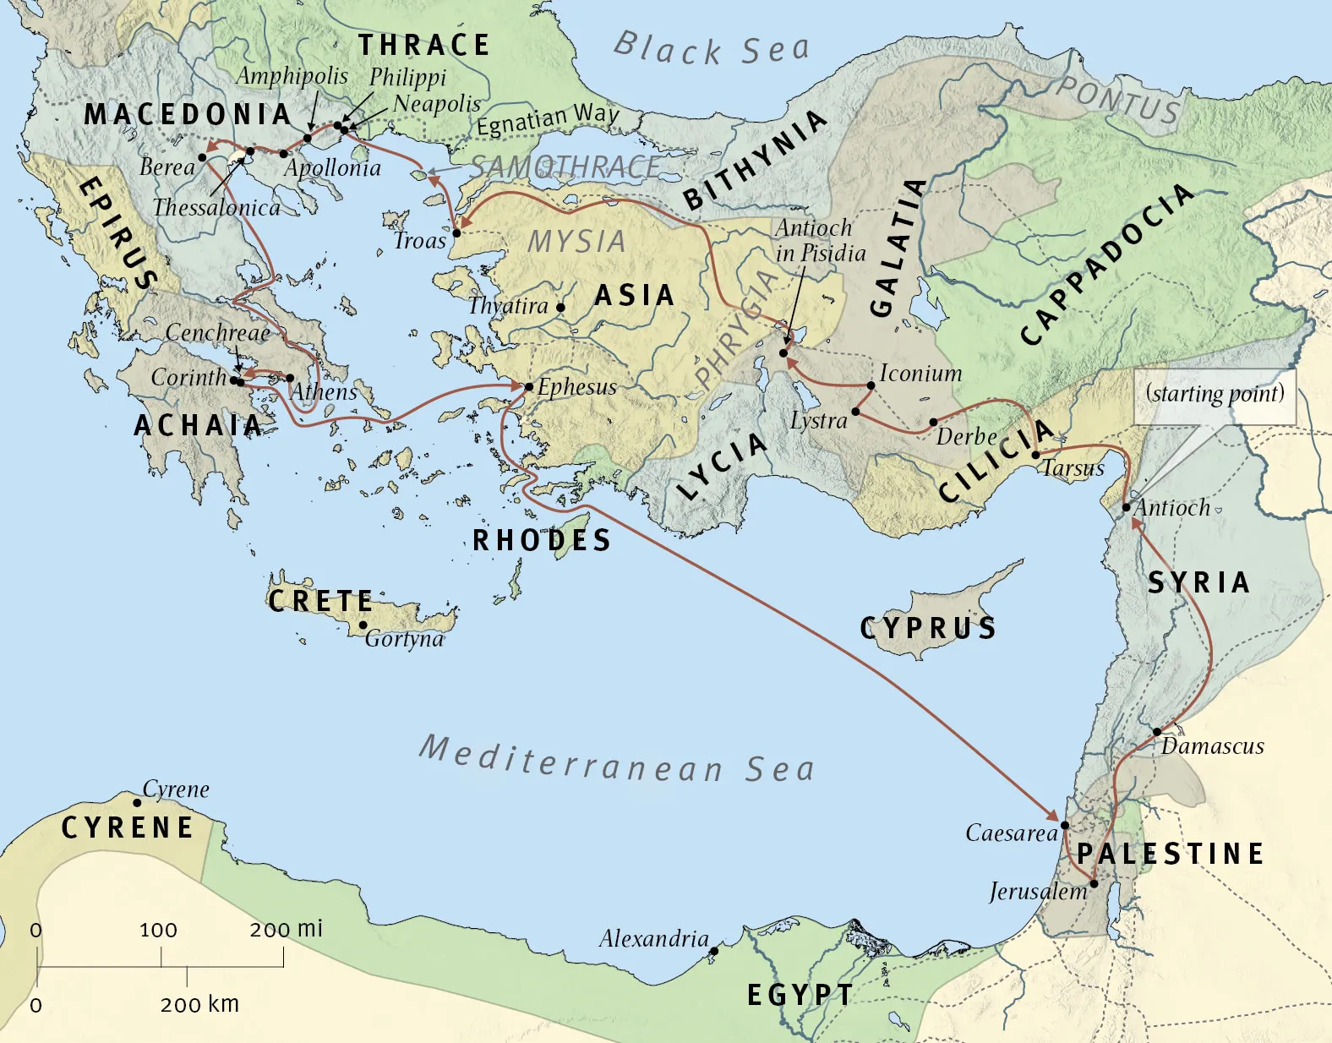

Slide 5
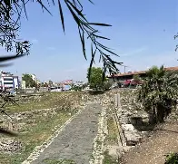


Slide 6
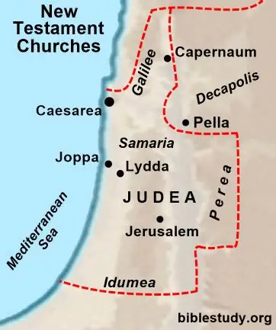
9:32-43 – Peter travels, preaches, and heals in Lydda and Joppa.

Slide 7
9:32-43 – Peter travels, preaches, and heals in Lydda and Joppa.
In Joppa, Peter raises Tabitha from the dead.
This is the first recorded resurrection by an apostle.

