Slide 1
Walk With the Word
John 10

Slide 2
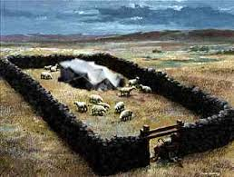
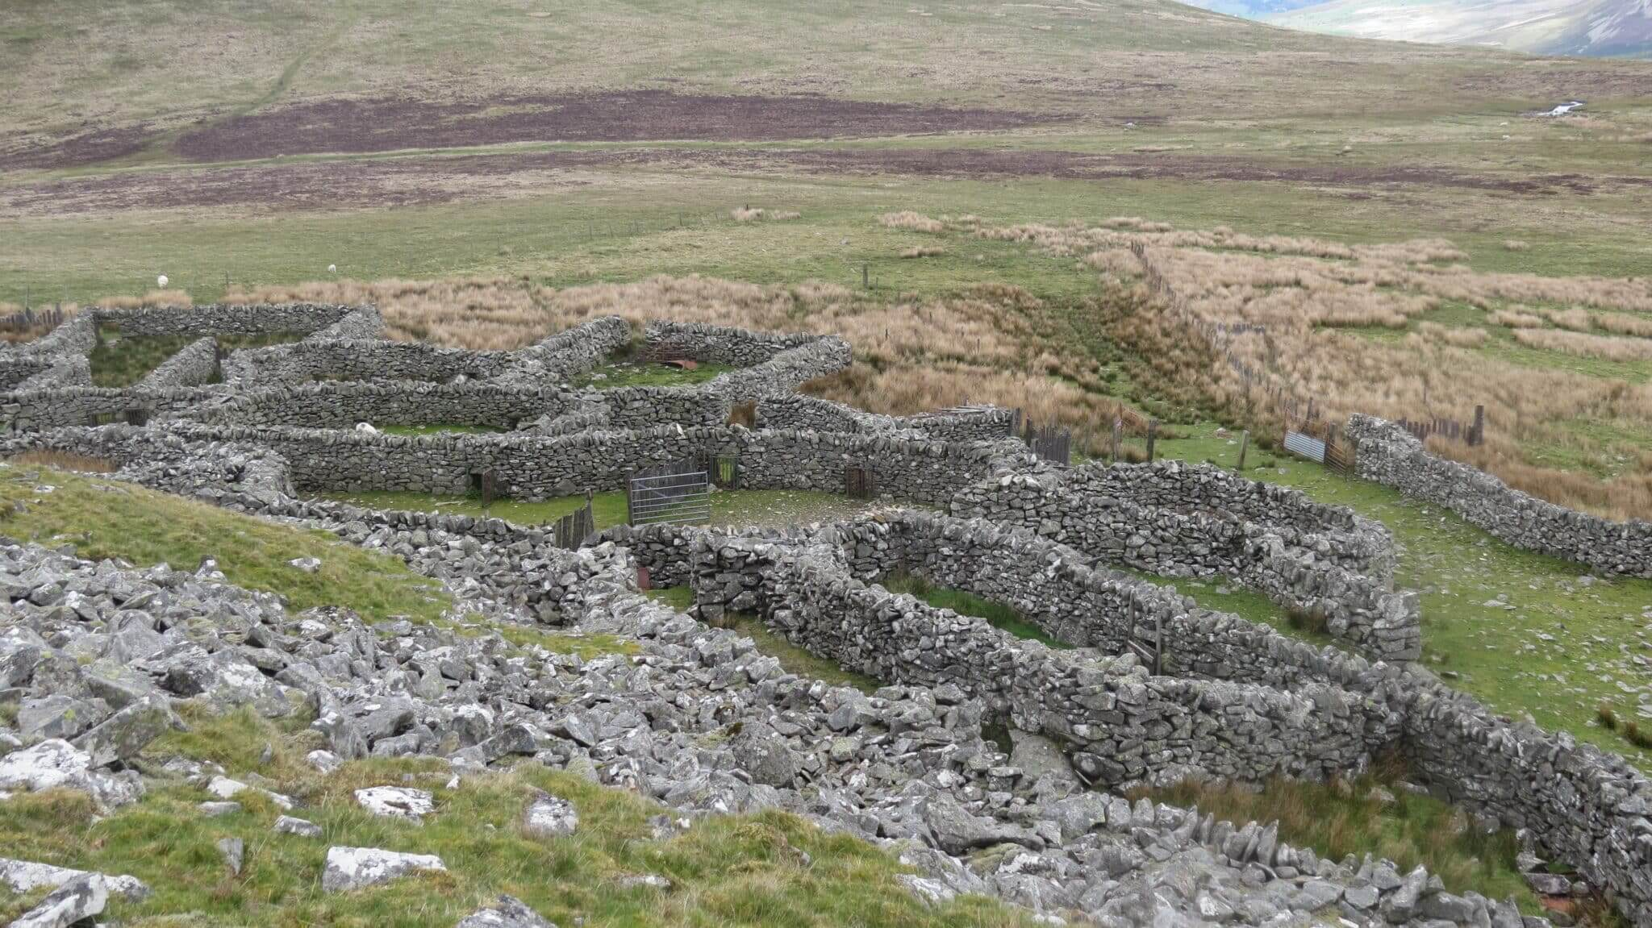
10:1-10 – Jesus’ third “I am”: “I am the door of the sheep.”
Those who enter through “the door” have abundant life.

Slide 3
10:11-21 – Jesus’ fourth “I am”: “I am the good shepherd.”
v. 16: “I have other sheep” probably refers to Gentiles.
Jesus states that for His sheep, He will lay down His life.

Slide 4
10:22-30 – Jesus clearly makes Himself equal to God (v. 30).
Those who don’t believe: they are not Jesus’ sheep.
Two promises for His “sheep”:
1. They will have eternal life.
2. They can’t be snatched away.
Jesus states, “I and the Father are one.”

Slide 5
10:31-42 – Many do not believe despite Jesus’ good works.
Jesus clearly states that He is the Son of God.

