Slide 1
Walk With the Word
John 11

Slide 2
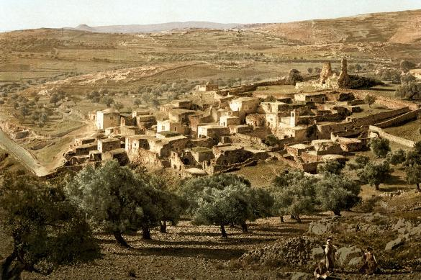
11:1-44 – The death and resurrection of Lazarus.
Bethany
On the eastern slopes of the Mount of Olives just outside Jerusalem

Slide 3
11:1-44 – The death and resurrection of Lazarus.
11:2 – Jesus will be anointed by Lazarus’ sister Mary (12:3)
11:4 – The 1st purpose for delaying: that Jesus will be glorified.

Slide 4

When the news of Lazarus’ sickness reached Jesus, tradition states that Jesus was at the place called Bethabara beyond the Jordan. The distance between Bethany and Bethabara is around 15 to 20 miles, i.e. a day's journey. After receiving the news Jesus stayed there 2 more days before returning.

Slide 5
11:1-44 – The death and resurrection of Lazarus.
11:2 – Jesus had been anointed by Lazarus’ sister Mary.
11:4 – The 1st purpose for delaying: that Jesus will be glorified.
11:11 – Jesus equates physical death with falling asleep.
11:15 – The 2nd purpose for Jesus’ delay: that they may believe.

Slide 6
11:25 – The great declaration of hope for all who believe:
“I am the resurrection and the life.”
5th of the great “I Am’s.” Key word: believe.
11:32 – Mary’s statement: she almost got it right.
11:35 – Jesus’ reaction to Lazarus’ death and their unbelief:
Jesus wept.

Slide 7
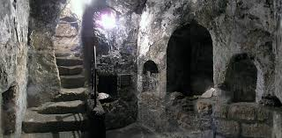

Slide 8
11:25 – The great declaration of hope for all who believe:
“I am the resurrection and the life.”
5th of the great “I Am’s.” Key word: believe.
11:32 – Mary’s statement: she almost got it right.
11:35 – Jesus’ reaction to Lazarus’ death and their unbelief:
Jesus wept.
11:42 – The purpose of Lazarus’ resurrection: “…so that they
may believe.” (“believe” used 9 times)

Slide 9
11:44 – The significance of “Unbind him and let him go.”
A picture of being unbound from sin and death.
11:45 – The result? Many believed in Him.
11:47-57 – The incomprehensible reaction by the priests
and the Pharisees to the raising of Lazarus from the dead:
their reaction is unbelievable!!
11:48 – Their fear? Many more will believe in Jesus.

