Slide 1
Walk With the Word
John 15

Slide 2
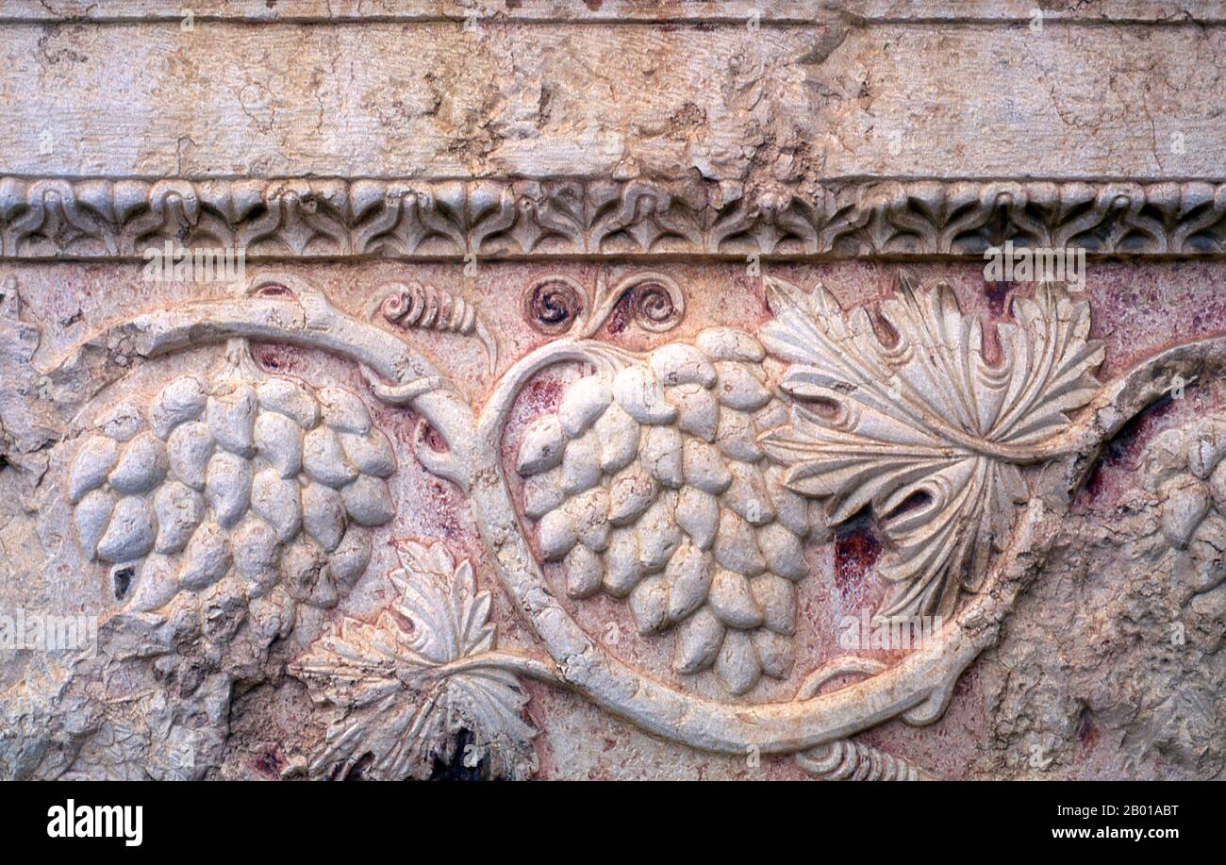

Slide 3
The Seven “I Am’s”
“I am the bread of life” (6)
“I am the light of the world” (8)
“I am the door of the sheep” (10)
“I am the good shepherd” (10)
“I am the resurrection and the life” (11)
“I am the way, the truth, and the life” (14)
“I am the true vine….” (15)

Slide 4
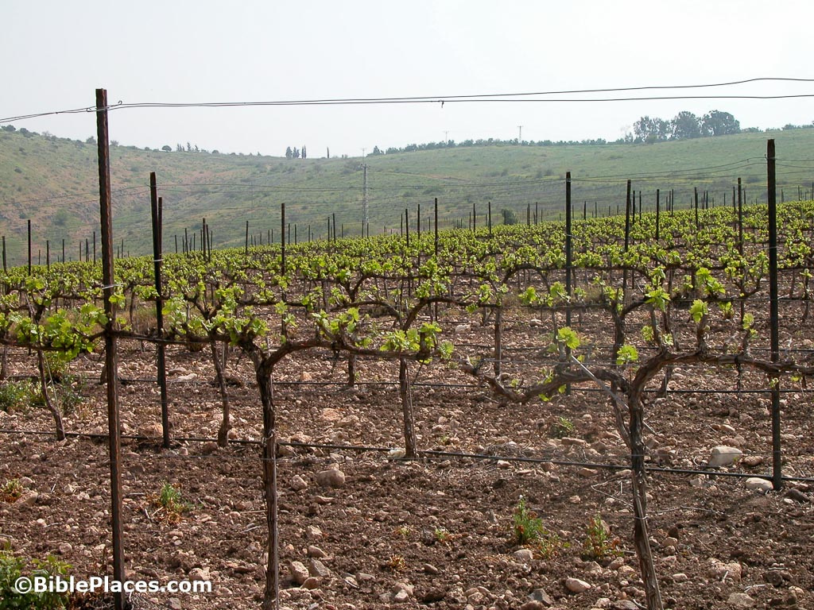
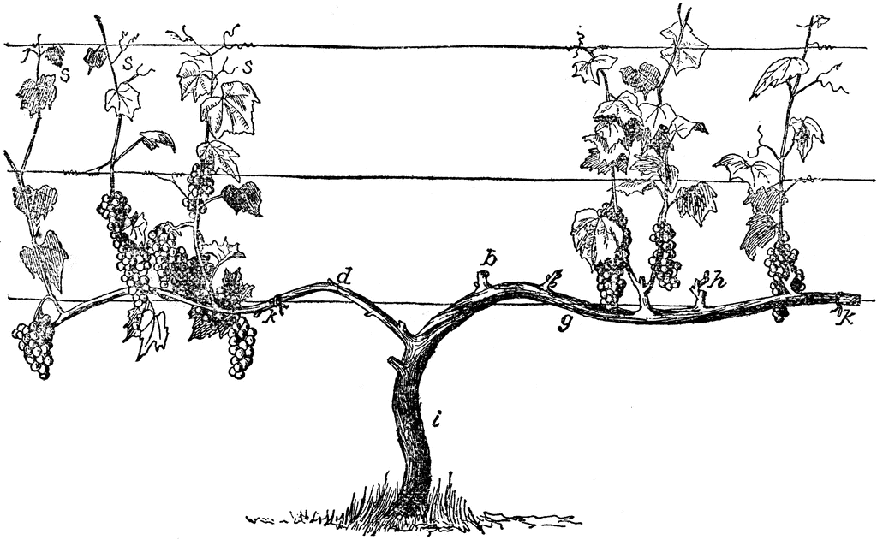
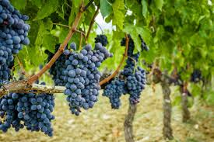
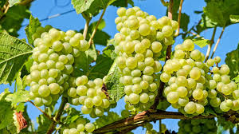

Slide 5
15:1-11 – The disciples’ relationship to Jesus.
The key to bearing fruit for Jesus: abide in Him.
To “abide” means to make Him your dwelling place.
What made the disciples “clean” was Jesus’ words.
The result & proof of abiding in Christ is to bear fruit.
v. 7: We must assume that there are conditions
and that this verse applies primarily to the disciples.

Slide 6
The way to glorify God is to bear fruit for the kingdom.
To abide in Jesus is to keep His commandments.
What is the commandment? Love one another.
To love and keep His commandment is the path to joy.

Slide 7
15:12-17 – The disciples’ relationship to each other.
Jesus reveals the commandment that sums up the Law:
love one another.
The greatest love is to be willing to sacrifice for Jesus.
To love as Jesus loves is to move from “slave” to “friend.”
v. 16: We must assume that this applies to the disciples.
Jesus’ final command: love one another.

Slide 8
15:18-24 – The disciples’ relationship to the world.
There’s a price to pay for loving and obeying Jesus.
True followers of Jesus will be hated by the world.
15:26-27 – The disciples’ relationship to the Spirit.
Holy Spirit is the Spirit of truth.

