Slide 1
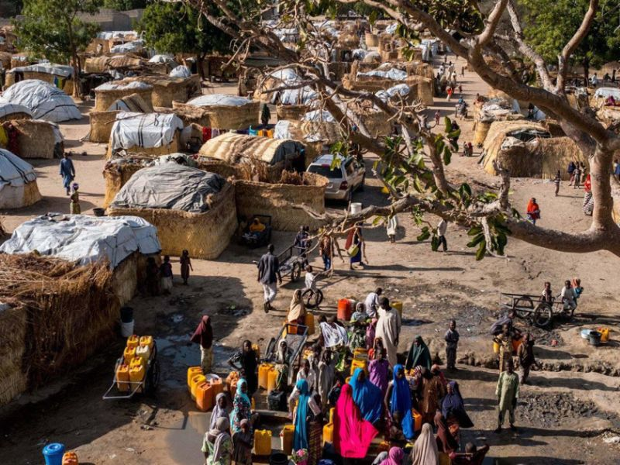

Slide 2
Walk With the Word
John 18

Slide 3
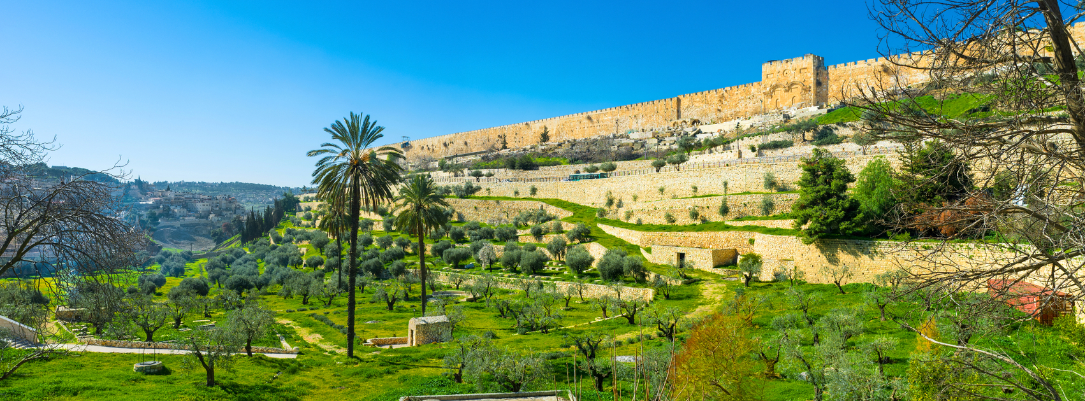

Slide 4
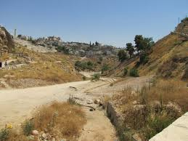
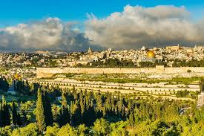

Slide 5


Slide 6
18:1-14 – The Kidron Valley: tainted w/ blood from sacrifices.
(Where David fled when he was betrayed by Absalom.)

Slide 7
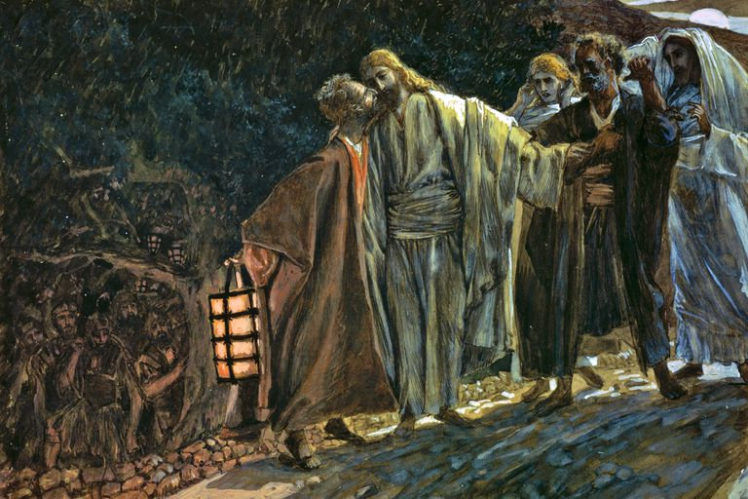
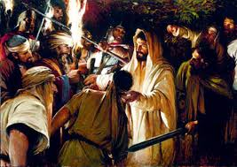

Slide 8
Jesus answers those seeking to arrest Him as “I am He.”
Jesus is arrested and taken to Annas, then to Caiaphas who advised
“one man should die.”

Slide 9
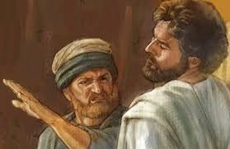
18:15-27 – Peter & John follow Jesus to the high priest Annas.
Jesus answers Annas with fact but is struck.

Slide 10
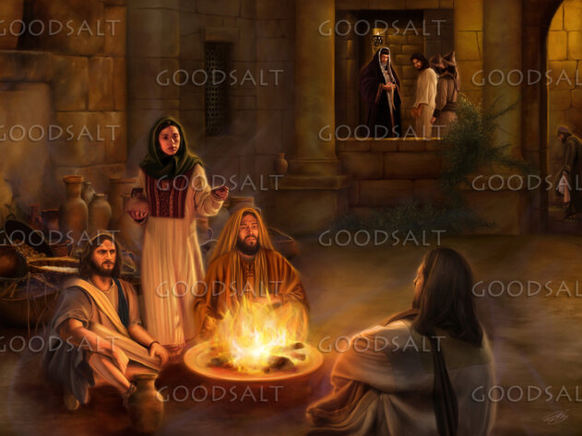
v. 17 – Peter’s first denial: “I am not....”

Slide 11

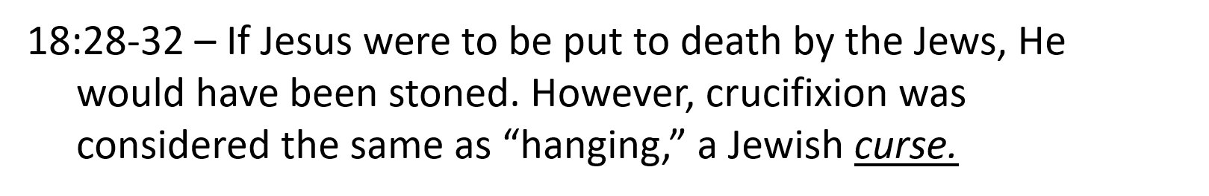
Jesus is sent to Caiaphas.
v. 25 – Peter’s second denial: “I am not….”
v. 26 – Peter’s third denial to Malchus’ relative.

Slide 12
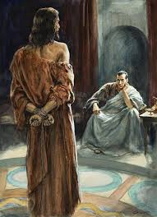
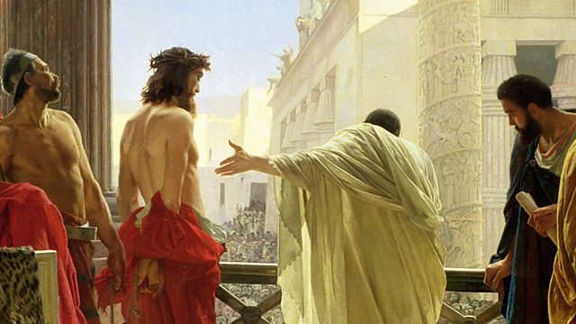
18:33-40 – By taking Jesus inside the Praetorium, Jesus is made unclean.
Pilate confronts Jesus: “Are you the king of the Jews?”
Jesus acknowledges He is a king, but not “of this world.”
Jesus states that He is king of the truth.
Pilate’s question about “the truth” is never answered.
Pilate finds “no guilt.”

Slide 13


