Slide 1
Walk With the Word
John 19

Slide 2
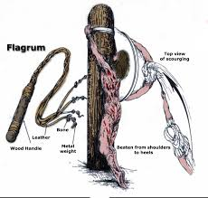
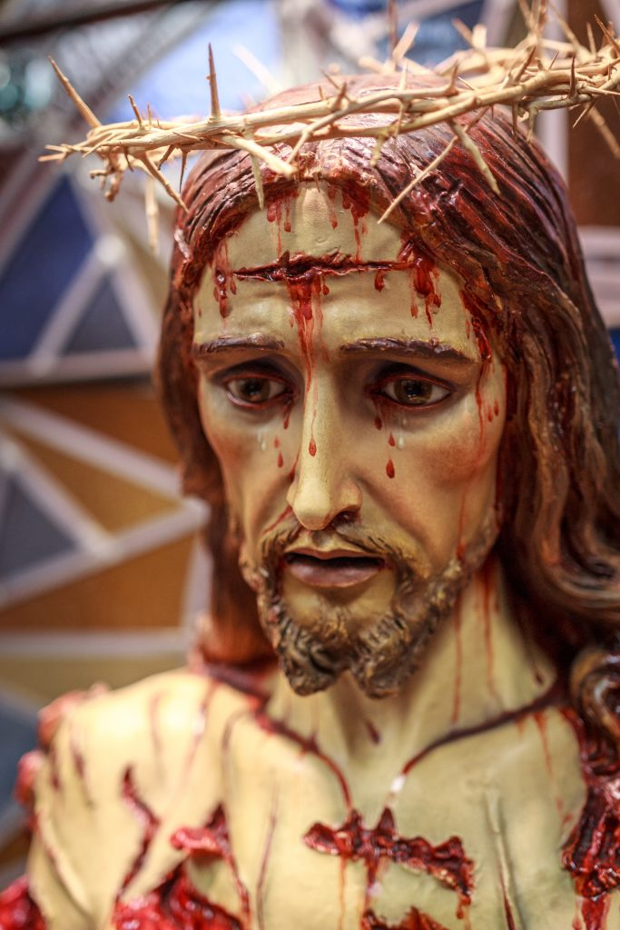
19:1-16 – After Jesus’ meeting w/ Pilate, Jesus is scourged.
The act of scourging took a victim near death.

Slide 3
Pilate interviews Jesus again and claims “no guilt.”
Jesus states Pilate’s authority has been given “from above”:
this puts Pilate in greater responsibility.
Pilate is intimidated by the crowd: “You are no friend of Caesar!”

Slide 4
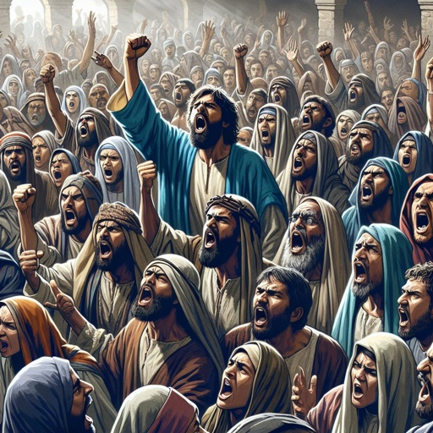
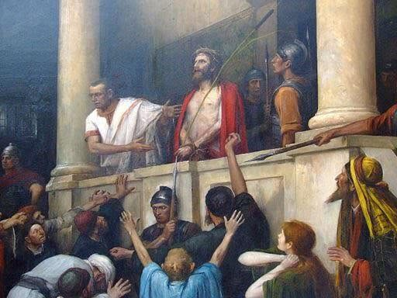
Pilate tells the crowd, “Behold, your king!” But the crowd
cries out, “We have no king but Caesar!”

Slide 5
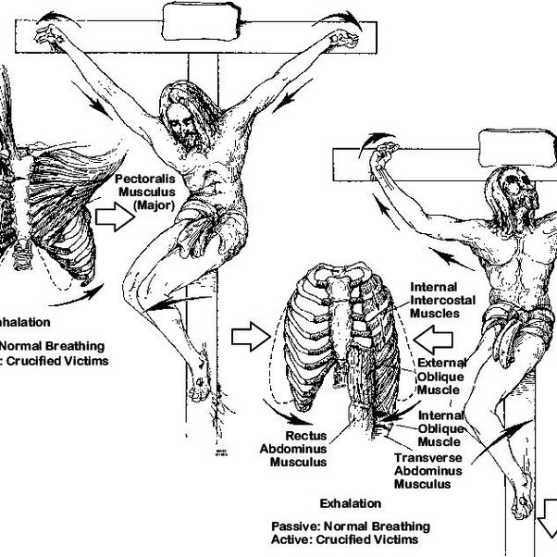
19:17-30 – Jesus is taken to be crucified at Golgotha.
Pilate commands the inscription: “Jesus the Nazarene, the
king of the Jews.”

Slide 6
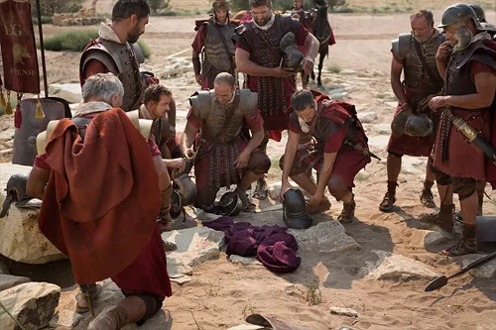
The soldiers cast lots for Jesus’ tunic: fulfills Psalm 22:18.

Slide 7
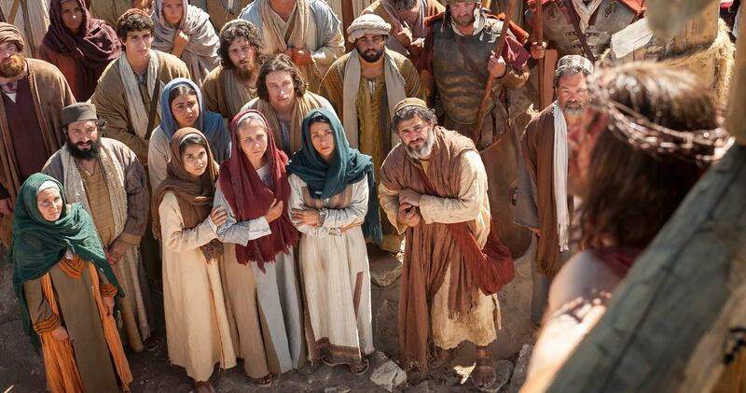
At the scene of the cross, there were 4 women and John.

Slide 8
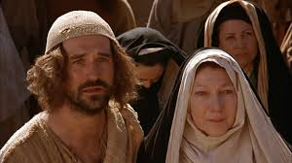
Jesus instructs John to look after His mother.

Slide 9
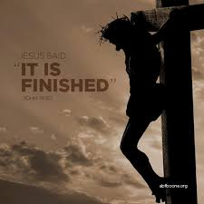
Jesus declares,
“It is finished!”

Slide 10
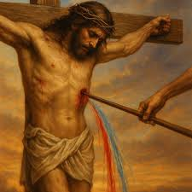
19:31-42 – Jesus’ legs are not broken: this fulfills Psalm 34:20.
When Jesus’ side was pierced, out flowed blood and water.

Slide 11
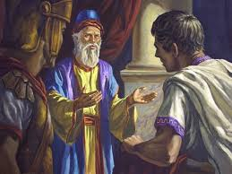
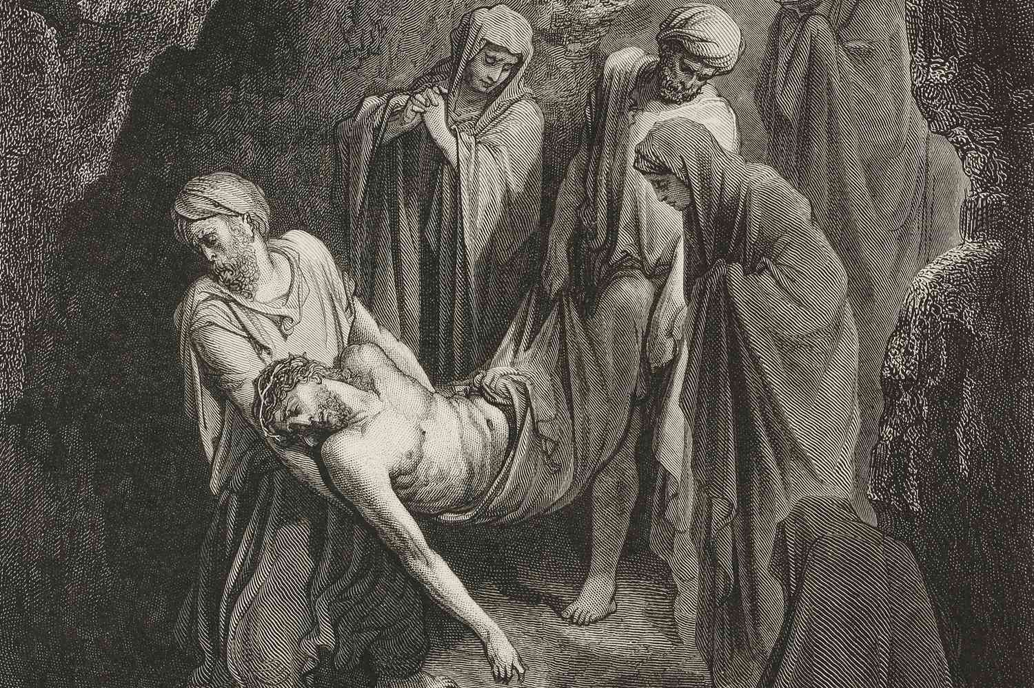
Jesus is prepared for burial by Joseph and Nicodemus.

Slide 12
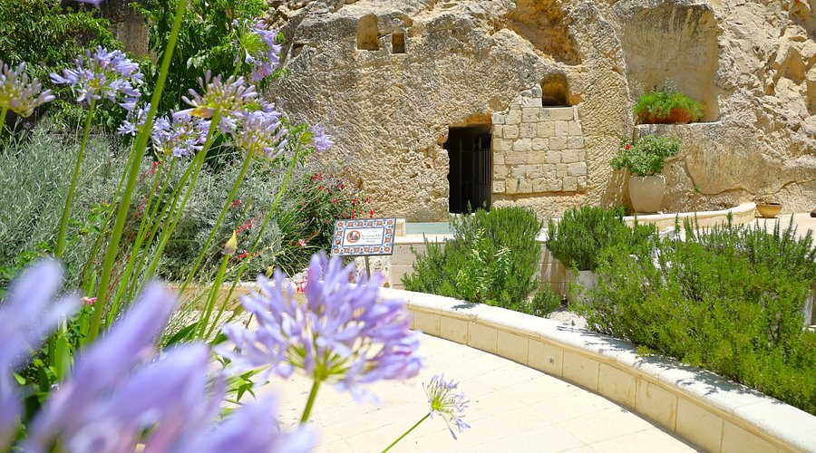
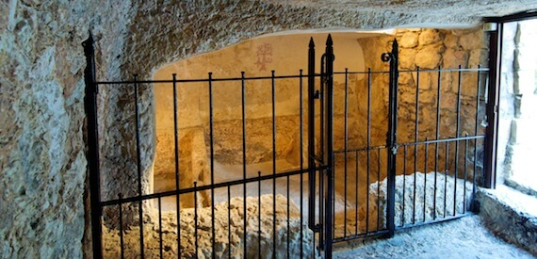
Jesus in entombed in the Garden of Gethsemane.

