Slide 1
Walk With the Word
John 21

Slide 2
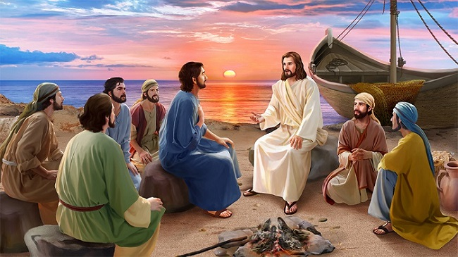
21:1-14 – Jesus appears to 7 disciples at the Sea of Galilee.

Slide 3
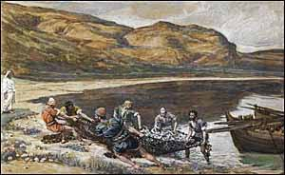
The leader of the group of disciples is clearly Peter.
Their fishing efforts are fruitless: they catch nothing.
Jesus instructs them to cast their nets on the other side.
They catch many, many fish: Peter realizes it is Jesus.

Slide 4
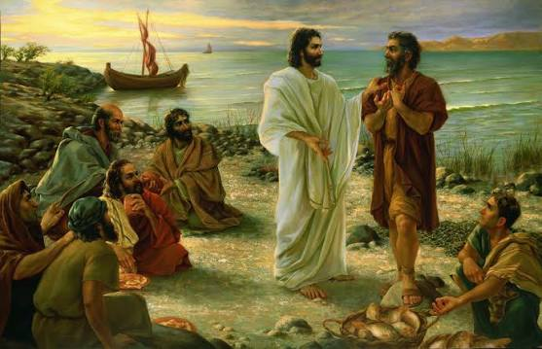
21:15-17 – Jesus’ commission to Peter.
Three times Jesus asks Peter, “Do you love Me?”
Jesus’ command indicates He has many “sheep” and Peter is
to “tend” and “feed them.”

Slide 5
21:18-23 – Jesus discloses to Peter his future life and death, and
commands Peter to “follow Me!”
Peter questions Jesus about John: Jesus once again instructs
Peter to “follow Me!”

