Slide 1
Walk With the Word
John 3

Slide 2
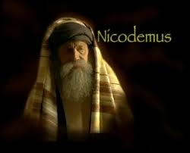
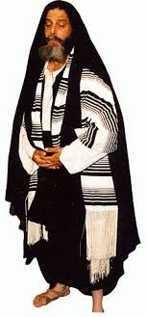
3:1-15 – Jesus is questioned by Nicodemus.

Slide 3
3:1-15 – Jesus is questioned by Nicodemus.
Jesus declares that a person must be born again.
“Born again” means being “rebirthed” by the Holy Spirit.
If not born by “the Spirit,” you cannot enter the kingdom.
To be born again? One must believe in Jesus.
“To believe: ____ x to this point, ____x in John’s gospel!

Slide 4
3:16-21 – Introduction that Jesus is the Light (1:4-5)
“Light” is revelation from God about who He is (His true
nature), what man is in relationship to Him, and how to
restore that relationship through Jesus: it is truth.
John affirms God “loves the Son” and speaks truth through Him.

Slide 5
3:22-36 – The on-going testimony of John the Baptist.
John gleefully refers to Jesus as the “bridegroom”: that is, the
long-awaited for King & Messiah.
John affirms God “loves the Son” and speaks truth through Him.

