Slide 1
Walk With the Word
John 4

Slide 2
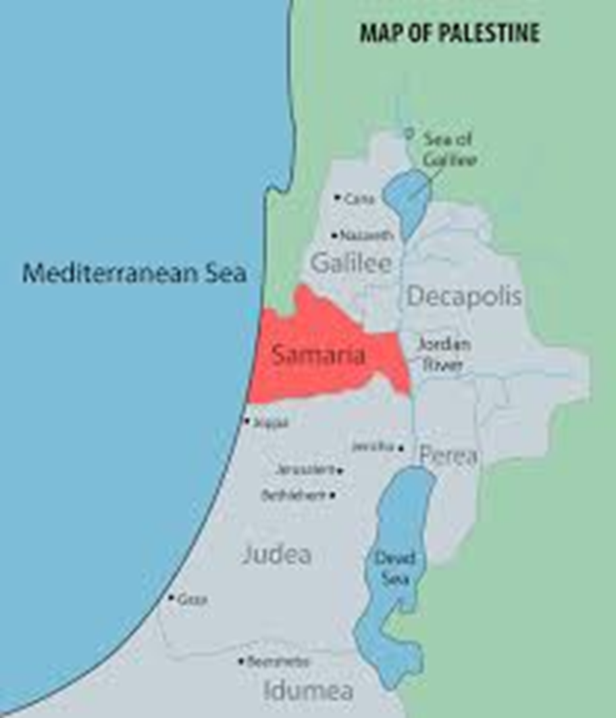
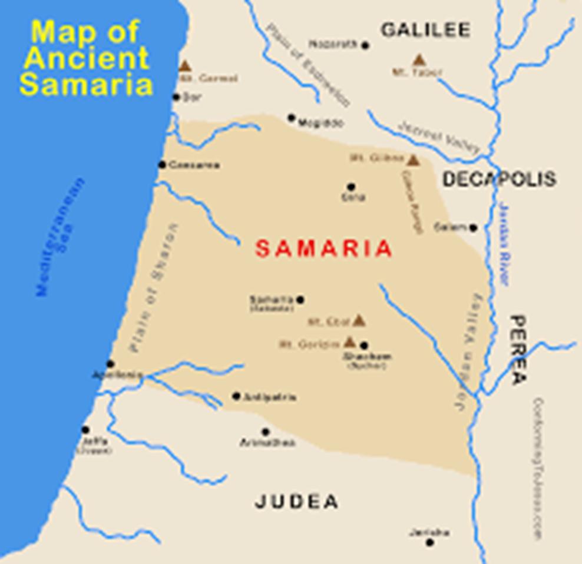

Slide 3
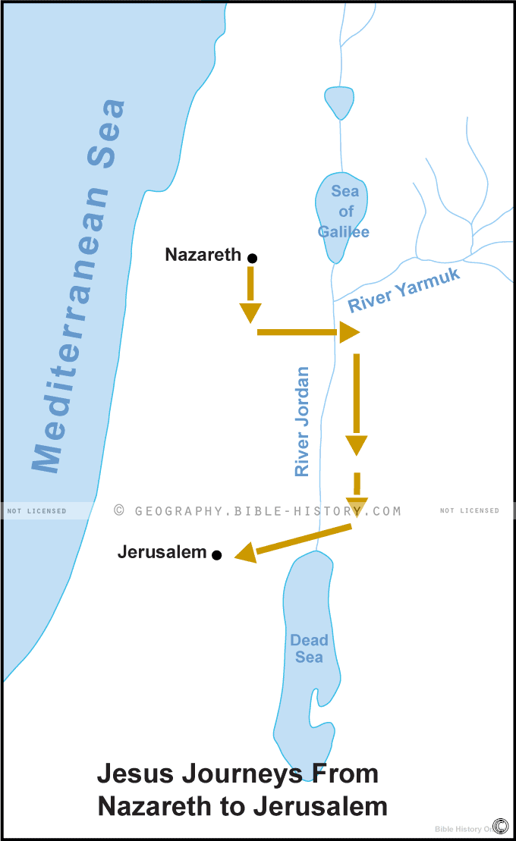











The
Normal
Route
But Jesus
heads to
Samaria
Sychar

Slide 4
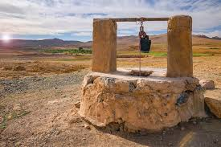

Slide 5
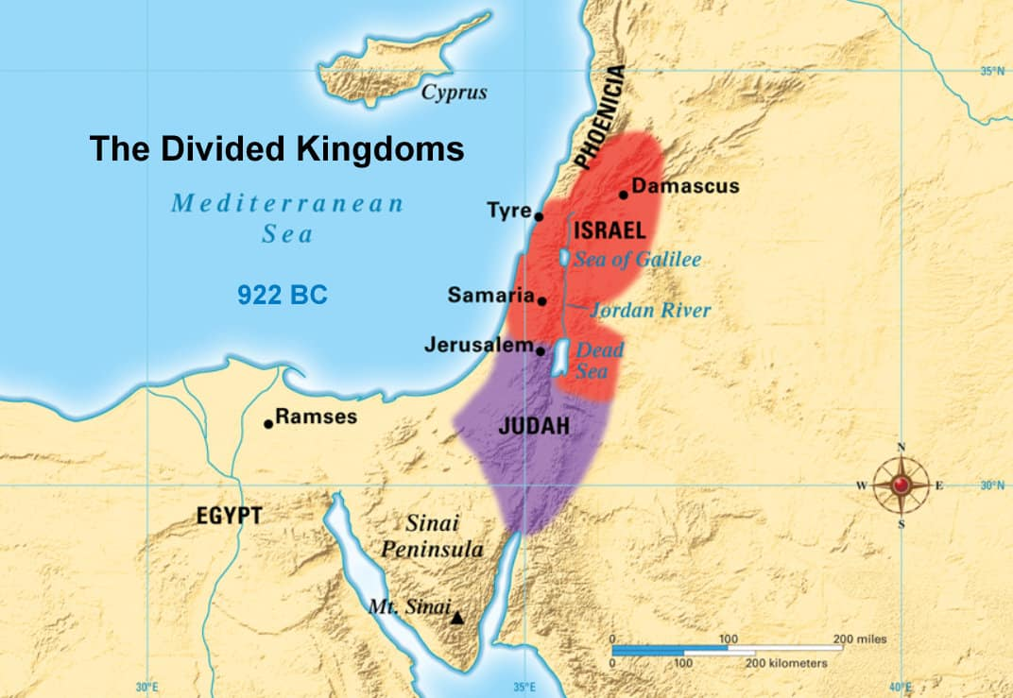
The Samaritans were partly Jew and partly Gentile.
In 722 B.C., they were brought in by the King of Assyria.
Northern Kingdom
conquered by the
King of Assyria
(Shalmaneser)

Slide 6
The
Normal
Route
But Jesus
heads to
Samaria

Slide 7
Sychar
7

Slide 8
Jesus likens the well to Himself and the water to eternal life.
First, Jesus raises the most serious issue: personal sin.
Jesus clarifies the truth: “salvation” comes only through the Jews.
(An indirect way of saying salvation comes only through Him.)

Slide 9
4:31-38 – Jesus states what comes first: the will of God.
4:39-42 – Jesus stays and teaches in unclean territory!
4:43-54 – A healing situation that John presents to emphasize
once again that to be saved (healed), you must believe.

