Slide 1
Walk With the Word
John 5

Slide 2
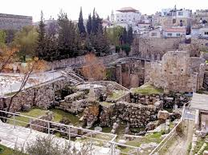
5:1-18 – Jesus heals the paralytic on the Sabbath.
The Pool at
Bethesda

Slide 3
Jesus commands the paralytic to carry his pallet.
Jesus attributes this man’s paralysis to sin.
Jesus states that He and the Father are working.

Slide 4
5:19-29 – The Jewish leaders are incensed that Jesus refers to
God as His Father, making Him equal to God.
Jesus states believing in Him overrides the Law.
Believing in Him results in resurrection.

Slide 5
5:30-47 – The five “witnesses”:
5:32-35 – John the Baptist
5:36 – Jesus’ works
5:37-38 – God’s voice
5:39-40 – The Scriptures
5:41-47 – Moses
Key words: “…you do not believe.”
All one has to do to receive eternal life is to believe.

