Slide 1
Walk With the Word
John 7

Slide 2
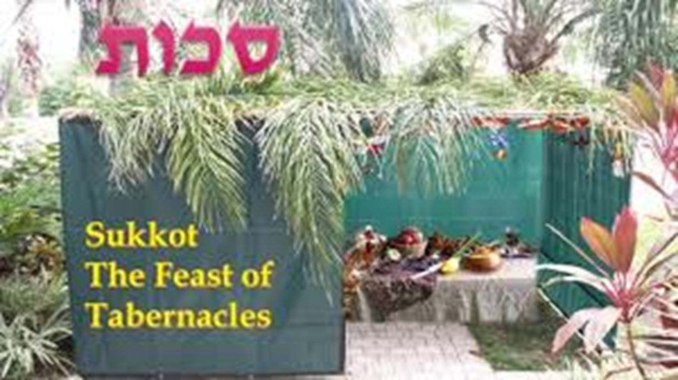
7:1-9 – Jesus prepares for a trip to Jerusalem.

Slide 3
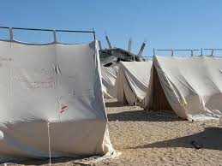
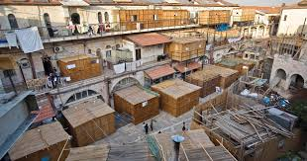
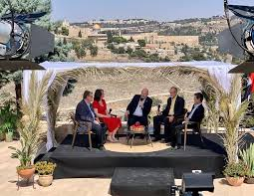

Slide 4
7:1-9 – Jesus prepares for a trip to Jerusalem.
v. 4 echoes the 3rd temptation by Satan.
v. 7: Jesus identifies the problem w/ the world: its works are evil.
7:10-18 – Jesus follows His brothers into Jerusalem secretly.
The key to His teaching: “If anyone is willing to do His will….”

Slide 5


Slide 6
7:19-24 – Jesus exposes the Jew’s inconsistency with the Law.
7:25-31 – Jesus declares plainly, “I am from Him.” (v. 29)
7:32-36 – Jesus predicts His crucifixion.
7:37-39 – Jesus predicts the coming of the Holy Spirit.
7:40-53 – Confusion of the “officers” over who Jesus is.
52: “Galilee” – an error of prejudice.

