Slide 1
Walk With the Word
Luke 1

Slide 2

1:1-4 – Luke, the physician, introduces his accurate account

Slide 3
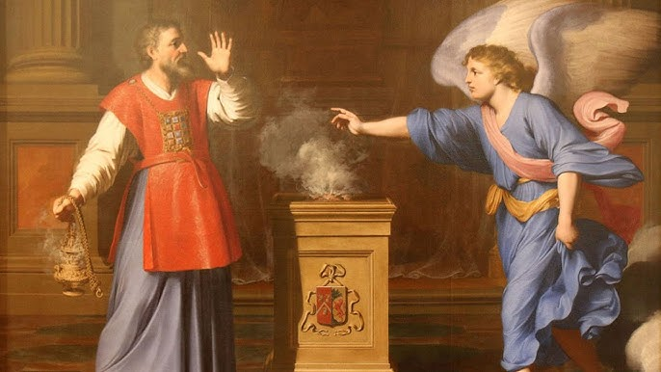
1:5-25 – The angelic announcement: the birth of John the Baptist.

Slide 4
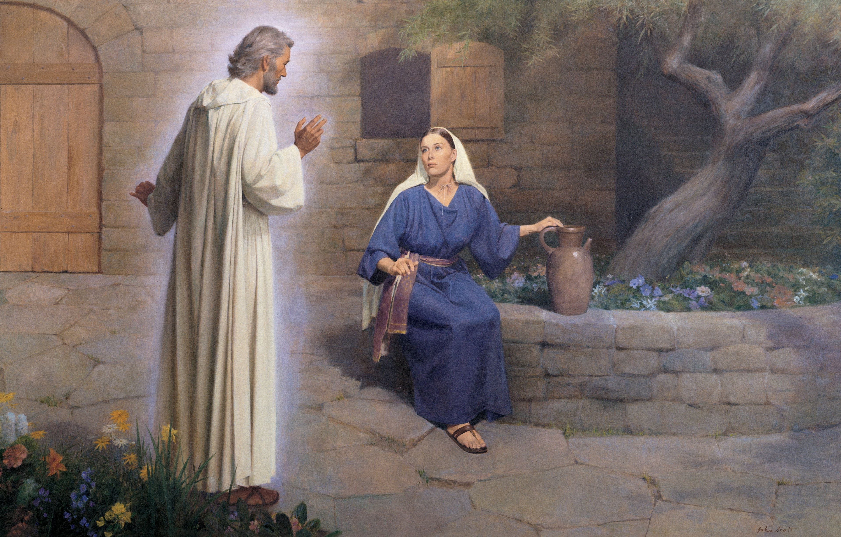
1:26-38 – The angelic announcement: the birth of Jesus.

Slide 5
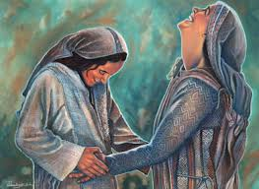
1:39-56 – Mary visits Elizabeth, and Mary’s song.

Slide 6
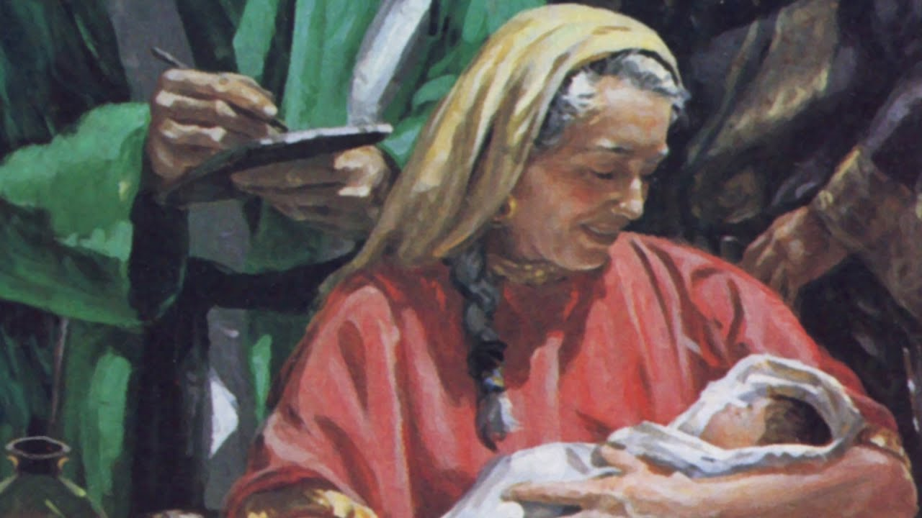
1:57-66 – The birth of John the Baptist.

Slide 7
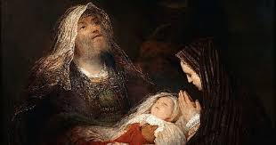
1:67-79 – The prophecy of Zechariah.

Slide 8

1:80 – The life of John the Baptist, the last Old Testament prophet.

