Slide 1
Walk With the Word
Luke 13

Slide 2
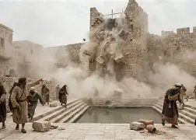
The Tower
of
Siloam
13:1-9 – Not every bad thing that happens is the result of sin.
We all sin and need to repent.
To repent means to turn oneself around.

Slide 3
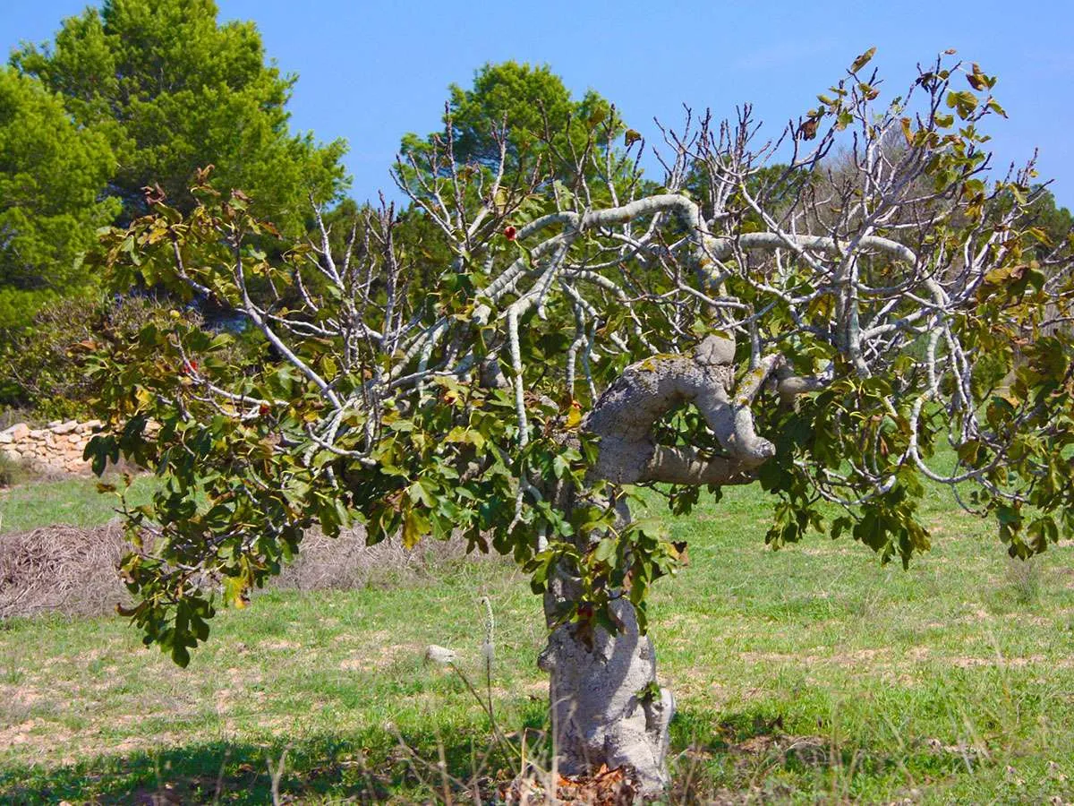

Slide 4
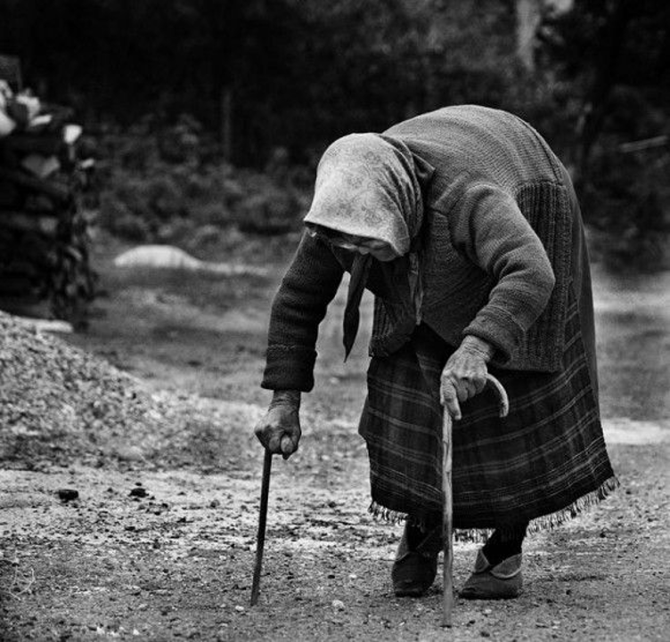
13:10-17 – The ruler’s objection: Jesus healing on the Sabbath.
The Sabbath precedent: their laws overrule caring.

Slide 5
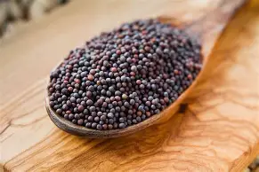
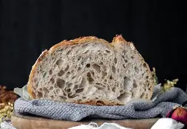
13:18-21 – The kingdom of God is like mustard seed and leaven.
Point: It only takes a little to bear much fruit.

Slide 6
13:22-30 – Teaching on who will be accepted into the kingdom of God.
Acceptance isn’t automatic just because they are Jewish.
The kingdom of God is open to all people.

Slide 7
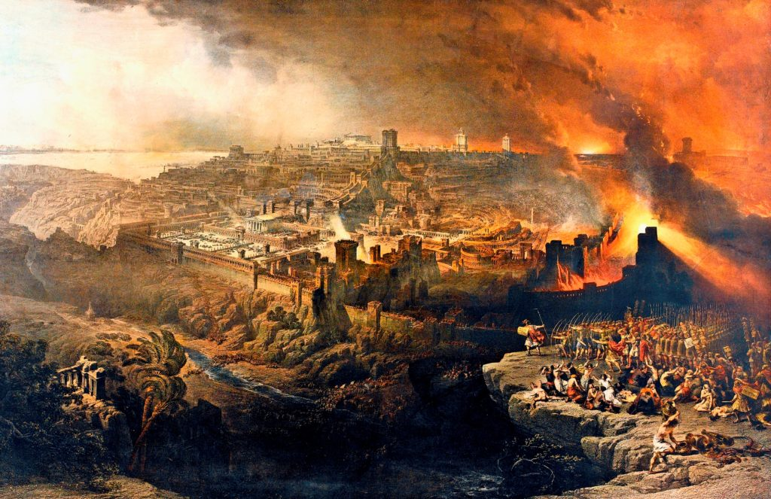
13:31-35 – Jesus laments over Jerusalem.

