Slide 1
Walk With the Word
Luke 14

Slide 2
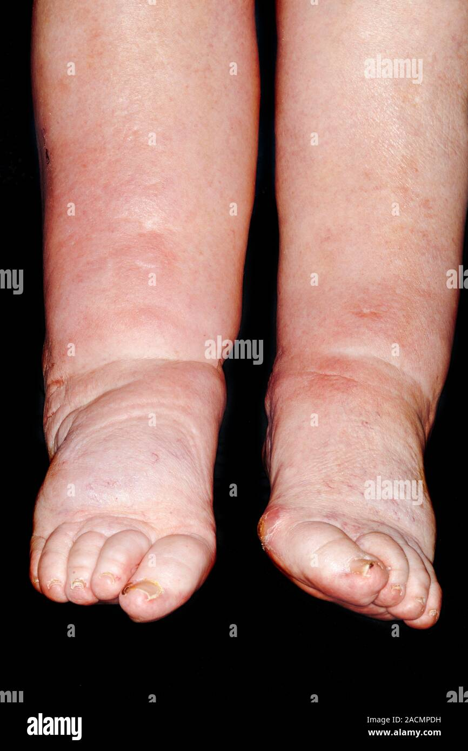
14:1-6 – Again, the issue of healing on the Sabbath.
The issue? Turning common sense behavior into sin.

Slide 3
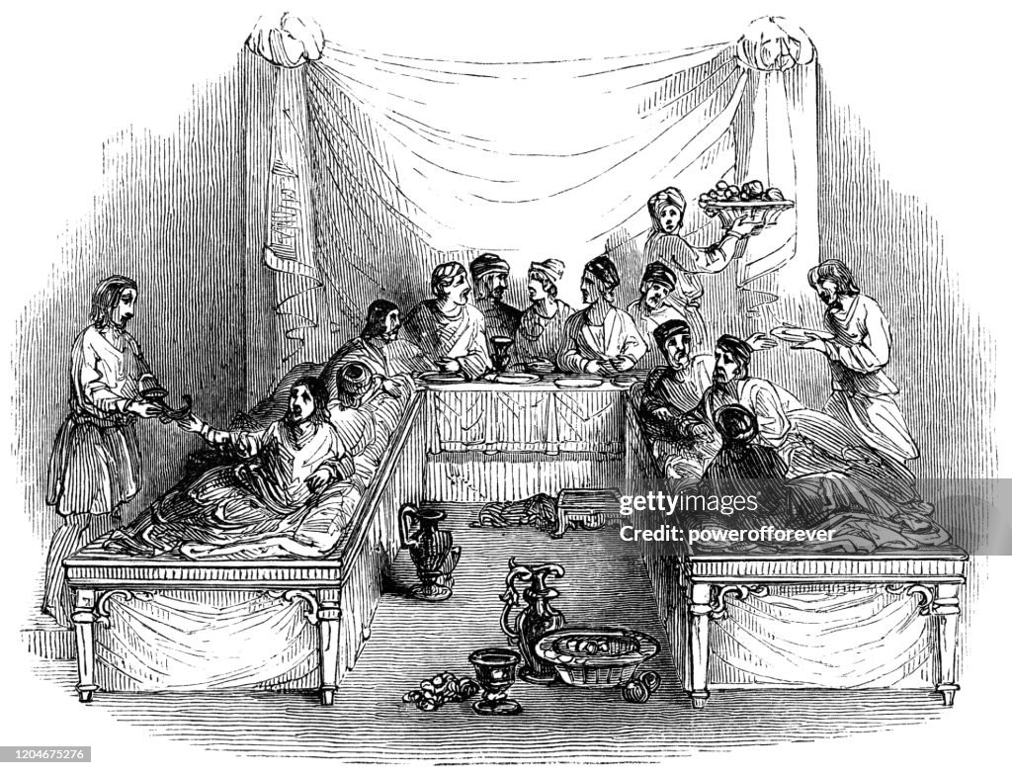
14:7-11 – The trappings of showing favoritism.
In God’s kingdom, true “places of honor” are the lowest.

Slide 4
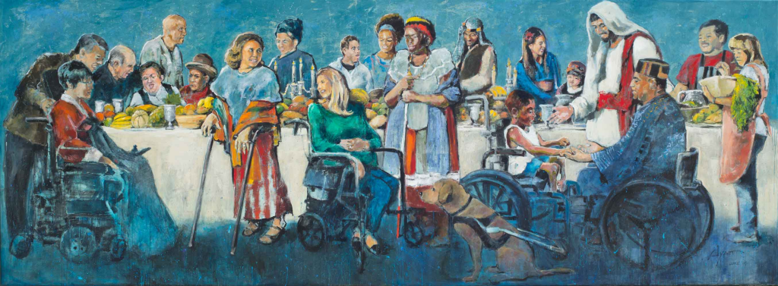
14:12-24 – The parable of the dinner invitation.
A picture of God offering salvation to the nation of Israel.
Some will find any excuse to reject or ignore God’s invitation.
God offers the kingdom to all. Those who do respond know
they have a need.

Slide 5
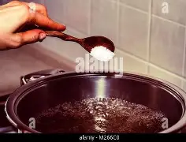
14:25-35 – The true cost of following Jesus.
Truly following Jesus doesn’t happen without a cost.
Salt can lose its “saltiness” when it is diluted.

