Slide 1
Walk With the Word
Luke 15

Slide 2
15:1-7 – The parable of the lost sheep.
The distain of the “righteous” toward the “unrighteous.”
Scribes/Pharisees: focused on rules rather than people.
The key concept: sinners and “the righteous” need repentance.

Slide 3
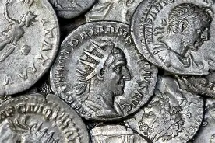
15:8-10 – The parable of the lost coin.
There is “joy” in heaven over one sinner who repents.

Slide 4
15:11-32 – The parable of the lost son.
He willfully chose to leave his father and squander his estate.
He found himself in circumstances he knew were hopeless.
He “came to his senses” and repented.
His waiting father felt compassion.

Slide 5
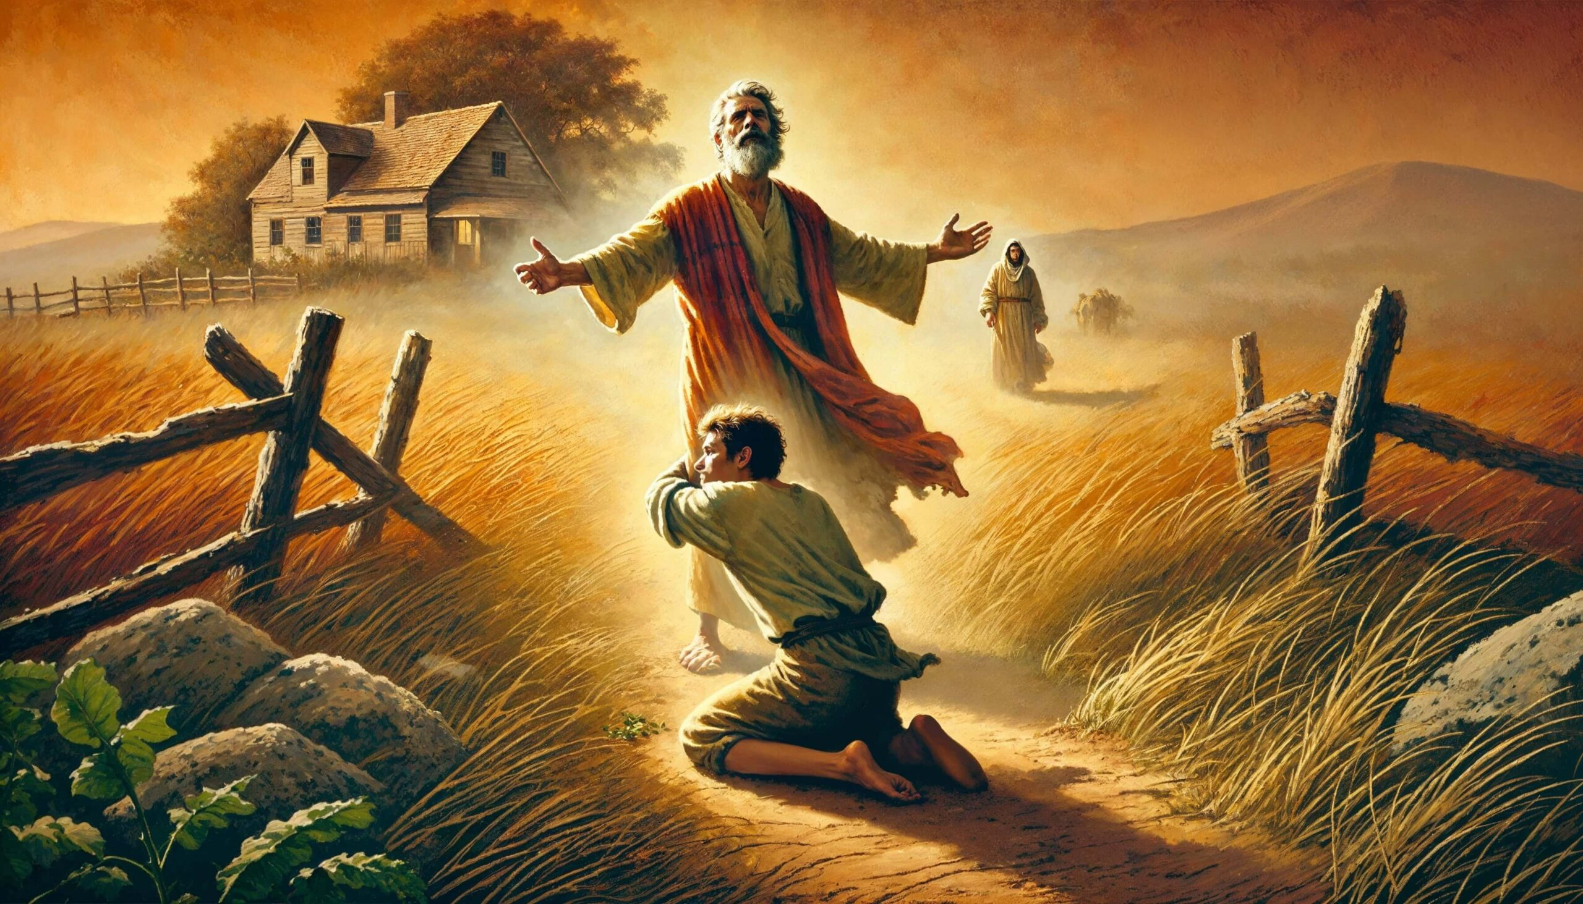
The son which was “lost” has now been found.
Though he was welcomed back, he lost his inheritance.

