Slide 1
Walk With the Word
Luke 16

Slide 2
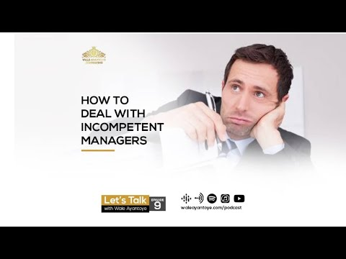
16:1-9 – A parable on forgiveness: the incompetent manager.
The manager does what he can to diffuse the situation.
The manager was shrewd because he offered forgiveness.

Slide 3

16:10-13 – We can’t have two masters: we either invest in the
world or we invest in the kingdom of God.

Slide 4
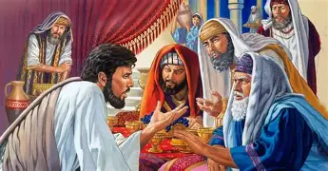
16:14-17 – Key: the Pharisees were lovers of money.
They were scoffing at Jesus’ teaching about money, making
them a spiritual abomination.
16:18 – A rebuke of the Pharisees concerning divorce.

Slide 5
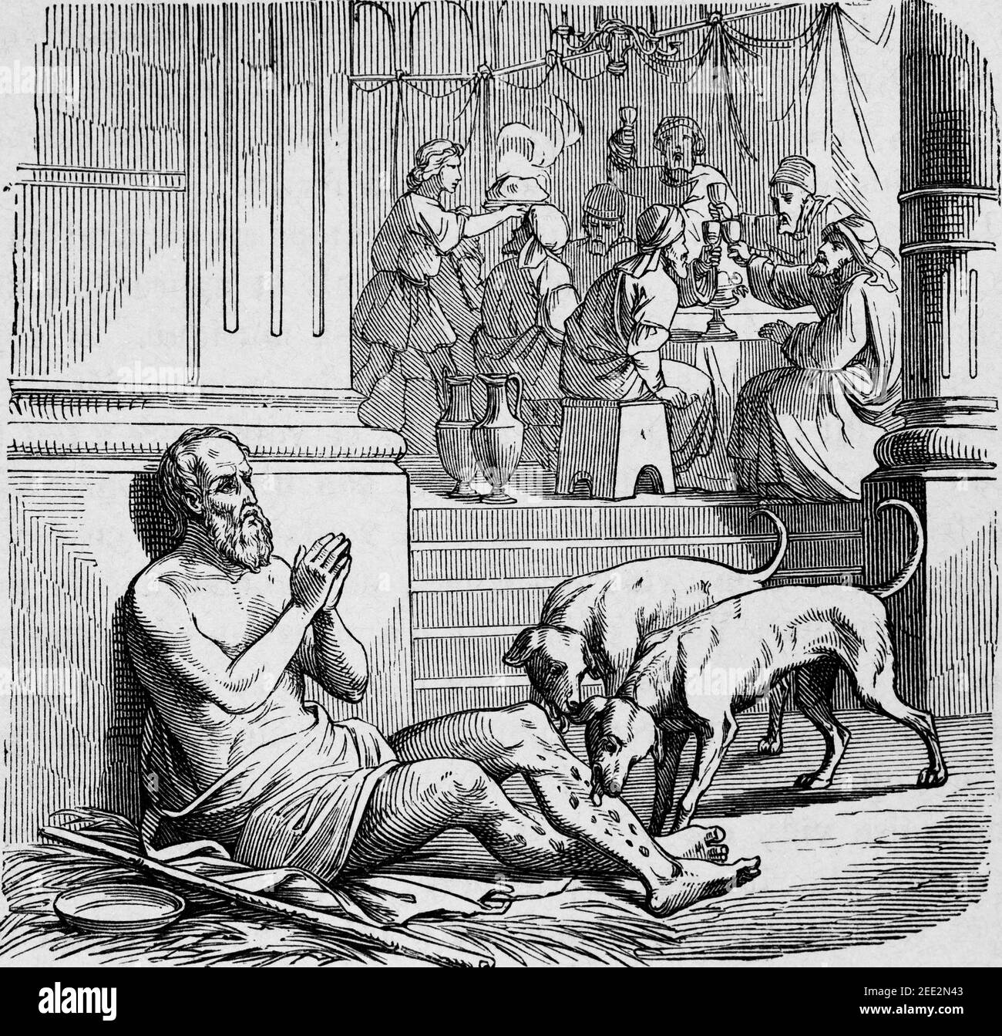
16:19-31 – The parable of the rich man and Lazarus.

Slide 6
Another lesson on the entrapment of riches and wealth.
Earthly wealth does nothing for us in eternity.
Scariest words: “…there is a great chasm fixed.”
The key lesson in chapter 16: “Repent.” (v. 30)

