Slide 1
Walk With the Word
Luke 17

Slide 2
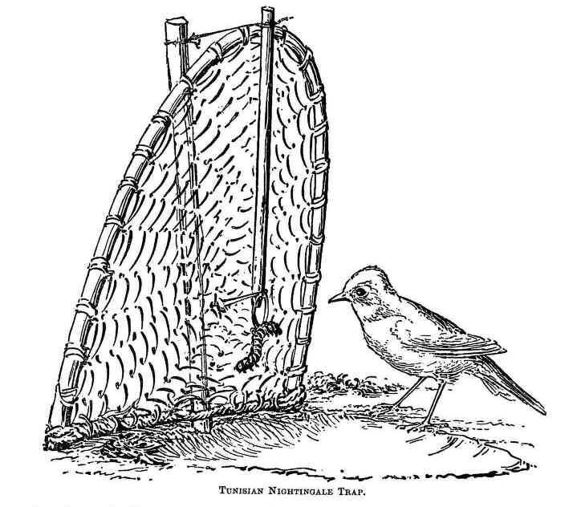
17:1-10 – Temptations and the need to forgive.
A skandala…
a baited trap

Slide 3

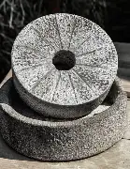
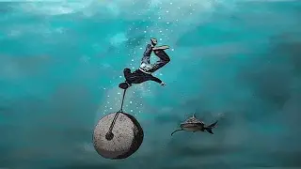
Inevitably, there will be those who tempt us.

Slide 4
Those who sin against us and repent are to be forgiven.
Caveat: “…if they repent….”
This is a hard thing to do and what’s required is great faith.
There is no special reward for forgiving: it is expected.

Slide 5
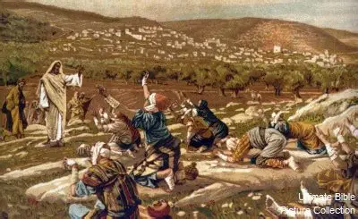
17:11-19 – Cleansing of the ten lepers.

Slide 6
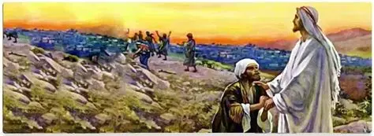
Of the ten, only one showed gratitude: the Samaritan.

Slide 7
17:20-37 – Jesus begins teaching on the coming kingdom.
The Pharisees were looking for the kingdom of God: little
did they realize it (He) was right before them!
Teachings concerning the second coming.
The second coming will happen when we least expect it.
Hanging onto this life and its pleasures is futile.

