Slide 1
Walk With the Word
Luke 19

Slide 2
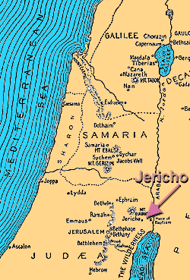
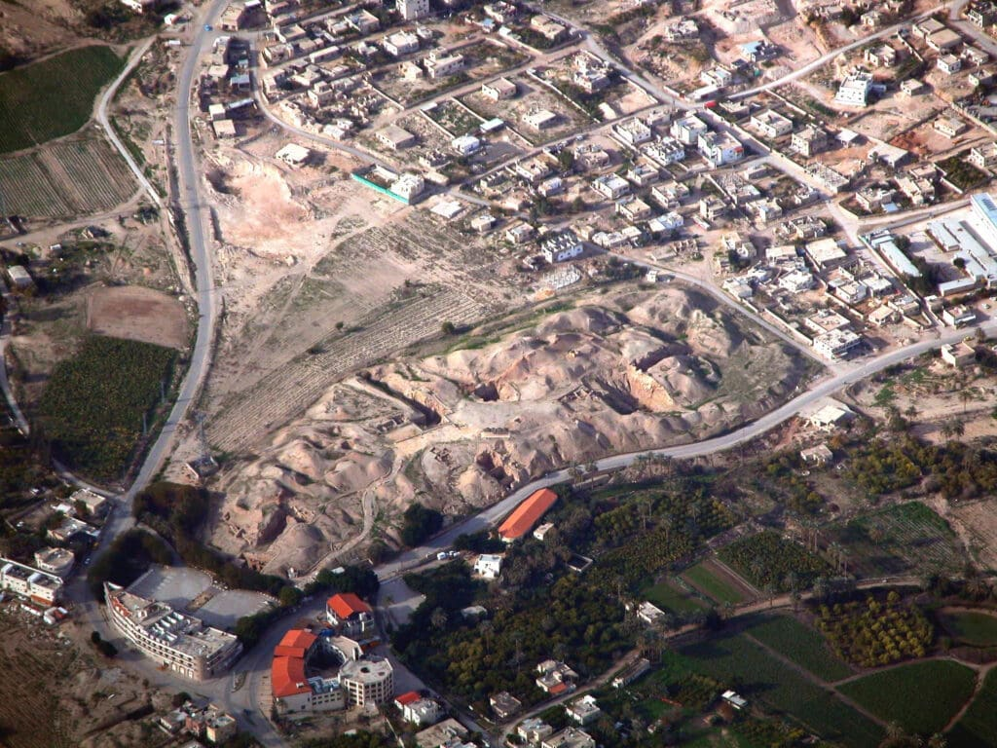
19:1-10 – Jesus’ encounter w/ the tax collector Zacchaeus.

Slide 3
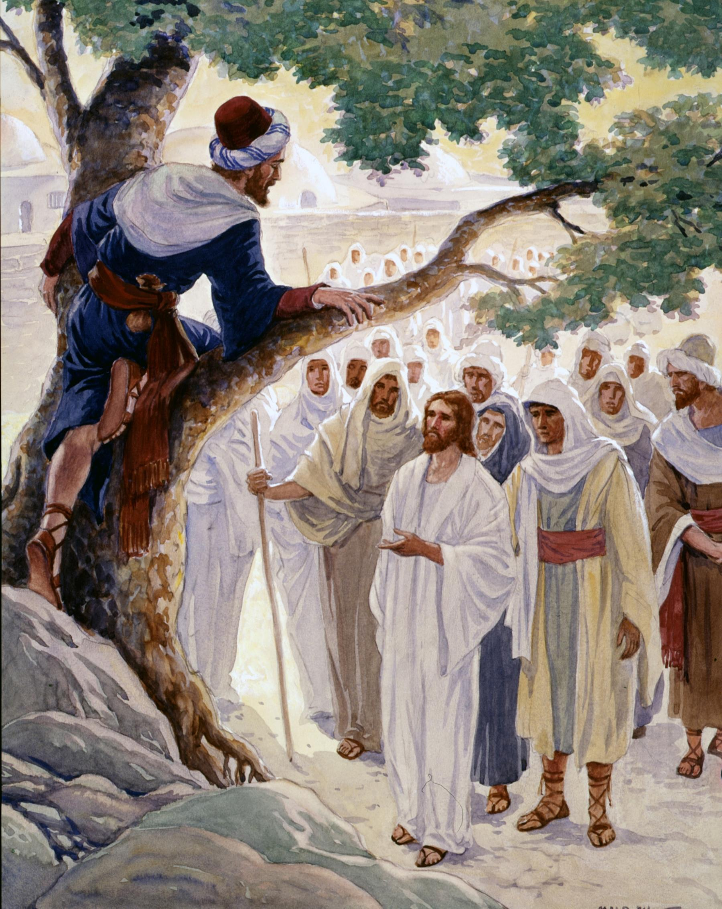
Zacchaeus’s salvation was assured because he
demonstrated his faith.

Slide 4
19:11-27 – The parable of the commissioned servants.
There are two themes here: (1) regarding the Jews, and
(2) regarding those who Jesus has appointed (called).
“…distant country…then return…” refers to 2nd coming.
“…citizens hated him…” refers to Jewish nation.
The commission by Jesus to invest your gifts.

Slide 5
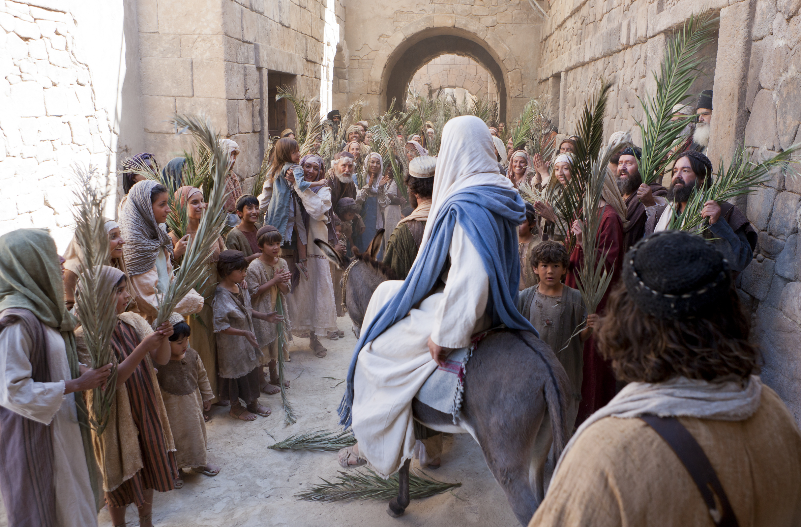
19:28-44 – Jesus’ triumphal entry into Jerusalem.
This entry foreshadowed by King David.
When Jesus saw the city, He wept.

Slide 6
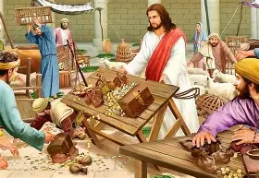
19:45-48 – Once again, Jesus drives away the money changers.
Foreshadows that the nation of Israel will not repent.

