Slide 1
Walk With the Word
Luke 2

Slide 2
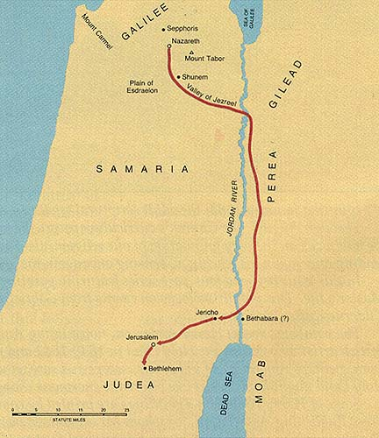
2:1-21 – The birth of Jesus in Bethlehem.

Slide 3
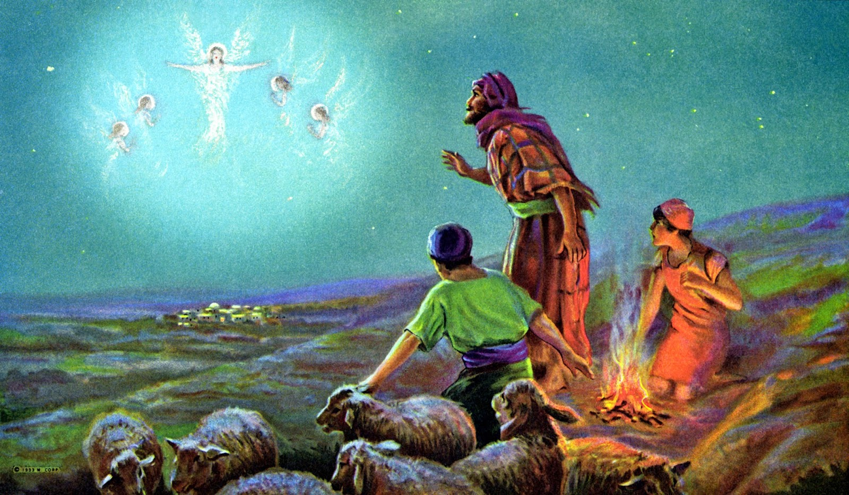
The Messiah being born in Bethlehem fulfills Micah 5:2.
Shepherd boys in the field are visited by angels.

Slide 4
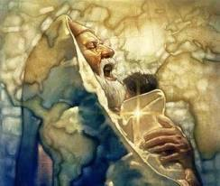
2:22-40 – Jesus is presented at the temple for circumcision.

Slide 5
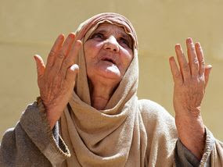
The prophetess Anna declares the redemption of Jerusalem.

Slide 6
2:41-52 – Visit to Jerusalem during the Feast of Passover.
Jesus was only 12 years old, 1 year short of Bar Mitzvah.
Jesus was missing from His parents for three days.

Slide 7
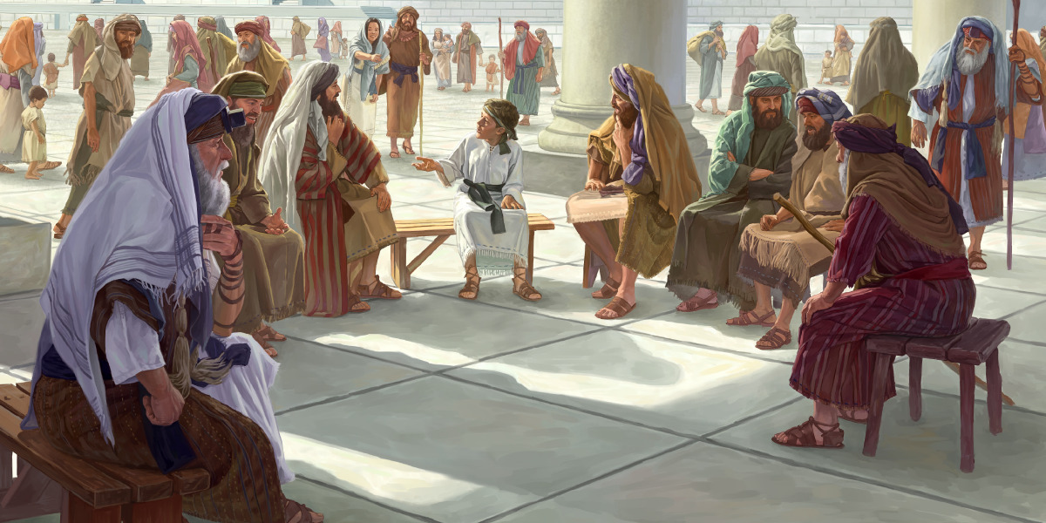
Jesus informs His parents that He is in “My Father’s house.”
Mary “treasured” these events, later interviewed by Luke (?)

