Slide 1
Walk With the Word
Luke 21

Slide 2
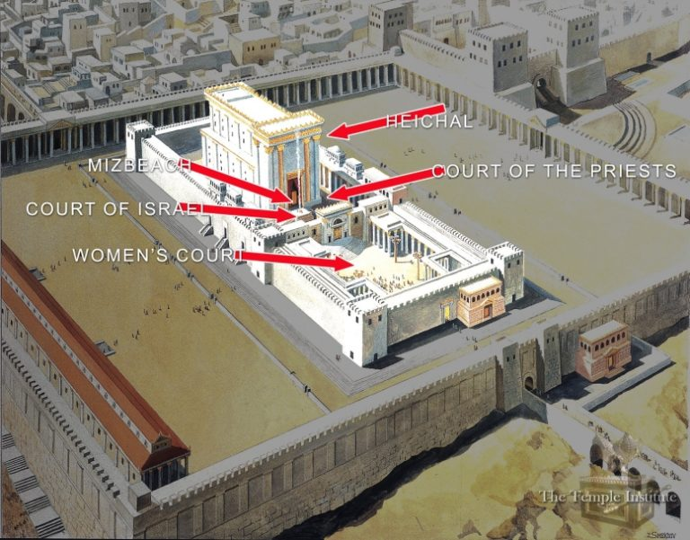
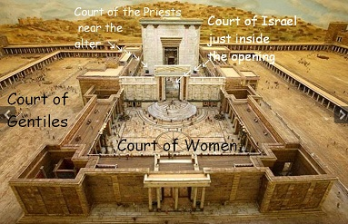
21:1-4 – Jesus observes the sacrifice of the widow.

Slide 3

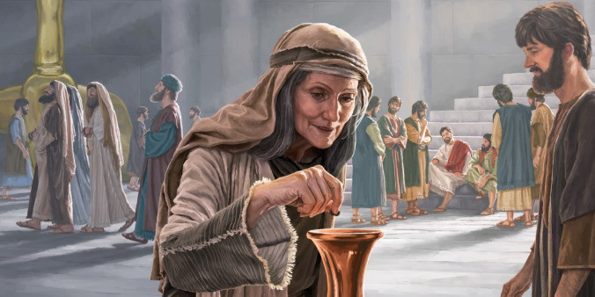
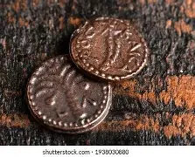
21:1-4 – Jesus observes the sacrifice of the widow.

Slide 4
21:5-36 – The “Olivet discourse” on the end times.
5-6: Jesus predicts the destruction of the temple.
7-9: Be on the alert for the deceivers.
10-11: The end will be marked by “great signs from heaven.”
12-19: In the end times, Jesus’ followers will be persecuted.

Slide 5
20-24: Key: “…until the times of the Gentiles are fulfilled.”
Note: No one is quite sure what that means.
25-28: The promise is this: Jesus will return.
29-33: Jesus’ promise: “…My words will not pass away.”
34-36: The command regarding the end: “Be on guard.”
21:37-38 – How Jesus prepared for the cross: prayer.

