Slide 1
Walk With the Word
Luke 22

Slide 2
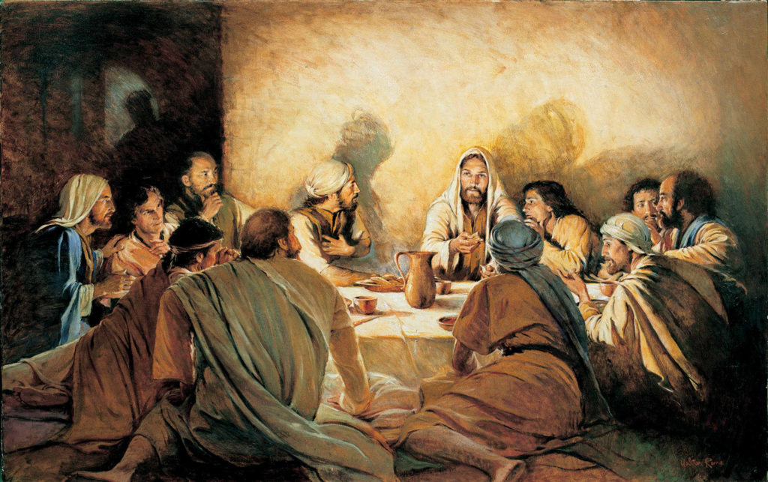
22:1-13 – The Feast of Unleavened Bread and the Passover: the
time for Jesus’ betrayal and crucifixion.
The crucial point: Jesus becomes our Passover.

Slide 3
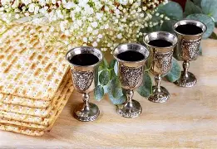
22:14-23 – The Last Supper: Jesus institutes Communion.
The cup represents Jesus’ blood, and the bread represents
Jesus’ body which is “given for you.”
“…until the kingdom of God comes”: most likely, Pentecost.

Slide 4
Key passages in 22:24-53:
22:26 – When it comes to acting like the world:
“But it is not this way with you….”
22:40 – When it comes to coping in times of stress:
“Pray that you may not enter into temptation.”
22:42 – When it comes to untenable spiritual situations:
“…yet not My will, but Yours be done.”

Slide 5
22:54-62 – Jesus’ arrest and Peter’s denial.
22:63-71 – Jesus’ mockery by the soldiers and Jesus’ trial
before the Sanhedrin: Jesus is asked if He is the Son of God
and He answers, “Yes, I am.”

