Slide 1
Walk With the Word
Luke 23

Slide 2
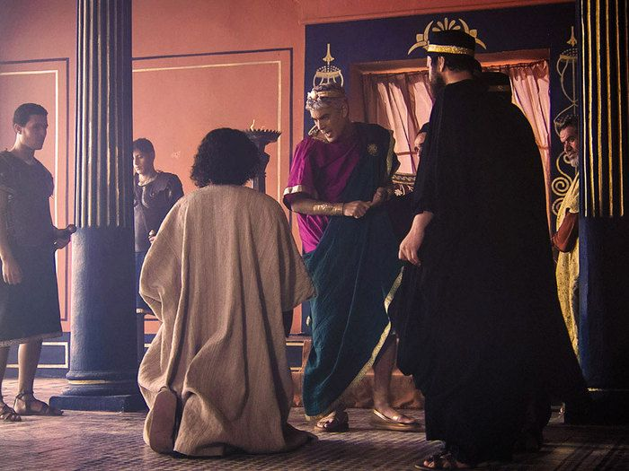
23:1-12 – Jesus stands trial before Pilate and Herod.

Slide 3

23:13-25 – Pilate seeks Jesus’ release, but the Jews want Barabbas.

Slide 4
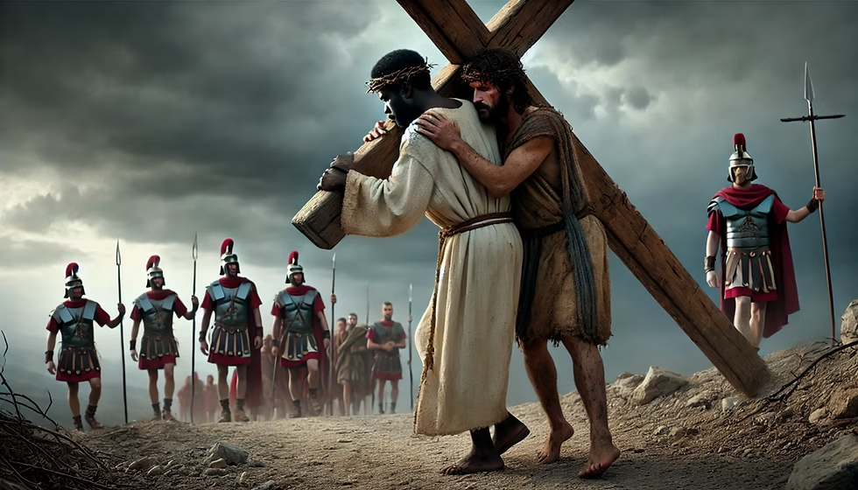
23:26-31 – Jesus bears His cross and is helped by Simon of Cyrene.

Slide 5
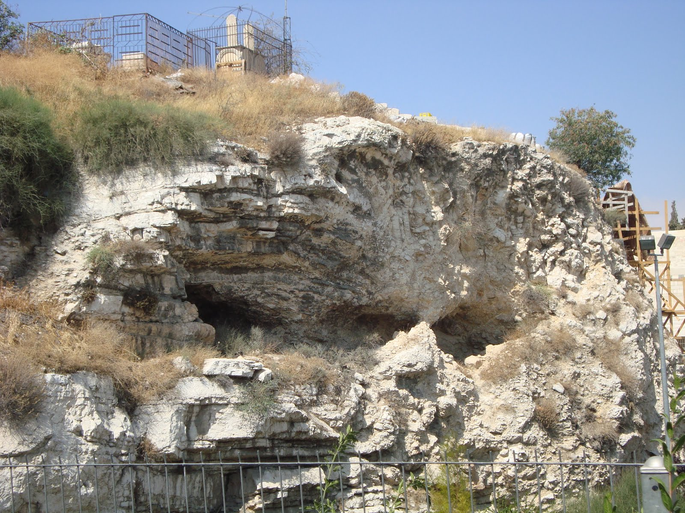
23:32-49 – Jesus is crucified on a hill called “the Skull.”

Slide 6
On the cross, Jesus asks, “Father, forgive them.”
On the cross, Jesus is mocked and scorned.
On the cross, Jesus promises a criminal “paradise.”
On the cross, the veil is torn in two, top to bottom.
On the cross, a centurion begins praising God.
On the cross, nearby were Mary, other women, and John.

Slide 7
23:50-56 – Jesus is laid in the tomb on “preparation day,”
meaning “the Sabbath was about to begin.”

