Slide 1
Walk With the Word
Luke 3

Slide 2
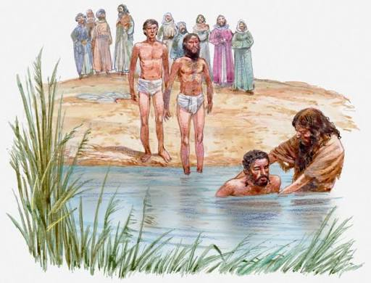
3:1-20 – The ministry of John the Baptist.

Slide 3
John preaches a baptism of repentance of sins.
John the Baptist fulfills Isaiah 40:3-5.
John’s call for repentance is for a lack of love for others
and how you treat others!
Note: nothing about the Law, sacrifices, or the Sabbath.

Slide 4
John prophesies One will come to baptize w/ the Holy Spirit.
John is recorded to be preaching “the gospel.”
John is imprisoned and later executed by Herod Antipas.

Slide 5
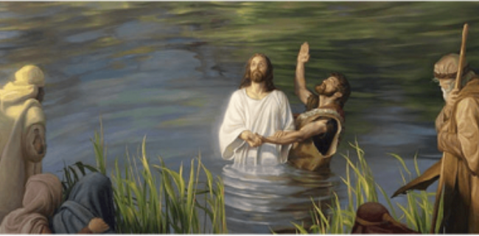
3:21-22 – Before John is imprisoned, he baptizes Jesus.

Slide 6
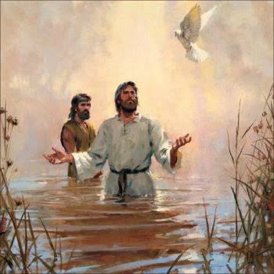
When Jesus is baptized, He is empowered by the Holy Spirit.

Slide 7
3:23-38 – The genealogy of Jesus Christ.
Point: Both Joseph and Mary are direct descendants of David.

