Slide 1
Walk With the Word
Luke 4

Slide 2
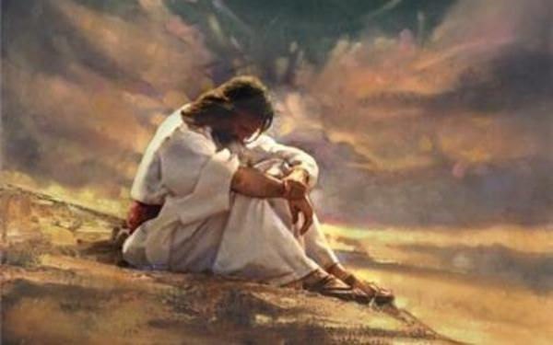
4:1-13 – Jesus is “led” into Satan’s temptation by the Holy Spirit.

Slide 3

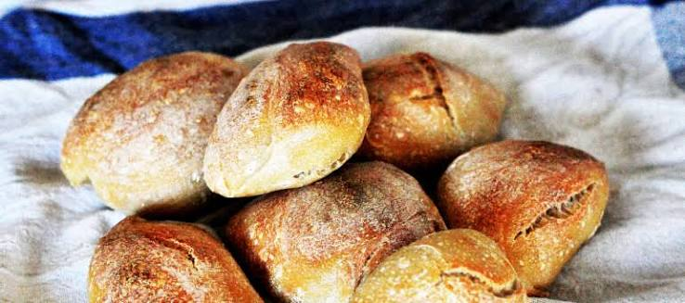
#1: The temptation to satisfy the needs of the flesh.

Slide 4
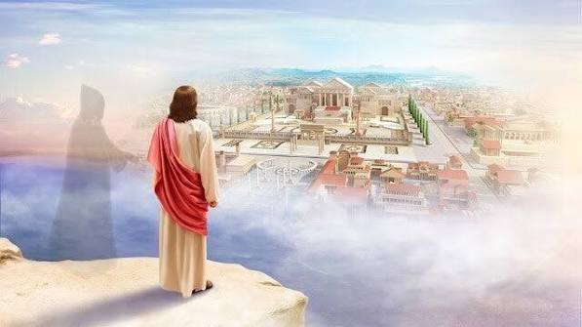
#2: The temptation to acquire personal power.

Slide 5
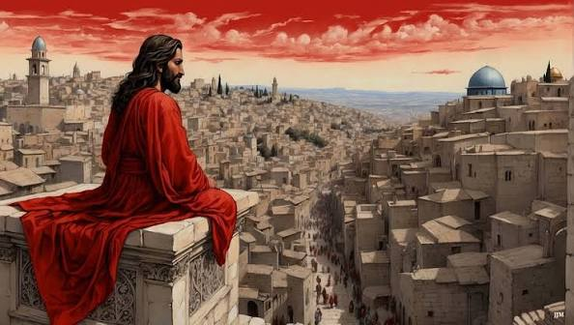
#3: The temptation to prove visibly He is the Son of God.

Slide 6
Each temptation is responded to by Scripture.
Satan leaves Jesus until the opportune time.

Slide 7
4:31-39 – Jesus casts out spirits in the synagogue in Capernaum.
Jesus’ real identity is known by demons.
Jesus heals Simon Peter’s mother.
4:40-44 – Jesus heals, casts out demons, and preaches.

