Slide 1
Walk With the Word
Luke 5

Slide 2
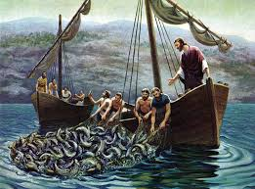
5:1-11 – Jesus begins gathering His disciples.
This miracle occurs again in John 21 after the resurrection.

Slide 3
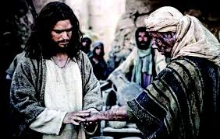
5:12-26 – Jesus proves to the religious leaders that He has the
authority to forgive sin.
1st, He heals the leper by touching him.

Slide 4
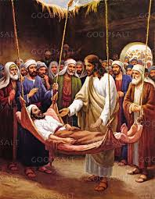
2nd, He heals a paralytic based on “their faith.”

Slide 5


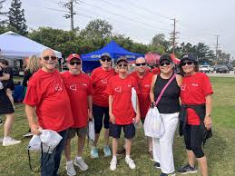
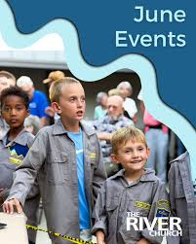
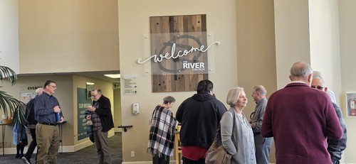
3rd, the spiritual lesson here is that sin paralyzes.
4th, the friends are a picture of the church.

Slide 6
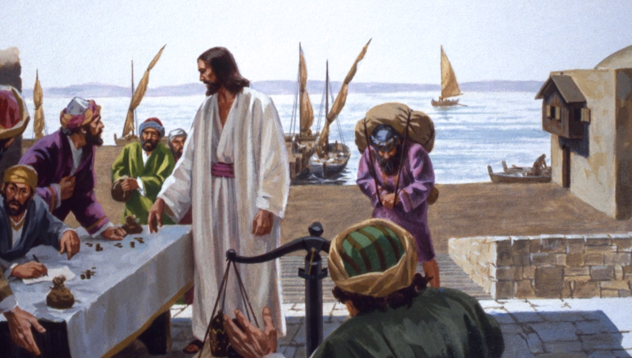
5:27-39 – The call of the tax collector Levi (Matthew).

Slide 7
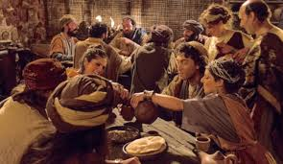
Jesus associates, not with “the righteous,” but w/ sinners.

Slide 8
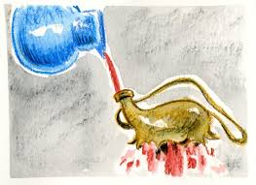
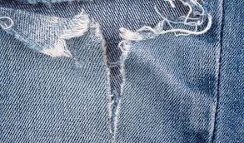
Jesus provides two metaphors for New Testament teachings:
the Old Testament is no longer binding.
The “new” teaching will be: “love one another.”

