Slide 1
Walk With the Word
Luke 6

Slide 2
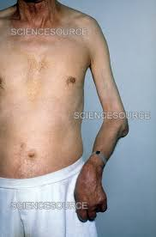
6:1-11 – Jesus declares Himself Lord of the Sabbath.
On the Sabbath, He “works.”
On the Sabbath, He heals.

Slide 3
6:12-16 – Jesus chooses the 12 apostles.
Peter—to Antioch & Rome; crucified by Nero @ AD 66
Andrew—north to Russia/Turkey; martyred.
James—to Spain(?); back to Jerusalem; executed by Herod Agrippa 1.
John—cared for Mary; exiled to Patmos; died in Ephesus.
Philip—to Egypt/N. Africa; crucified upside down (like Peter).
Bartholomew (Nathanael)—Armenia/Beirut; beheaded.

Slide 4
Thomas—traveled to India and was martyred.
Matthew—Mediterranean areas; martyred in Ethiopia.
James (son of Alphaeus)—N. Israel(?); stoned by Jews in Jerusalem.
Simon the Zealot—to Egypt/Persia/Lebanon; in AD 65, martyred.
Jude (Thaddeus)—martyred in Lebanon.
Matthias—stoned by Jews; beheaded by a Roman soldier in Jerusalem.

Slide 5
6:17-19 – Following Jesus, in the crowd, are many Gentiles.
6:20-49 – Luke’s synopsis of the Sermon on the Mount.
Jesus probably preached “the sermon” 100s of times.
The most important theme: treat everyone w/ love.

