Slide 1
Walk With the Word
Luke 7

Slide 2
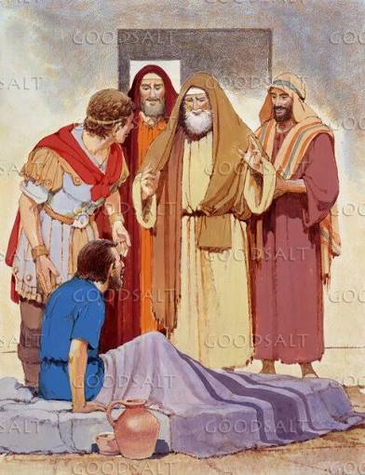
7:1-10 – Healing the centurion’s servant.
The centurion was a Gentile who love the nation.
The centurion was a Gentile who showed great faith.

Slide 3
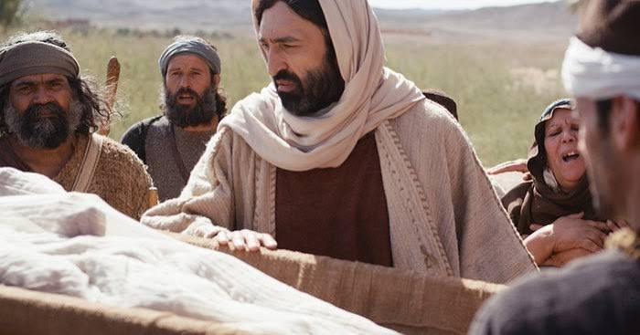
7:11-17 – Raising the widow’s only son in Nain.
The consequences of a widow losing her only son.
Jesus touches the bier.

Slide 4
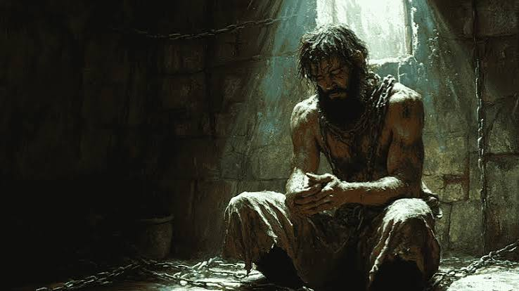
7:18-35 – The inquiry into Jesus’ identity by John the Baptist.
Jesus’ answer describes acts attributed only to the Messiah.
The need for baptism was rejected by lawyers and Pharisees.

Slide 5
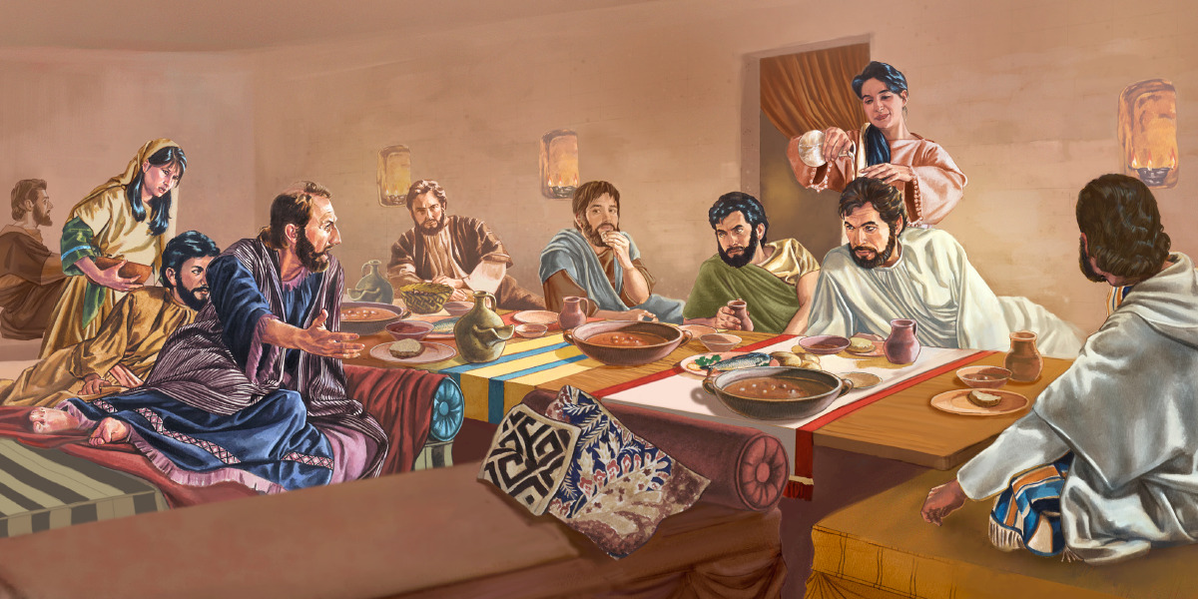
7:36-50 – Dinner at the house of Simon the Pharisee.

Slide 6
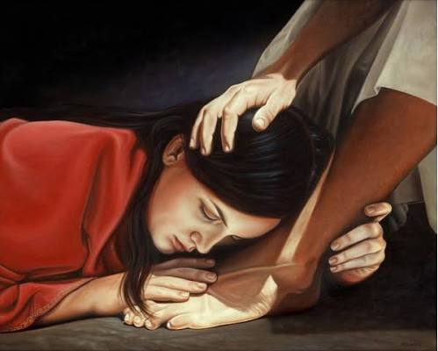
Jesus’ feet are anointed w/ costly perfume by a sinner.
Jesus addresses Simon’s lack of normal hospitality.
Jesus forgives the woman’s sins based on her faith.

