Slide 1
Walk With the Word
Luke 8

Slide 2
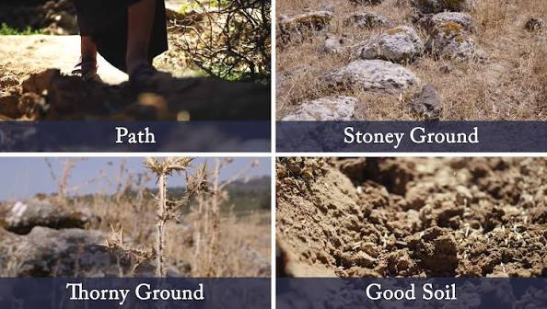
8:1-15 – Proclaiming and preaching: parable of the soils.
The four soils represent those who respond to the Word.
Parables: to teach truths of the kingdom to those who will
believe and hide truths from those who will not believe.

Slide 3
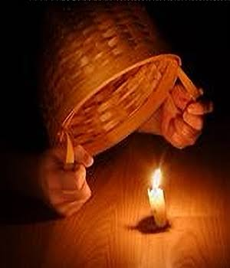
8:16-18 – The parable of the lamp: the “light” is the gospel.

Slide 4
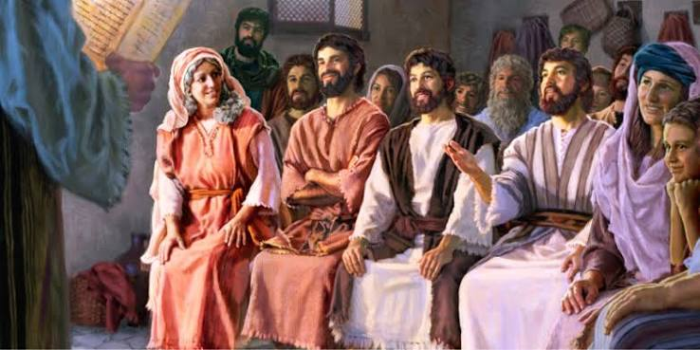
8:19-21 – Jesus’ “mother and brothers” are those who hear the
Word of God and do it!

Slide 5
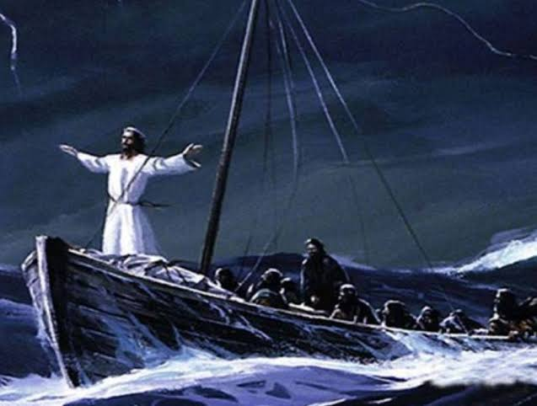
8:22-25 – Jesus calms the rough seas with His word.

Slide 6
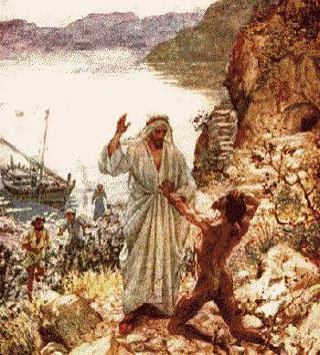
8:26-39 – The demoniac is cured from a legion of demons.

Slide 7
The demons in the man know clearly who Jesus is.
The demoniac is cured, and he is restored to a right mind.
The reaction of the cured demoniac: proclaiming Jesus.

Slide 8
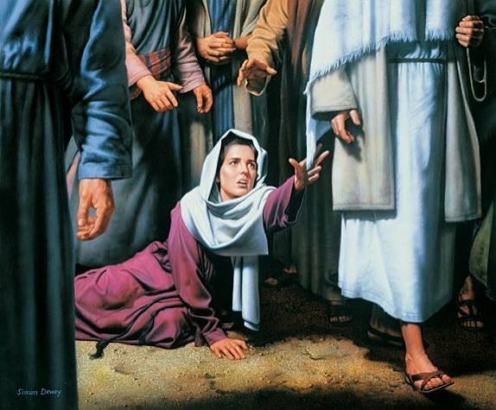
8:40-56 – Jesus leaves to heal the daughter of Jairus.
A woman with a hemorrhage touches Jesus.
She is cured by her daring faith.

Slide 9
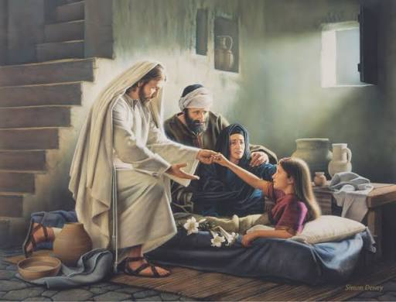
Jesus returns the spirit to Jairus’s daughter.

