Slide 1
Walk With the Word
Mark 1

Slide 2
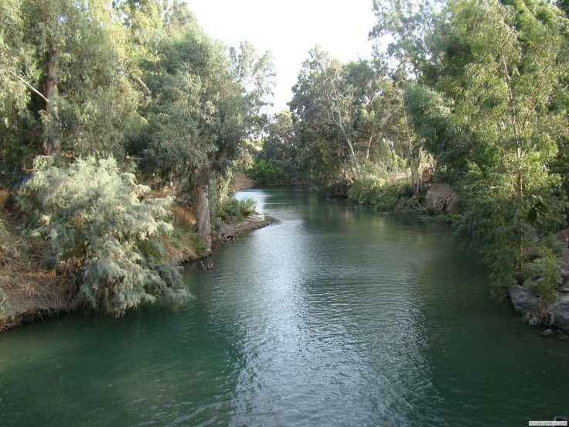
1:1-8 – The ministry of John the Baptist.

Slide 3
1:9-13 – Jesus’ baptism and temptation by Satan.
1:14-20 – Jesus calls disciples: they follow immediately.
1:21-28 – Demons call Jesus “the Holy One of God.”

Slide 4
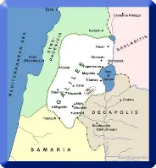
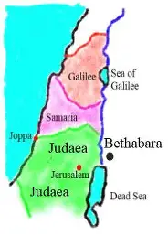
1:29-34 – Jesus casts out unclean spirits and demons.
1:35-39 – Jesus extends His ministry throughout Galilee.

Slide 5
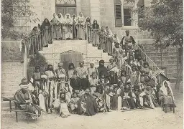
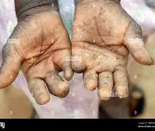
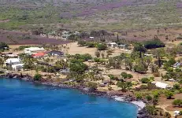
1:40-45 – Jesus makes a leper clean.

