Slide 1
Walk With the Word
Mark 12

Slide 2
12:1-12 – The parable of the vine-grower.
This illustration is taken from Isaiah 5:1-7.
A picture of the rejection of Jesus (the “son”).
Ends with a quote from a Messianic psalm: 118:22-23.
12:13-17 – Attempting to set a trap for Jesus with insincere flattery.

Slide 3
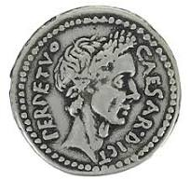

Slide 4
12:1-12 – The parable of the vine-grower.
This illustration is taken from Isaiah 5:1-7.
A picture of the rejection of Jesus (the “son”).
Ends with a quote from a Messianic psalm: 118:22-23.
12:13-17 – Attempting to set a trap for Jesus with insincere flattery.
12:14-27 – Attempting to set a trap by having Jesus take sides.

Slide 5
12:18-34 – The scribe who almost got it right!
The most significant part of the scribe’s response:
“You shall love your neighbor as yourself.”
Significance of this statement: it’s not new!

Slide 6
12:35-44 – In the temple compound, Jesus teaches three lessons:
#1: By riddle, He wants them to know who He is.

Slide 7
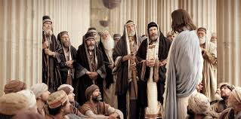

Slide 8
12:35-44 – In the temple compound, Jesus teaches three lessons:
#1: By riddle, He wants them to know who He is.
#2: By hypocrisy of the spiritual leaders, greater condemnation.

Slide 9
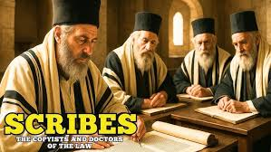

Slide 10
12:35-44 – In the temple compound, Jesus teaches three lessons:
#1: By riddle, He wants them to know who He is.
#2: By hypocrisy of the spiritual leaders, greater condemnation.
#3: By the example of the widow, a right heart.

Slide 11
