Slide 1
Walk With the Word
Mark 13

Slide 2
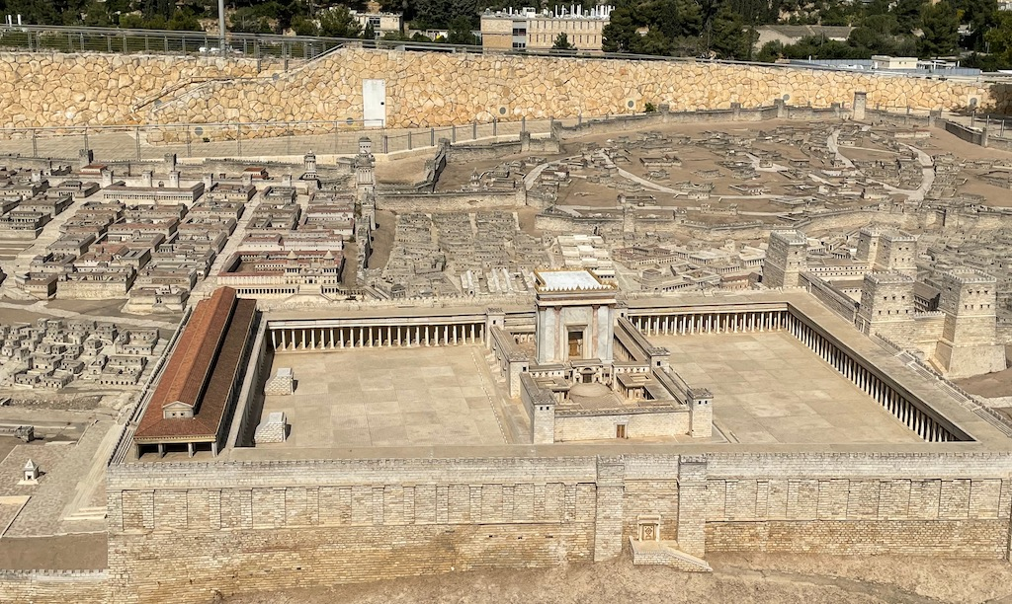
13:1-37 – Mark’s version of the Olivet Discourse.
(Matt. 24-25; Luke 21)

Slide 3
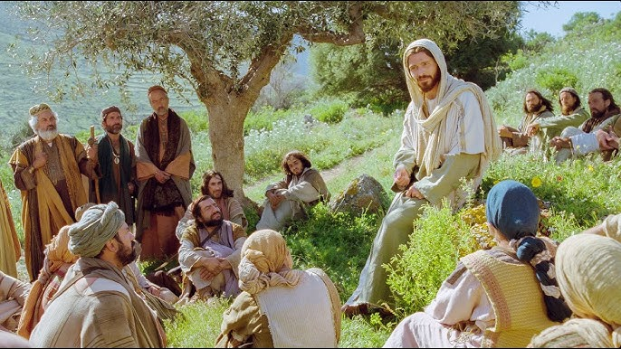

Slide 4
13:3-10 – Key to understanding when end times will come:
“The gospel must first be preached to all the nations.”
13:11-13 – What Christians can expect as the end approaches:
“You will be hated by all because of My name.”

Slide 5
13:14-23 – Signs the end is near:
#1: The abomination of desolation (v. 14).
From Daniel 9, 11, 12:
From the time of the decree to rebuild Jerusalem (Artaxerxes, 445 BC),
seven weeks of seven years = 490 years.
After 69 weeks, Messiah arrives but will be “cut off.” This takes us to
about AD 30. Then the Temple and city are destroyed by the Romans.
A “week” is unfulfilled. Interpretation? Time of the Gentiles which is
essentially a long period of time during which the Gospel is spread
throughout the world.

Slide 6
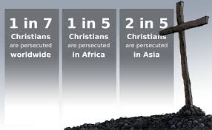
13:14-23 – Signs the end is near:
#2: A great worldwide persecution.

Slide 7
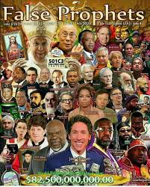
13:14-23 – Signs the end is near:
#3: There will be false prophets.

Slide 8
13:14-23 – Signs the end is near:
Point: You want to be one of the elect.

Slide 9
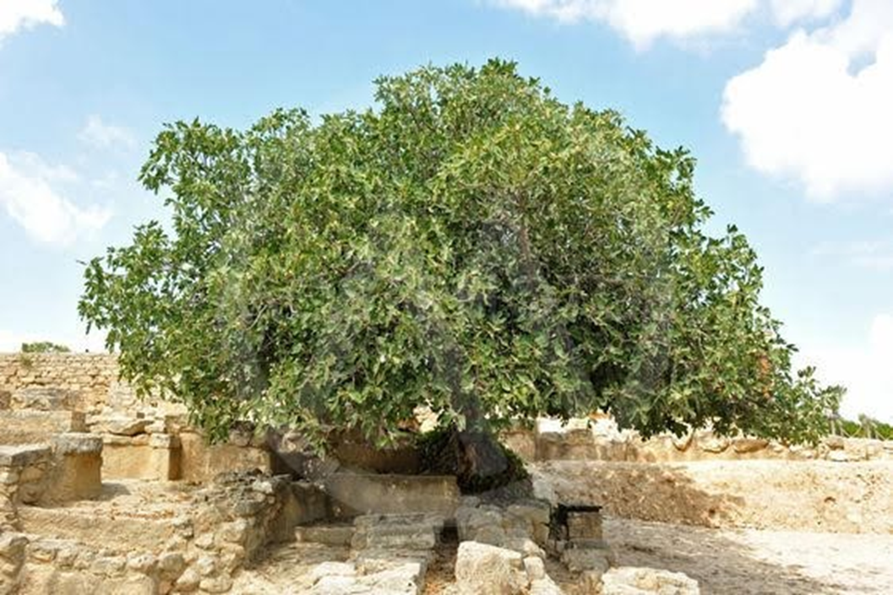

13:24-31 – Jesus’ promise to His followers: He will come again.
Jesus’ great promise: His words “will not pass away.”

Slide 10


Slide 11
13:32-37 – All Jesus’ followers are to remain “on alert.”

